Slide 1
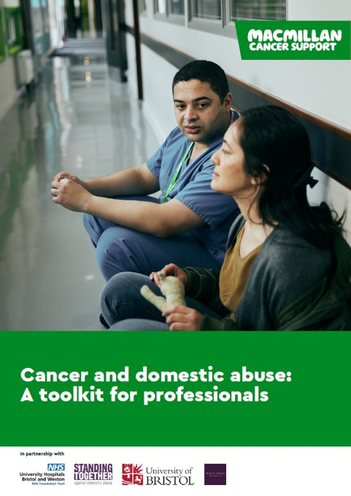
Enhancing the Cancer Workforce Response to Domestic Abuse

Slide 2


Notes:
- Quick trigger warning that this is a heavy topic and please do look after yourself during and after this session.
- And acknowledged that some people in the session will have had or be having a personal exp of DA.
- If you do have personal experience, you are not alone. If you haven’t sought support before, there are people ready to listen to you and help.
- The national domestic abuse helpline number is in the corner and will remain in the corner throughout the presentation.
*Marion’s talk will involve descriptions of abuse and I will share some examples during this first 15 minutes also.
So if you do feel triggered or distressed, please do leave if you need to.

Slide 3
Domestic abuse is an incident or pattern of incidents of controlling, coercive, threatening, degrading and violent behaviour, including sexual violence, in the majority of cases by a partner or ex-partner, but also by a family member or carer.
Notes:
- 1 in 4 women and 1 in 6 men will experience domestic abuse in their lifetime.
- And the domestic abuse act outlines that it can be physical or non-physical, such as emotional, economic, verbal, coercive control, and there is almost always there’s overlap between all of these.
- It can be perpetrated by a partner/ex-partner or another family member.
- Children ‘exposed’ to domestic abuse are victims in their own right.

Slide 4
Cancer and domestic abuse are both extremely common and therefore some peoples experience of these two things will unfortunately overlap.
Notes:
Cancer and domestic abuse are both extremely common, and therefore some peoples experience of these two things will unfortunately overlap.
*so back in 2020 when the project started
Other research also showed us that people experiencing abuse were less likely to attend screening appointments or go to the GP for signs and symptoms, therefore often facing later diagnosis and poorer outcomes.
And those who did receive a diagnosis would face problems throughout treatment and care from their abusive partners.
There was also some, but limited information, that the carers of people with cancer could also experience abuse, perpetrated by the person living with cancer. Which was often compounded by the perpetrators illness.
*But why was this something that Macmillan and the wider cancer world and workforce should be considering?
Previous research told us that intervention at a healthcare level is crucial. Victim-survivors are more likely to disclose domestic abuse to a healthcare professional than any other professional. And we knew that areas such as A&E and Maternity, where there were interventions in place, had high rates of disclosure and follow up support to people. However there was no specialist intervention for in cancer settings.
Internally at Macmillan, we had seen calls to our support line mentioning abuse had been rising steadily over the last few years, and it was a common theme on conversation on our online community for people seeking clarity and support on the issue.
So it was from here that the project was formed. We started the first phase of research *wanted to go back to the foundations and not assume anything

Slide 5
Phase 1 : Surveys and interviews with cancer professionals and survivors
1. Domestic abuse did not stop and often worsened after a cancer diagnosis.
2. Abuse affected cancer treatment, surgery, and recovery in ways that led to pain and suffering.
3. Most cancer professionals agreed that they have a responsibility to identify and respond to domestic abuse.
4. Of the victim-survivors, just 9/20 reported that they had disclosed domestic abuse to cancer professionals.
5. When referred to services, victim-survivors reported that the cancer setting led them to get domestic abuse support for the first time.
6. Professionals and victim-survivors felt that the cancer setting provided a unique opportunity for domestic abuse to be identified and responded to.
7. But lack of confidence and knowledge was a barrier to a good response.
8. Victim-survivors wanted professionals to make the setting a clear safe space for disclosure and offer support and signposting
9. Professionals were eager to improve their response to domestic abuse.
Notes:
We spoke to over 300 Healthcare Professionals and 20 people with lived experience.
Domestic abuse did not stop and often worsened after a cancer diagnosis. The most common types were Non-physical coercive control, psychological, and financial abuse, and all of these left victim-survivors feeling unsafe and fearful.
2. Abuse affected cancer treatment, surgery, and recovery in ways that led to pain and suffering. Most victim-survivors reported that the abuser stopped them from resting and ridiculed their treatment choices and appearance post-treatment or surgery.
3. Most cancer professionals agreed that they have a responsibility to identify and respond to domestic abuse. Fifty percent had encountered domestic abuse in the past three years, and other professionals said they had likely missed cases.
4. Less than half the victim survivors reported that they had disclosed domestic abuse to cancer professionals. And said the two biggest barriers were not thinking it was relevant to the professionals’ role and not being asked the right questions or any question at all.
5. Victim-survivors said that the cancer setting led them to get domestic abuse support for the first time that they may not have otherwise accessed
6. Both sides felt that the cancer setting provided a unique opportunity for domestic abuse to be identified and responded to due to the frequency of contact, length of appointments, continuity of care, and discussion of holistic needs.
7. However there was a lack of confidence and knowledge felt by healthcare professionals.. Firstly in in recognising the signs of domestic abuse and then in confidence in knowing what to say if someone discloses abuse.
8. To improve the cancer workforce response to domestic abuse, victim-survivors wanted professionals to make the setting a clear safe space for disclosure, to recognise the signs—particularly of non-physical abuse, to enquire safely and provide first-line support, and to refer them to specialist support options.
9. Professionals were eager to improve their response to domestic abuse. As such, they said they want specialist training, education, awareness, and a culture shift wherein all cancer professionals, from surgeons to nurses, see identifying and responding to domestic abuse as their role

Slide 6
“I had thought that cancer would make the abuse stop but it gave an excuse for it to get worse”
Victim-survivors were overall extremely positive about their cancer care and thought these professionals were well-placed to ‘make a difference’ regarding domestic abuse: “Some amazing health workers out there who could make such a difference”
Notes:
No one reported that domestic abuse stopped or became less severe after their diagnosis.
Instead it was reported by almost every victim survivor, that the cancer, either when diagnosed themselves or caring for someone, gave abusers the opportunity to take advantage of their situation and worsen the abuse or start new forms of abuse.
Some examples of this include:
Coercing patients into or away from treatment e.g. into breast reconstruction or forcing scalp cooling
humiliating them about treatment-related appearance changes.
using treatments, surgeries, blood tests etc as excuses for bruises, scars, wounds in cases where there was physical violence
IMPORTANT to recognise the non-physical signs too
cancelling life and health insurance,
coercing them into making a living will or changing their final wishes
withholding basic support e.g. access to food, money.
obstructing appointments or medication
Isolated them from support – they were too ill to work or see family.
Or from the carers perspective – the abusive partner with cancer would use their illness as a tool to manipulate and control, decline help form others leaving the carer to do all the caregiving alone, and start new forms of abuse whilst the carer the feeling mixed emotions of guilt for them.
*But the research also showed us that victim-survivors felt that the cancer setting and the healthcare professionals in it, were people they could open up to and get support and signposting from. And although confidence was low in some areas, healthcare professionals felt it was there responsibility and were keen to know more on how to support.

Slide 7

Our mission statement:
We want the cancer setting to offer a safe time and space for victim-survivors of domestic abuse to get the support they need, from skilled and confident healthcare workers and cancer professionals.
Notes:
So this formed out mission statement:
Our mission statement is that we want cancer setting offers a safe time and space for victim-survivors of domestic abuse to get the support they need, from skilled and confident healthcare workers and cancer professionals.

Slide 8


Phase 2 : Evaluation of domestic abuse training for the cancer workforce
Macmillan Domestic Abuse Co-ordinators trained 1080 staff across the two locations.
Training significantly increased confidence in asking about and responding to domestic abuse and reduced perceived barriers to doing so. (Dheensa, forthcoming)
Notes:
So we then had one more stage to do before we created the toolkit which Ruth will talk you later in the session.
We put two domestic abuse co-Ordinator roles in two settings – the Royal Marsden and the Bristol and Weston NHS Trust.
Here the roles created and testing training for healthcare professionals for a short session, half day and full day training. Really allowed us to test what HCP needed to know and how they wanted to receive the information.
This was opened up to any role in the hospital, including receptionists and porters, as we know anyone can help. Often the one’s they won’t put an act on for.
They training over 1,000 staff members which was almost 20% of the workforce there.
The training significantly increased confidence in asking about and responding to domestic abuse, and reduced perceived barriers to doing so, which will lead to more people getting support on the future.

Slide 9
Marion

Slide 10

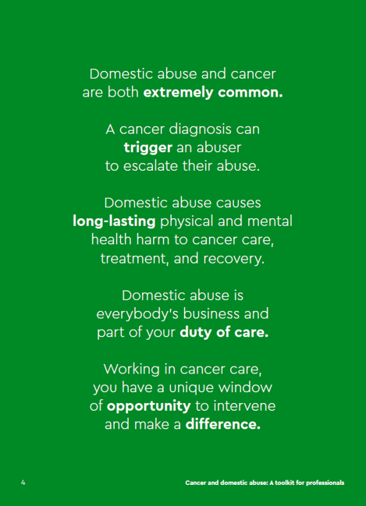

Slide 11
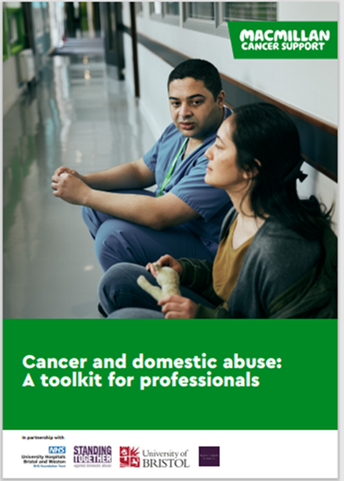
A toolkit for cancer professionals
Quick reference guides
Terminology and definitions
Who is at risk?
Domestic abuse in the cancer setting
Red flags to look out for
What to do if you suspect someone is experiencing domestic abuse
Risk management
Caring for yourself
References
Positive feedback

Slide 12
Key reflections, relevant to the cancer workforce
A diagnosis of cancer can be a trigger for DA to start or exciting DA to escalate
The perpetrator of DA, could be the patient, patient’s partner, close family member
Victim/survivors of DA, view cancer professionals as trusted people to talk to
Victim / survivors of DA, view cancer hospital appointments as safe places
On the whole, victim/survivors want staff to identify and respond to what they see

Slide 13
Remember the intersection of cancer and domestic abuse
Research says
1:5 people in the UK will be a victim / survivor of DA
1:2 people born in the UK will have a cancer diagnosis in their lifetime
DA can affect cancer diagnosis, care, treatment and recovery
Relevant to the whole cancer workforce
Remember to think ‘outside the cancer box’
Cancer can mask DA ‘red flags’
Have a lower threshold of suspicion
“Abusers will use discussions around how hard it is for partners and spouses to their benefit. When someone shouts & swears at you it’s abuse.” (abuse and cancer survivor)

Slide 14
Next Steps
Opportunities to embed key learning into existing training structures
Safeguarding / Domestic Abuse
Cancer related training / induction / communication skills
Raise awareness and access to the Macmillan cancer and domestic abuse cancer professional’s toolkit
SWAG Cancer Alliance funding – 18 months
Dedicated cancer and domestic abuse expertise to roll-out Macmillan training across all SWAG Trusts and explore a training model within Integrated Care Systems and Primary Care.
Develop a sustainable future cancer workforce training model
SWAG – Somerset Wiltshire Avon and Gloucestershire Cancer Alliance

Slide 15
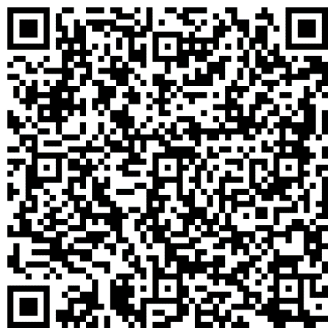
What can you do now?
Read and share the toolkit
Join our National Working Group
Notes:
Evie to put links in chat*
Treatment resources for healthcare professionals | Macmillan Cancer Support
be.macmillan - Cancer and Domestic Abuse: a toolkit for professionals
1) Read and share the toolkit
Please read the toolkit.. It’s available to download online as well. Please order some for you and your peers
Amazing feedback that it’s really easy to use. Really accessible and able to read in full and then refer back to.
We think it’s also got a lot of weighting coming from you as lead nurses and senior leaders, so please advocate for it
Everyone in the room today could be going to your place of work tomorrow or next week, and interacting with someone who is experiencing abuse, and this toolkit offers you the tools to spot those signs, ask the right questions and have confidence of signposting someone to support.
2) Join the National Working Group
My second ask is to please consider joining the national working group if you’d like to get more involved with the project.
We meet once a quarter for an hour and a half online. It’s a real range of people in the group:

Slide 16
“Having to turn to my abuser for help during my cancer treatment, after spending years trying to escape the abusive relationship, was the number one source of stress, fear, and misery during cancer treatment—much worse than the treatment and the cancer itself.”
Notes:
I want to end on this quote we got from a victim-survivor in the interview stage at the start of the project, as I think it really summaries the importance of this project and the difference everyone can make.
Time for questions?

