Slide 1


Primary Care Referral Improvement Toolkit: An information and resource pack to support with early detection of cancer and referral practice
Version: 1.0
Date of publication: September 2025
Date of review: September 2026

Slide 2
Contents
This information toolkit offers an overview of the PCN Network Directed Enhanced Service 25/26. It is designed for primary and community care colleagues and provides a variety of information, resources, and educational opportunities to help improve awareness and understanding of cancer risk factors, signs, and symptoms.
Topic | Slide number
Why is diagnosing cancer early so important? | 3
PCN Directed Enhanced Service - overview | 4 - 8
Improving referral practice - overview | 9 – 12
Bowel cancer and FIT | 13 – 16
Prostate cancer | 17 – 20
Breast cancer | 21 - 23
Lung cancer | 24 - 26
Pancreatic cancer | 27 - 29
Non-specific-symptoms (NSS) | 30
Safety-netting | 31
Checklists | 32 - 33

Slide 3
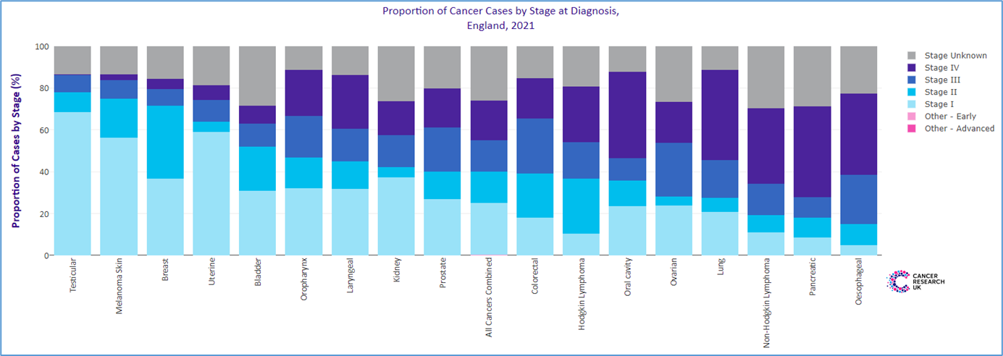
Why is diagnosing cancer early so important?
If a cancer is diagnosed at an early stage, there is a much greater chance of being able to treat the disease successfully, often with less invasive procedures and fewer long-term side effects. But too many people are being diagnosed with cancer at later stages.
It is also important that we diagnose cancers as fast as possible so that treatment can start quickly and as accurately as possible - for example, identifying the genetic make-up of an individual’s tumour tells us how best to treat it.
People diagnosed earlier with cancer are not only more likely to survive, but importantly also to have better experiences of care, lower treatment morbidity, and improved quality of life compared with those diagnosed late.

Slide 4
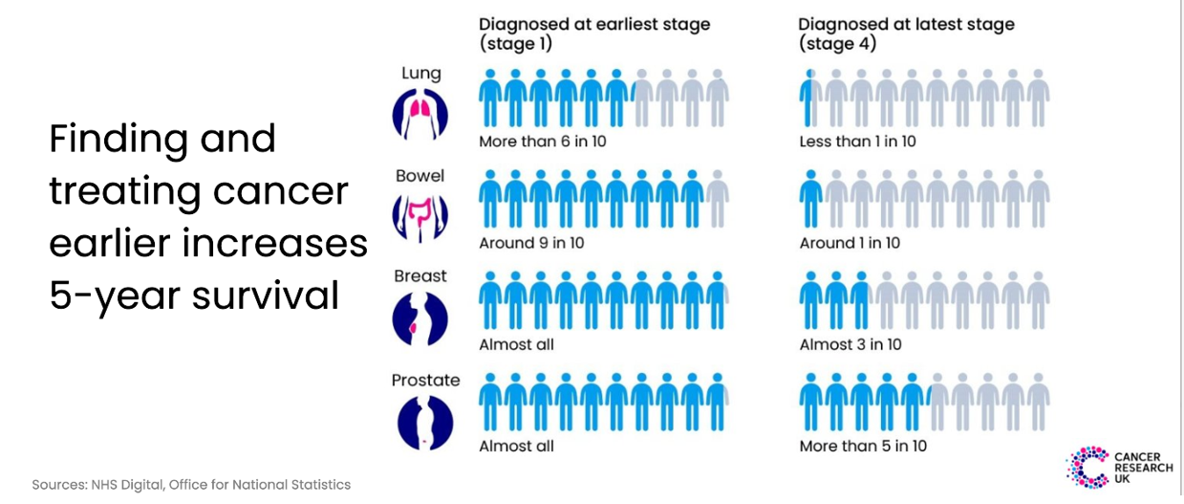
Reducing late-stage diagnosis is vital

Slide 5


PCN Directed Enhanced Service
The Network Contract Direct Enhanced Service (DES) underpins the role of PCNs in empowering general practice within the wider NHS and improving the range and effectiveness of primary care services.
At a PCN level, practices can discuss variation, build consensus, implement best practice and hold each other to account. They can potentially benefit from operational economies of scale and a shared primary care workforce.
Essential Resources:
PCN DES specifications for 2025-26
PCN DES Video Mini-Series 25/26
CRUK GP Contract Hub 25/26
CRUK PCN top tips (2022)
Note: there are no national requirements for monitoring of the early cancer element of the PCN DES and the only monitoring and direct funding is for IIF element. However, we would encourage PCNs to feedback using the Des checklist at the end of this toolkit so we collate learning and exchange ideas.
Send to england.tvcaadmin@nhs.net

Slide 6

PCN Directed Enhanced Service: Early cancer diagnosis 25/26 – No change
The PCN Directed Enhanced Service ask for two things focused on cancer:
The Des also focuses on health inequalities:
2.1.6 A PCN should “actively seek to reduce health inequalities across its Core Network Practices in line with guidance and the CORE20PLUS5 approach.”
2.1.7 A PCN should work in partnership within local communities to address health inequalities that are amenable to primary care interventions. The CORE20PLUS5 approach provides a helpful focal point for galvanising action and guiding targeting and outreach regarding conditions which disproportionately affect people from areas of greater deprivation.
2.1.8 Two of the five clinical areas set out in the of CORE20PLUS5 approach for adults focus on improving cardiovascular disease (CVD) prevention and diagnosis, and early cancer diagnosis.
1. Review referral practice to improve early detection with clear actions and milestones (this toolkit)
2. Work with partners to improve screening uptake

Slide 7
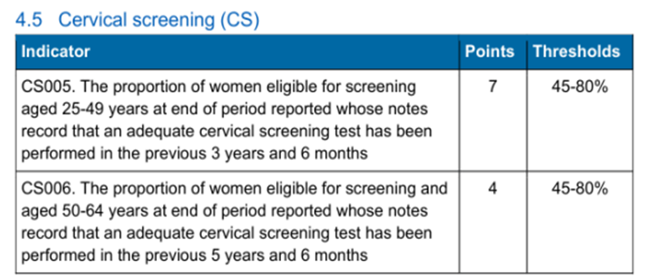
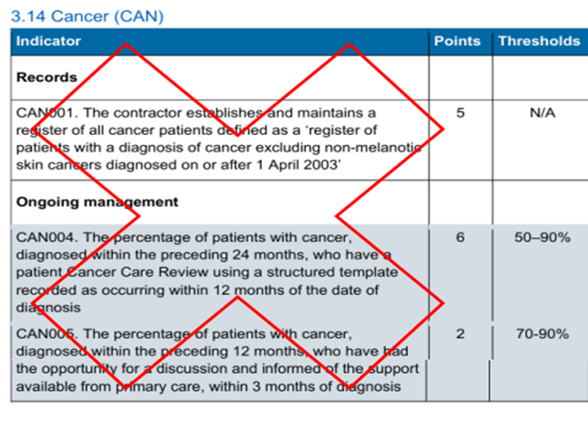
Quality Outcomes Framework 25/26
QOF CS005 CS006 – Cervical Screening: NO CHANGE
CAN001,CAN004,CAN005: RETIRED

Slide 8
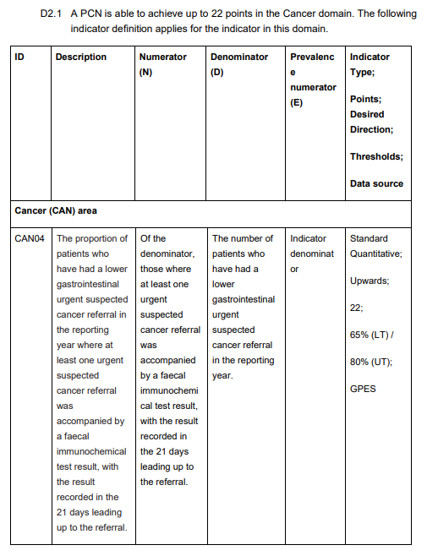
Investment & Impact Fund Indicators (IIF)
25/26, CAN 04:
No change

Slide 9
Improving referral practice

Slide 10
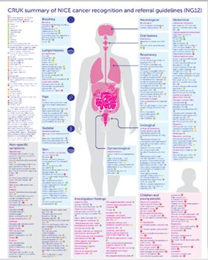
Improving referral practice
“Reviewing cancer referral practice in collaboration with partners and making efforts to improve support of early diagnosis rates with clear actions and milestones”
What you can do:
Ensure local referral practice reflects NICE Guideline NG12
Audit referrals for people who have received a diagnosis of cancer using templates like the National Cancer Diagnosis Audit (NCDA) Patient Proforma and NCDA Data collection template
Use Office for Health Improvement and Disparities (OHID) Fingertips to inform improvement actions
Assess different stages in the pathway for improvement eg the interval between first presentation and when an urgent suspected cancer referral is made or the number of appointments prior to urgent suspected cancer referral
Education and resources:
NG12 Body Map and NG12 Interactive symptom guide
CRUK Coding and Safety-netting
Macmillan Cancer Awareness
CRUK Cancer awareness and prevention for professionals
Remote consultations
Gateway C – improving the quality of your referral

Slide 11
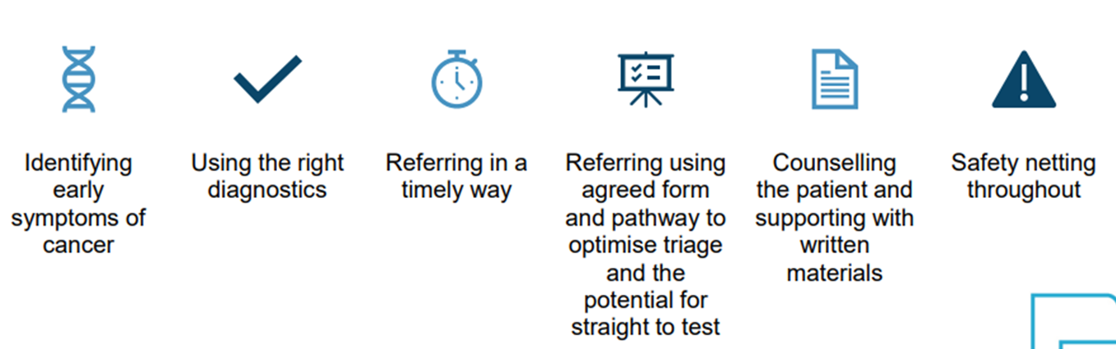
What makes a good referral?

Slide 12
Improving referral practice: 3 step plan - examples
STEP 1: Understand your referral data to identify cancer areas of focus:
Look at PCN level reports on Urgent Suspected Cancer (USC) referrals, diagnostics, demographics using Cancer services - OHID Fingertip (phe.org.uk) Review ERS monthly data to understand trends in referral rates Conduct a referral practice review across your PCN and core practices to assess suspected‑cancer referrals and identify gaps, especially for disadvantaged groups
STEP 2: Consider which aspects of referral to focus on e.g.
Interval between patient first presenting with symptoms and when Urgent Suspected Cancer referral made and the number of appointments attended prior to referral Referrals resulting in a cancer diagnosis to identify variation in management of referrals/change in pathway Routes of presentation to diagnosis – Urgent Suspected Cancer referral or A&E Ensuring that there is a consistent approach (safety netting) in monitoring patients referred urgently, or Checking patients receive information (signposting) on - why they are being referred, importance of attending, appointment and accessing further support
STEP 3: Create a PCN action plan following these steps:
Agree project scope – what will and won’t be done during the project? Establish milestones – what will be done and by when? Project team – who will do what? Reporting and governance – who needs to see your work? Does it need approval and by which group? Evaluation - write up you project and make sure you share what you have found with others and to support shared learning and sustainability

Slide 13
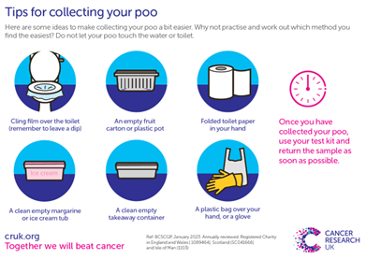
Improve referral practice: Promote use of Faecal Immunochemical Testing (FIT) in symptomatic patients
Guidance has been updated to support and streamline diagnosis and referral practice in primary care. A PCN should:
Use Faecal Immunochemical Testing (FIT) for patients with signs and symptoms of colorectal cancer to identify those requiring a Lower GI Urgent Suspected Cancer referral
FIT testing should be delivered in accordance with NICE Diagnostics Guidance 56. Patients living in more deprived areas are more likely to be diagnosed with bowel cancer at a later stage and are less likely to complete a FIT test
PCNs should target action to address variation in completion of FIT tests in symptomatic patients by deprivation and develop patient education and safety netting approaches to follow up with those who have not returned their FIT test
Education and resources
Watch the TVCA FIT videos for both screening and symptomatic patients, available in x languages and BSL. To access, follow the link
Get CPD points and refresh your knowledge by completing a short online course: Gateway C – colorectal cancer
Gateway C FIT resources, FIT for clinicians and FIT for administrators
Check out Cancer Research UK Symptomatic FIT page
Provide information to patients on how to collect a sample with this CRUK leaflet
CRUK Be clear on the difference between screening and symptomatic FIT
Doctors.net.uk bowel cancer symptomatic and screening resources

Slide 14
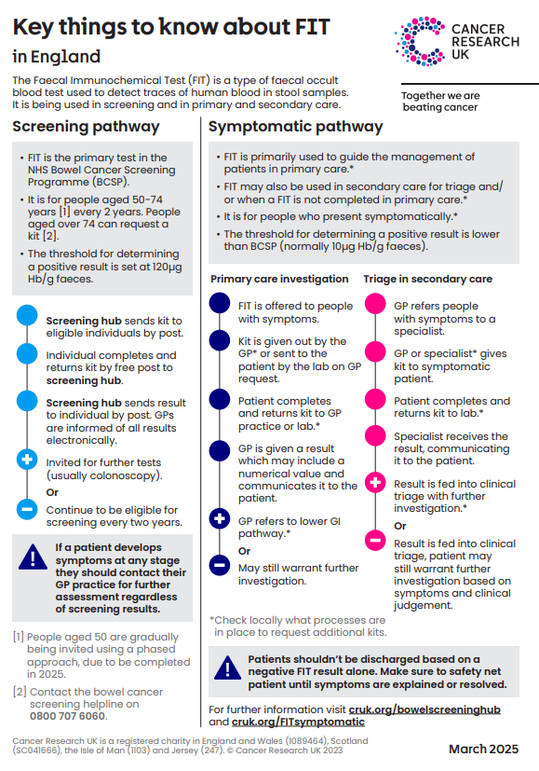
Screening and symptomatic FIT at a glance
 | Screening | Symptomatic
Who | Assumed asymptomatic patients With age extension, 50-74 years | Symptomatic LGI patients aged 18 years and over
When | Offered every 2 years | Offered when patients present with eligible signs and symptoms of lower gastrointestinal cancer
Threshold | Threshold 120µg Hb/g for investigation eg ‘positive screen’* | Threshold 10µg Hb/g for investigation eg ‘positive result’
*A national programme is in development to lower the screening threshold to 80µg Hb/g (FIT@80). More detail will be shared as it is made available.
Any patient presenting with symptoms of suspected colorectal cancer with a negative screening FIT result, even if very recent, MUST be clinically assessed and have a symptomatic FIT if eligible.
DO NOT be falsely reassured by a negative screening FIT result because screening assumes that the patient has no symptoms and a positive screening FIT result is significantly higher

Slide 15
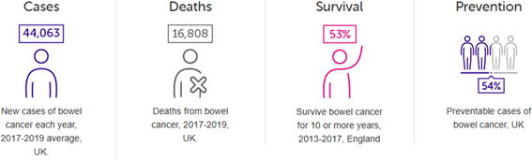
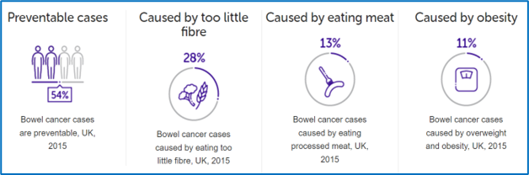
Improve referral practice: Bowel cancer signs,
symptoms and risk factors
Bowel cancer statistics - for detailed information visit: Bowel cancer statistics | Cancer Research UK
Bowel cancer is 4th most common cancer in the UK
Bowel cancer is the 2nd most common cause of cancer death in the UK
A full time GP is likely to diagnose approximately one person with colorectal cancer every year. (NICE CKS)
Bowel cancer risk factors for detailed information on all risks visit: Bowel cancer risk | Cancer Research UK
Bowel cancer risk is 70% higher in people with inflammatory bowel disease (IBD) (ulcerative or
Crohn's colitis) compared with the general population
Around 20% of bowel cancers are associated with hereditary factors other than Familial adenomatous polyposis (FAP) and Hereditary non-polyposis colorectal cancer eg Lynch syndrome
Characteristics of bowel cancer – to read full paper, ctrl click here
>50% of all patients with bowel cancer present with rectal bleeding in combination with a persistent and unremitting change in bowel habit to increased frequency of defaecation and looser stools (odds ratio 5.4*)
>20% have a similar change in bowel habit without rectal bleeding (odds ratio 2.1-2.5*)
>12% have persistent rectal bleeding without anal symptoms without a change in bowel habit (odds ratio 2.9*)
<2% have abdominal pain (odds ratio 0.6†) as a single symptom, which is always provoked by eating, causing weight loss
25% have a rectal mass (odds ratio 31.5)
12% have an abdominal mass (odds ratio 1.8-8.5*)
8% have an iron deficiency anaemia with or without bowel symptoms (odds ratio 4.4-8.4*)
*Odds ratio on multivariate analysis. †Odds ratio of abdominal pain on univariate analysis without defining whether it is always associated with eating and weight loss

Slide 16
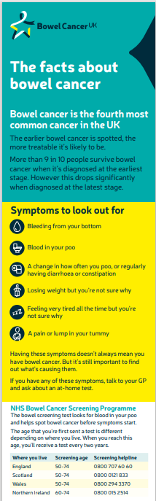
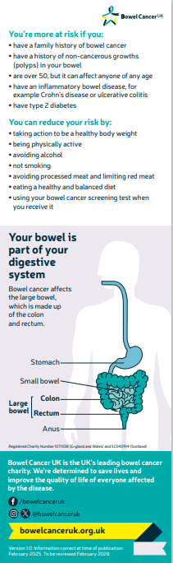
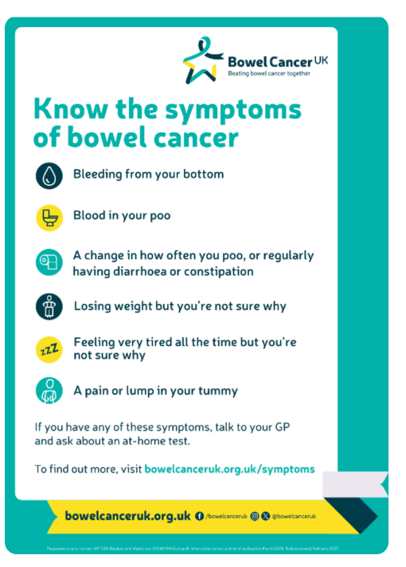
Bowel cancer notice board and engagement resources:
Click on the images below to access
Translated material:
Bowel cancer UK offer information in other languages including: Polish, Punjabi, Romanian, and Welsh.
Click here to access

Slide 17
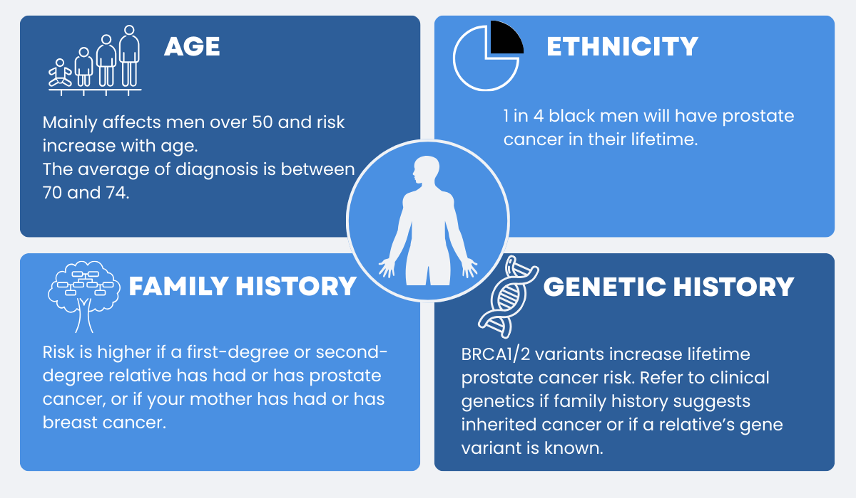
Improve referral practice: be aware of prostate cancer risk factors
Prostate cancer is the most common cancer affecting males in the UK. ​ ​
​
1 in 8 men will be diagnosed with prostate cancer in theirlifetime¹. ​
​
The exact cause of prostate cancer isn’t known but there are some risk factors that increase the likelihood of getting it.
Read more on increased risk factors at: Prostate cancer risk | Cancer Research UK
References:
Prostate cancer risk | Cancer Research UK
Prostate Cancer Risk Factors | Prostate Cancer UK | Prostate Cancer UK

Slide 18
Be aware of prostate cancer – the PSA test
Patients can ask their GP for a Prostate-Specific Antigen (PSA) test from the age of 50 years or 45 years if they have a higher risk of prostate cancer
The decision to request a PSA test should be made on a case-by-case basis with careful counselling regarding the risk of false positives or negatives and describing any potential onward investigations
When counselling a patient on PSA testing, consider what can falsely raise the result such as:
Vigorous exercise, such as cycling, within the last 48 hours
Ejaculation in the last 48 hours
Prescription or over-the-counter medicines, for example, 5-alpha-reductase inhibitors such as finasteride (Proscar®) or dutasteride (Avodart®)
Having had a urological procedure such as a prostate biopsy within the last 6 weeks
Having had a urine infection in the 6 weeks prior to PSA test
Men should be given balanced information on the pros and cons of the PSA blood test and supported to make an informed choice whether to have one. Consider signposting patients to Cancer Research UK information about PSA testing
The use of Digital Rectal Exam (DRE
Prostate Cancer UK and the British Association of Urological Surgeons (BAUS) are advising that men with suspected cancer do not require a rectal exam before being referred for further tests. A PSA test should be done first and referral made based on results
For more information click here for Prostate Cancer UK rectal exam news and read at these FAQs

Slide 19
Prostate cancer education
What you can do:
Ensure your team is aware of the increased risk factors for Prostate Cancer such as age, family history and black ethnicity
Read the Gateway C information about family history of prostate cancer published following the news of Sir Chris Hoy’s diagnosis
Download this CRUK poster with information to support timely referrals for patients with suspected prostate cancer
Listen to BBC radio 4 Inside Health discussion on prostate cancer risk and PSA
Get CPD points and refresh your knowledge by completing a short online course:
E Learning: Gateway C Early Diagnosis of Prostate Cancer in General Practice
E learning: Prostate Cancer UK, Prostate cancer essentials

Slide 20
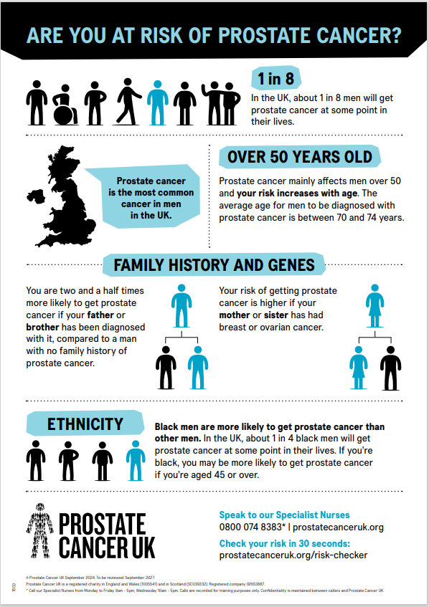



Prostate cancer notice board and engagement resources
Click on the images below to access
Translated material:
Prostate Cancer UK offer information in other languages including: Arabic, Bengali, Chinese, Dari, Fasi, Gujarati, Pashto, Polish, Portuguese, Punjabi, Romanian, Russian, Somali, Tamil, Turkish, Ukrainian, Urdu and Welsh.
Click here to access
LGBTQ +
For information to support trans women, visit the Prostate Cancer UK website
Click on this link for Prostate Cancer UK campaign resources including social media posts and email signatures

Slide 21
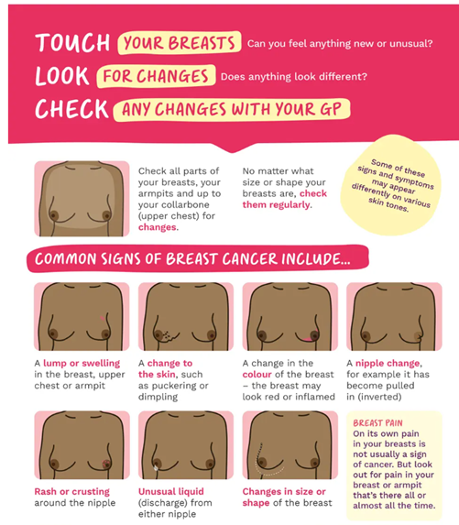
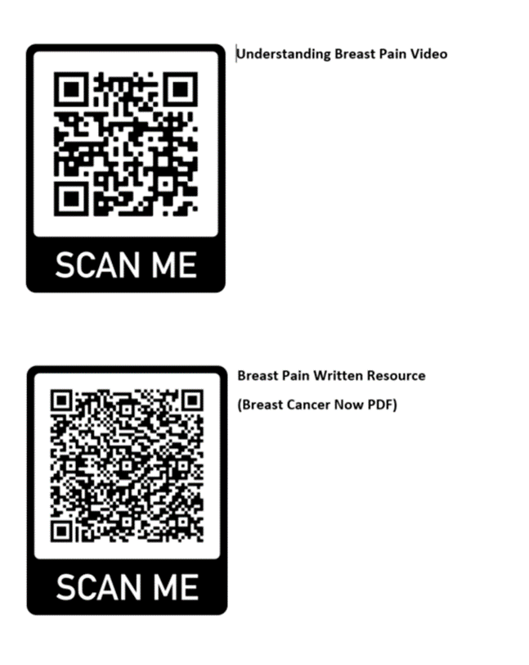
Improve referral practice: breast pain
Patients can scan these QR codes to get direct access to a 4 minute video of a GP explaining breast pain and the Breast Cancer Now Breast Pain Patient Information Leaflet. Consider printing to have in your clinic room.

Slide 22


Improve referral practice: breast cancer in
Black and Asian women
Supported by NHS England and Gilead, the RCGP learning hub have launched a 30minute educational course worth 0.5 CPD points. The course aims to inform GPs about the experiences of Black women with breast cancer. It explores the specific risk factors, challenges related to timely diagnosis, and the lived experience of Black women during the diagnosis process. The course also addresses the social and cultural barriers to healthcare, using case studies to support GPs develop culturally sensitive and effective approaches to care.
Follow the link to access and note RCGP login details are required
RCGP Breast cancer in Black women
Gateway C podcast - Breast cancer early diagnosis in Black and Asian women
The episode explores cultural, social and language barriers impacting healthcare access, the importance of awareness and representation and why empowering patients to seek help early is vital.
Follow the link to access Breast cancer early diagnosis in Black and Asian women

Slide 23
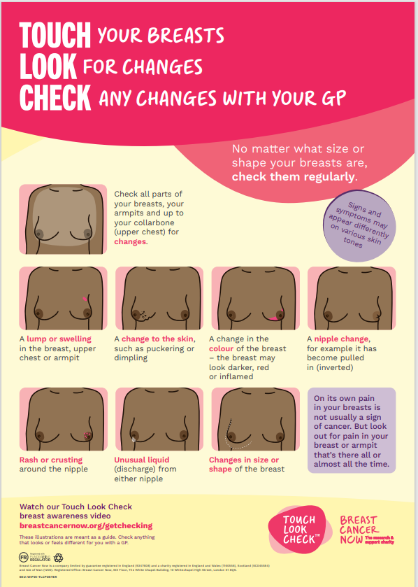
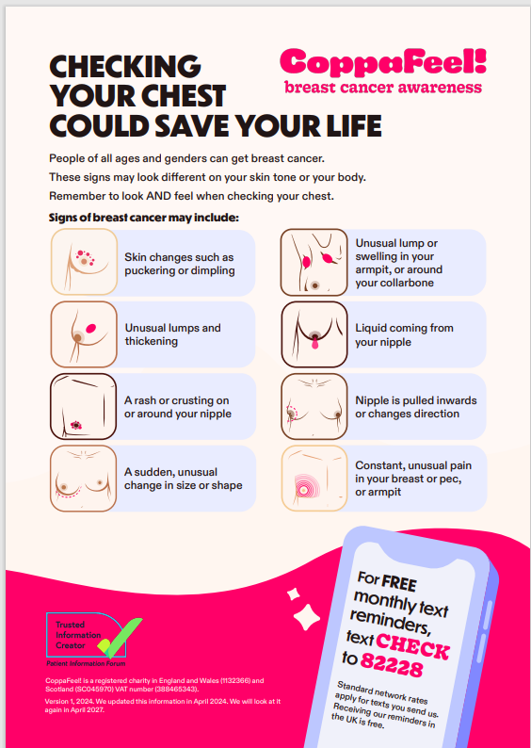
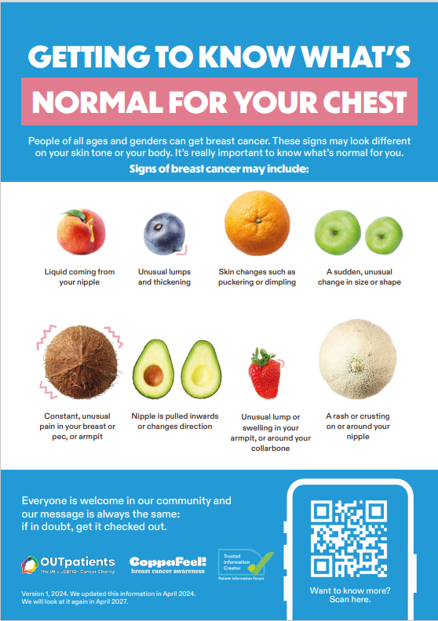
Breast cancer notice board and engagement resources
Click on the images below to access
Translated material:
Breast Cancer Now offer information in other languages including: Arabic, Bengali, French, Gujarati, Hindi, Polish, Portuguese, Punjabi, Romanian, Simplified Chinese, Ukrainian Urdu and Welsh. Click here to access
Learning disability:
Coppafeel provide resources and information to support people with a learning disability. Visit the Coppafeel website to access
LGBTQ +
For information to support trans and non-binary people, visit the Coppafeel website

Slide 24
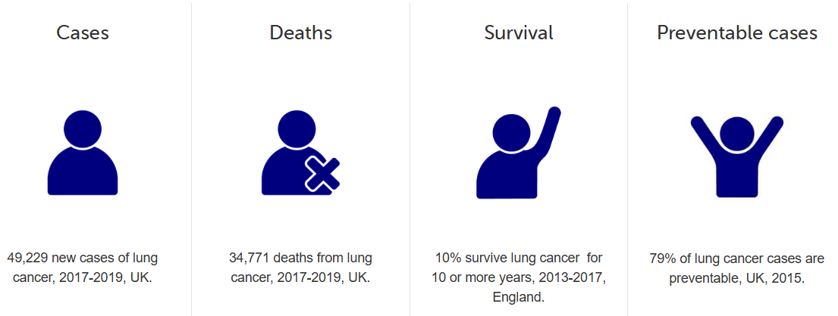
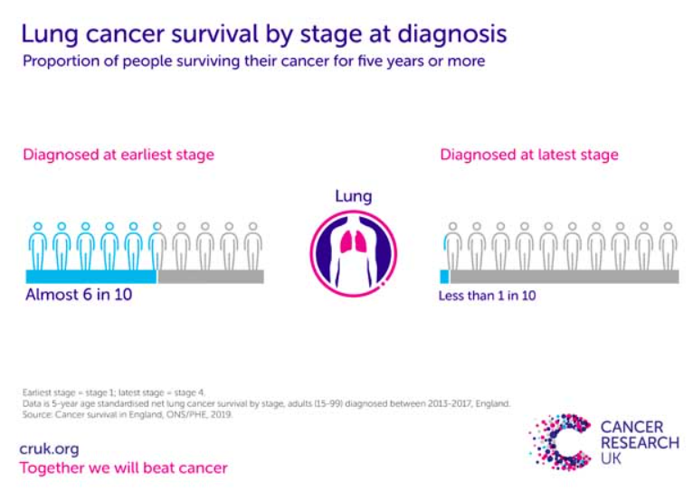
Improving referral practice: lung cancer
Headline statistics:
Lung cancer is the 3rd most common cancer in the UK and the leading cause of cancer mortality
Lung cancer primarily affects older adults – almost 45% of new cases occur in those aged 75+
Smoking is the dominant cause (over 70% of cases)
Incidence and outcomes are strongly linked to deprivation and other factors. An estimated 14,300 lung cancer cases per year in England are attributable to socioeconomic deprivation (roughly 6,600 in women and 7,800 in men)
A full time GP is likely to diagnose approximately one person with lung cancer each year
What you can do:
If you want to learn more about lung cancer, listen to this Podcast for primary care from GatewayC: https://www.gatewayc.org.uk/podcast/lung-cancer
Use this NHS video explaining the signs/symptoms of lung cancer as part or your local awareness campaigns, or this video developed by CRUK
Learn more about lung cancer risk factors by visiting the CRUK website

Slide 25
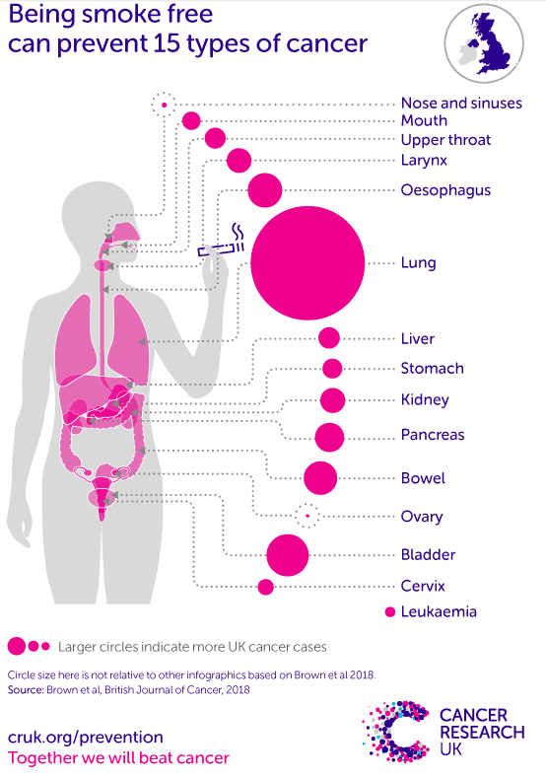
Improving referral practice: lung cancer
Signs and symptoms of lung cancer: For more detail see NG12
The main symptoms of lung cancer include:
a cough that does not go away after 3 weeks
a long-standing cough that gets worse
chest infections that keep coming back
coughing up blood
an ache or pain when breathing or coughing
persistent breathlessness
persistent tiredness or lack of energy
loss of appetite or unexplained weight loss
Risk factors:
79% of lung cancer cases in the UK are preventable
72% of lung cancer cases in the UK are caused by smoking
5% of lung cancer cases in the UK are caused by ionising radiation
13% of lung cancer cases in the UK are caused by workplace exposures
8% of lung cancer cases in the UK are caused by air pollution
NOTE: In symptomatic patients, the majority of chest X-rays will be abnormal, but a normal chest X-ray does not exclude diagnosis of lung cancer. This was shown in the 2006 BJGP study of normal and abnormal chest x-rays in lung cancer patients, 23% of lung cancer patients had a negative X-ray within a year prior to diagnosis.
Please refer if there is a normal CXR but high suspicion of lung cancer

Slide 26

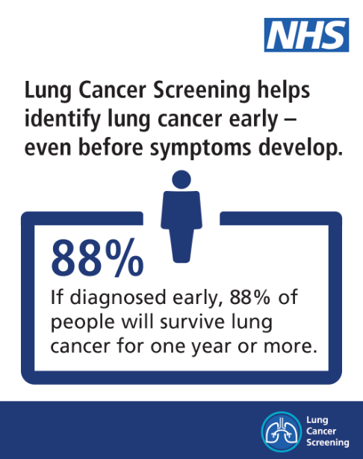
Lung cancer screening programme:
From February 2025, the Targeted Lung Health Check Programme became known as Lung Cancer Screening.
The aim of the Lung Cancer Screening Programme is to find lung cancer earlier, often before symptoms develop. This can widen the treatment options available and improve patient outcomes.
Approximately three quarters of people who have been diagnosed with lung cancer through the programme have been caught at an early stage (stages I or II) when lung cancer is easier to treat with curative intent.
A lung health check is offered to people between the ages of 55 and 74 who smoke or have smoked in the past.
NHS England’s ambition is to have lung health checks rolled out to all eligible patients by 2030. Read more here: NHS lung cancer screening
Across the Thames Valley Cancer Alliance, the Lung Cancer Screening Programme is being delivered by the following providers, who aim to have 100% roll out by 2030/31:
Oxford University Hospital NHS Foundation Trust
Royal Berkshire Hospital NHS Foundation Trust
Buckinghamshire Healthcare NHS Trust
Great Western Hospital NHS Foundation Trust
Registered patients who are aged 55-74 and have a history of smoking on their medical record will be offered Lung Cancer screening when the programme reaches their area.
For more information contact: england.tvcaadmin@nhs.net

Slide 27

Improving referral practice: Pancreatic cancer
Pancreatic cancer is the 10th most common cancer in the UK. It is difficult to detect, is often diagnosed at an advanced stage, and survival rates are extremely poor. One in four people diagnosed with pancreatic cancer in England survive their disease for one year or more, with emergency presentation the most common route to diagnosis. (Cancer Research UK, 2013-2017)
New onset diabetes:
Diabetes, especially Type 2, is common among the general population. However, unexplained new-onset diabetes should be investigated as a possible indicator of pancreatic cancer. It is also important to ask patients about other symptoms of pancreatic cancer such as steatorrhea, back pain and weight loss.
NICE NG12 guidelines recommend an urgent direct access CT scan (to be performed within 2 weeks), or an urgent ultrasound scan if CT is not available, to assess for pancreatic cancer in people aged 60 and over with weight loss any of the following: diarrhoea, back pain, abdominal pain, nausea, vomiting, constipation, new-onset diabetes.
Refer people using an urgent suspected cancer pathway referral (for an appointment within 2 weeks) for pancreatic cancer if they are aged 40 and over and have jaundice.
See Pancreatic Cancer UK information on diabetes and pancreatic cancer including information for your patients.
Pancreatic cancer is a difficult disease to diagnose. Pancreatic Cancer Action have developed resources for GPs including:
e-learning, resource packs, NICE diagnostic and referral guidelines, EMIS risk tool and a GP seminar.
Resources for GPs | Pancreatic Cancer Awareness | PCA
For pharmacists, click here to access similar resources

Slide 28

Improving referral practice: Pancreatic cancer and inherited risk
Inherited risk of pancreatic cancer
About 10% of pancreatic cancers are hereditary meaning that for every 10 people with the disease, one likely had increased risk due to genetic mutations.
Mutated DNA can pass from generation to generation (germline mutations). These mutations may lead to hereditary pancreatic cancer. This is the only way the disease can be inherited.
Most individuals with inherited and other risk factors for developing pancreatic cancer are not aware of their risk or involved in any surveillance.
Read more about Family History of Pancreatic Cancer from Pancreatic Cancer UK.
Family History of Pancreatic cancer: SNOMED concept ID 429000004
This code is now available on EMIS and SystmOne

Slide 29
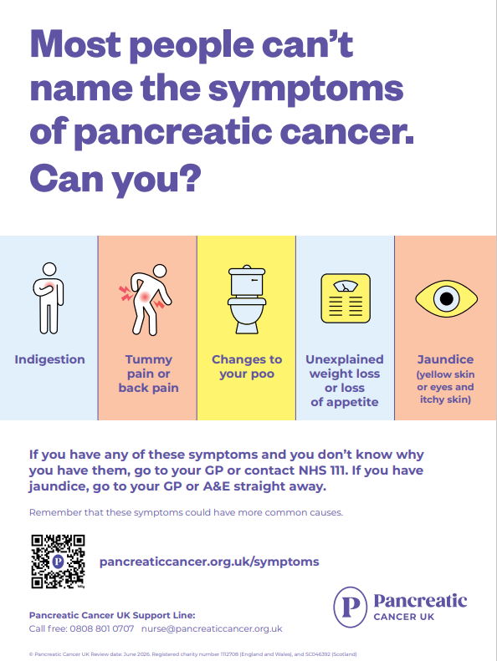

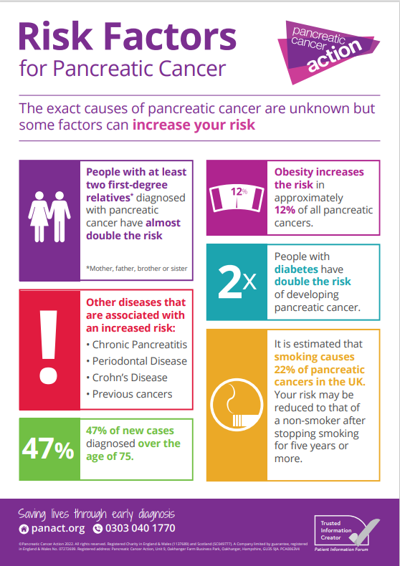
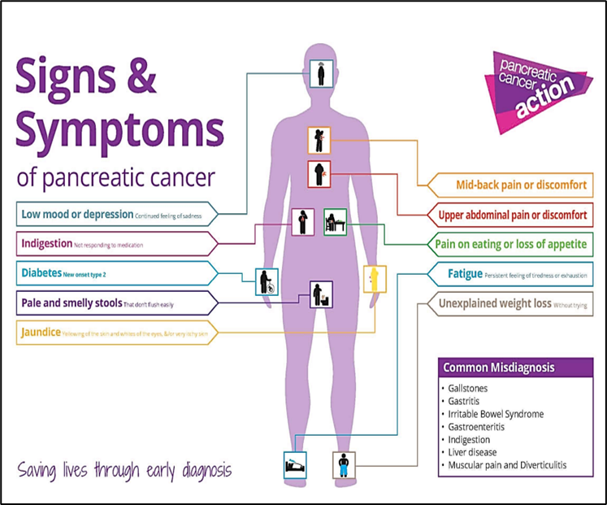
Pancreatic cancer: noticeboard and engagement resources
Click on the images below to access
Translated material:
Pancreatic Cancer Action offer information in other languages including: Arabic, Bengali, Gujarati, Polish, Punjabi and Urdu.
Click here to access
Accessible information:
Pancreatic Cancer Action provide resources and information in accessible formats. Visit the Pancreatic Cancer Action website
Visit Pancreatic Cancer UK for information to support people with learning disabilities
For campaign materials, visit the Pancreatic Cancer Action website

Slide 30
Promote use of Non-Specific-Symptoms pathways (NSS)
Guidance has been updated to support and streamline diagnosis and referral practice in primary care. A PCN should:
Promote use of Non-Specific Symptom (NSS) pathways for patients with symptoms that could indicate cancer but who do not fit clearly into a single Urgent Suspected Cancer referral pathway. PCNs should support practices to undertake clinically appropriate filter function tests for NSS patients.
Across Thames Valley Cancer Alliance, NSS pathways have been implemented in the following locations:
Oxford University Hospital NHS Foundation Trust
Royal Berkshire Hospital NHS Foundation Trust
Buckinghamshire Healthcare NHS Trust
Great Western Hospital NHS Foundation Trust
Education and resources:
Access CRUK non-specific symptoms web pages
Listen to Dr Neil Smith talk about the main considerations when managing people who present with vague symptoms
Gateway C non-specific symptoms course
Read about the management of non-specific signs and symptoms of suspected cancer on Doctors Net (free but login required)

Slide 31
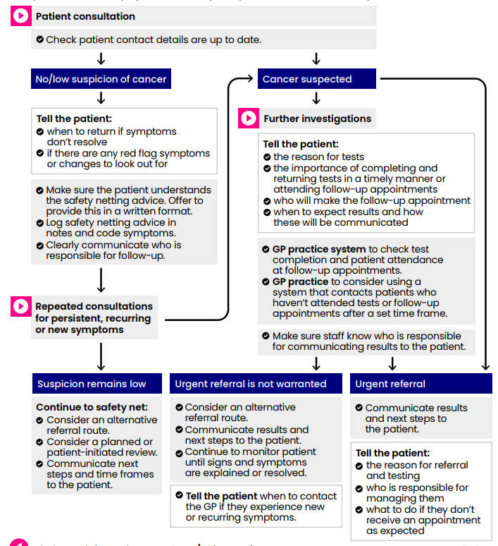
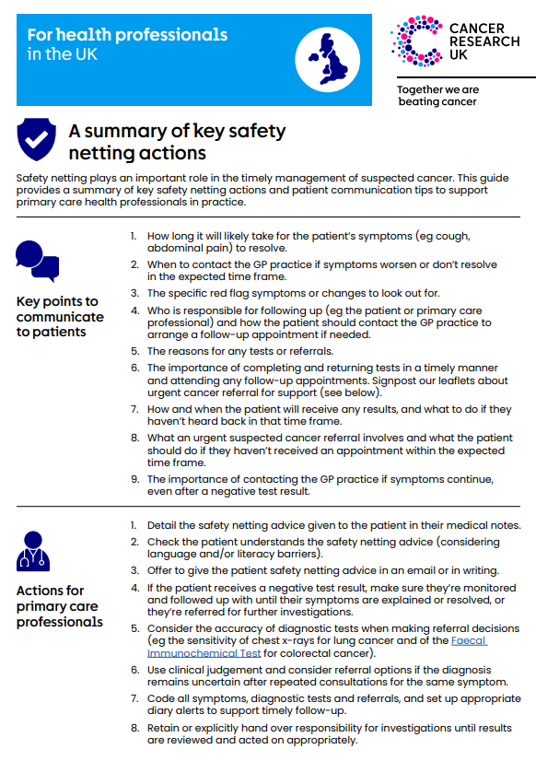
Safety netting
Safety netting is a diagnostic management strategy that ensures patients with potential cancer symptoms are monitored until they are explained or resolved, or the patient is referred.
For a summary of CRUK top safety netting actions, click on the image
Learn more about safety netting and the Cancer Research UK resources by visiting their safety netting hub.
Ardens safety netting resources:
Click here for Cancer Recognition
Click here for Referral Safety Netting Letter
Click here for Referral Safety Netting - Email Referral Tracking
Click here for Referral Safety Netting - Referral Tracking

Slide 32
DES checklist: Referral practice
PCN DES requirements | Yes (include date) | No | If Yes, please provide further detail of how you have met the PCN components
Reviewed the quality of referrals for suspected cancer, against the recommendations of NG12?
Made use of clinical decision support tools?
Accessed data available to identify cancer tumour groups to focus on?
Met safety netting requirements?
Conducted a review of diagnosis via emergency presentation of diagnosis at stage 3/4
Ensure that all patients are given up to date patient information, in their language?

Slide 33
DES checklist: FIT
PCN DES requirements | Yes (include date) | No | If Yes, please provide further detail of how you have met the PCN components
Do your Practices have enough FIT kits? Do they have a supply chain?
Are resources available to support patients understand the importance of completing a FIT (if symptomatic)?
Are all staff aware of the requirements (both DES and IIF) of the completion of FIT prior to referral to Lower GI pathway?
Do practices have systems in place to code and track all FIT tests and is there a system in place to ensure results are acted on?
Is best practice on embedding FIT being shared across the PCN?

