Slide 1

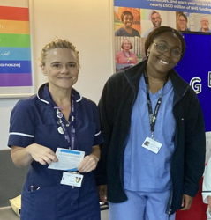
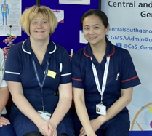
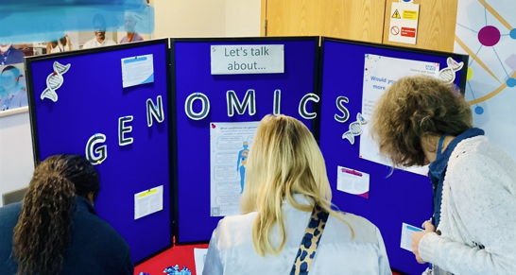
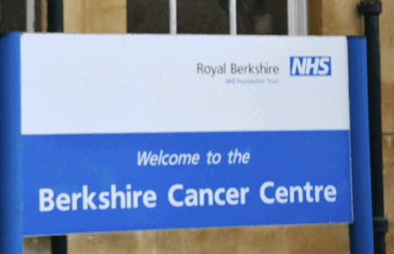

Developing a
mainstreaming cancer susceptibility gene testing service
Mary Tanay PhD RN
Macmillan Consultant Nurse in Genomics
Berkshire Cancer Centre
Compassionate Aspirational Resourceful Excellent

Slide 2
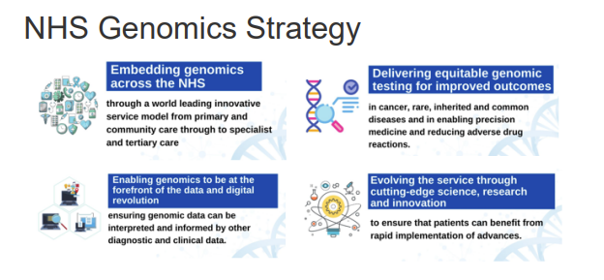

Slide 3
What is mainstreaming
describes pre-test counselling and consent processes being undertaken at the point-of-care by a member of the clinical cancer team caring for the patient.
Compassionate Aspirational Resourceful Excellent

Slide 4
Benefits of mainstreaming service
Patient:
Surveillance and Prevention
Patient:
Treatment decisions
Family:
Testing and Surveillance
Organisation
Allows equitable access to genomic tests.
Prevention or early detection of cancers can save resources.
Genomics-prepared workforce
Research and future developments
Patients with positive results are offered more regular screening procedures.
Risk-reducing surgery
Chemoprophylaxis
L:ifestyle advice
Positivity can be associated with better response
with immunotherapy.
Family members are given the option to be tested
Holistic support
Compassionate Aspirational Resourceful Excellent

Slide 5
At a quick glance…
evidenced-based
sustainable
Compassionate Aspirational Resourceful Excellent

Slide 6
…but it is complex
The need for:
  a structured patient pathway
  formalised training procedures
  close collaborations
Compassionate Aspirational Resourceful Excellent

Slide 7
Key elements of a robust mainstreaming service
genomic literacy of the clinical team
job planning
pathway mapping of mainstream service
      timing
      return of results
      collaboration with clinical genetics
Compassionate Aspirational Resourceful Excellent

Slide 8
RBH Lynch Syndrome
Mainstreaming Clinic
Compassionate Aspirational Resourceful Excellent

Slide 9
What is Lynch Syndrome?
inherited condition | increases risk of developing several types of cancers
around 175,000-200,000 have Lynch syndrome in the UK | less than 5% have been identified
Compassionate Aspirational Resourceful Excellent

Slide 10
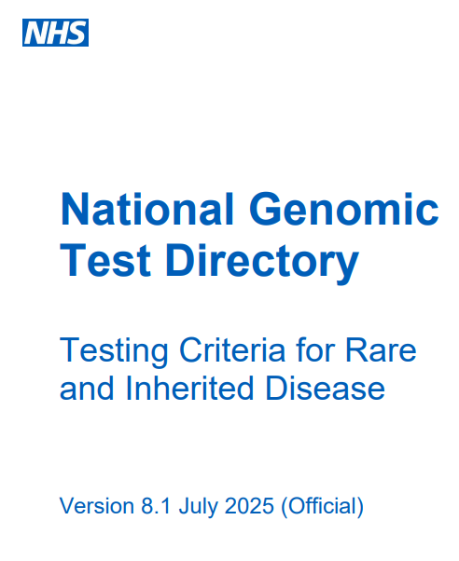
Evidence and resources
National Institute for Health and Care Excellence (NICE) recommendations:
  colorectal cancer
  (NICE DG27)
  endometrial cancer (NICE DG42)
National Lynch Project
Other centres
National Genomic Test Directory
Compassionate Aspirational Resourceful Excellent

Slide 11
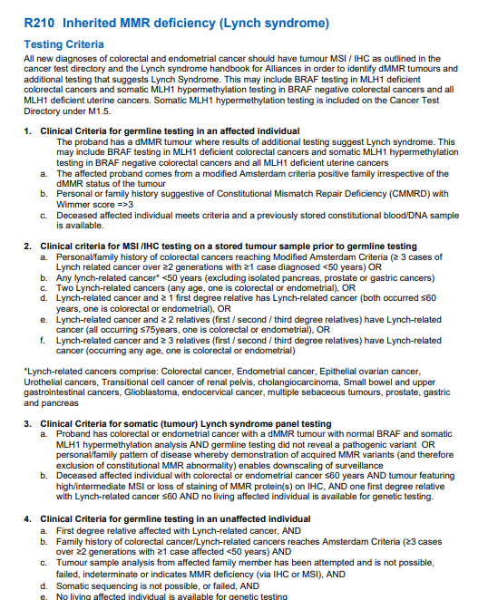
Compassionate Aspirational Resourceful Excellent

Slide 12
Three main stages
Identify
Counsel and testing
Action based on results
Compassionate Aspirational Resourceful Excellent

Slide 13
Clinical Nurse Specialists
Surgical Physician Associate
Consultant Nurse
Secretary
Data Team
Health Support Worker
Surgeons
Pathologists
Genetic Counsellors
GMSA
RBH and External Team
Compassionate Aspirational Resourceful Excellent

Slide 14
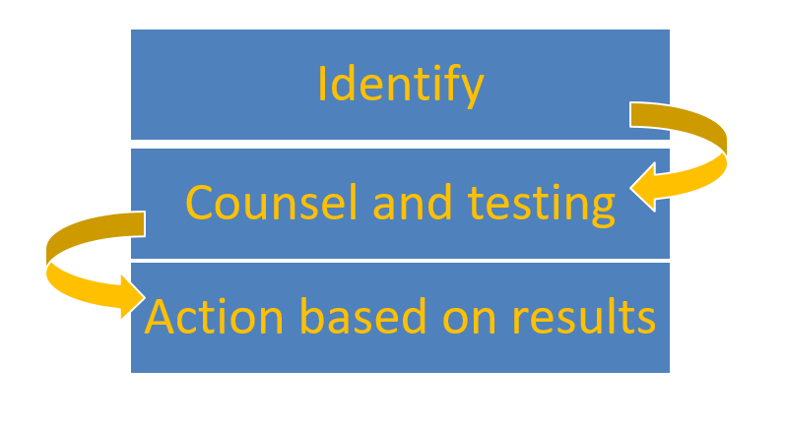
Not a linear process
but good to start here…
identify the local Lynch Champion
create an initial draft of the patient pathway
Compassionate Aspirational Resourceful Excellent

Slide 15
Merging the colorectal and gynae Lynch pathways
Identify
Where and who: MDT
Awareness: Training and education of the clinical team
Clarity of roles in the pathway
Compassionate Aspirational Resourceful Excellent

Slide 16
Identify
Counsel and testing
Action based on results
Five months from
start of development to launch of service
Compassionate Aspirational Resourceful Excellent

Slide 17
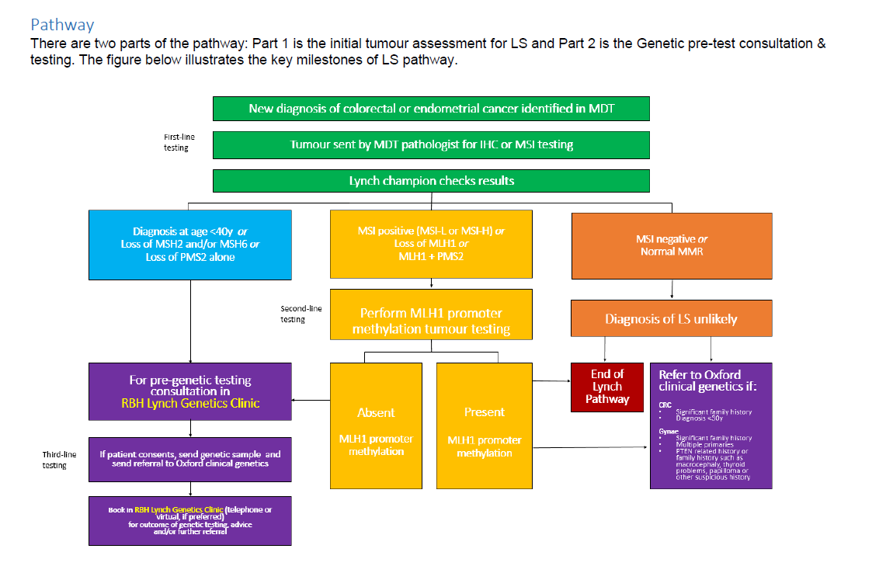

Slide 18
Genetic test process
Confirmed diagnosis
Refer to Oxford Genomics
Patient seen by Oxford Genomics
Reflex testing suggestive of Lynch
Oxford Genomics consent and blood test
Tumour sample is sent for reflex testing
4-8 months waitlist
4 months waitlist
Blood test results
8-12 months
(July 2024)
The RBH service
Patient referred to RBH Lynch Clinic
Patient follow-up with result
Confirmed diagnosis
Reflex testing suggestive of Lynch
Consent and blood test taken
4-6 months
(May 2025)
Most recent clinic: 5-6 weeks
Compassionate Aspirational Resourceful Excellent

Slide 19
Reflections almost one year since launch
The joy of a negative result
The joy of a positive result
Acknowledge limitations
When is it best to approach patients about Lynch germline testing
Refinement of the process and finalise pathway
Compassionate Aspirational Resourceful Excellent

Slide 20


Future directions
Conduct an annual service evaluation.
Genetic and genomic testing in oncology is evolving and more tests are being tested and discovered.
The clinic provides a template for future genetic clinics in RBH (e.g. R211 and R430)
BCC staff are genomics-prepared for future developments.
Compassionate Aspirational Resourceful Excellent

Slide 21
Thank you.
RBH Lynch Syndrome Clinic Team
Adedolapo Adesanya-Shine, Lisa Clarke,
Vanessa Newland, Ciara French, Nicky Dann,
Hannah Shepherd, Claire Hawkins, Amber Parsons
Presented by: Mary Tanay
Email: mary.tanay@royalberkshire.nhs.uk
Compassionate Aspirational Resourceful Excellent

