Slide 1


GENOMICS
Dr Lara Hawkes
Consultant in Clinical Genetics
Oxford Centre for Genomic Medicine

Slide 2
Overview
Basic genetics
Genetic investigations
Genomics – single genes/ panels/ WGS/ WES
Genetic variants
What genomics can do for our patients
Genomic medicine in the NHS

Slide 3
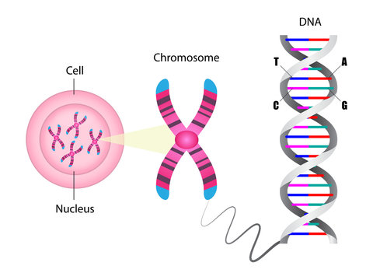
Basics of Genetics
Chromosomes and Genes
Humans have 23 pairs of chromosomes that package DNA, containing genes as units of heredity.
Chromosome Abnormalities
Chromosomal abnormalities like aneuploidy (abnormal number) and structural variations (deletions, duplications, translocations) cause various genetic disorders.
DNA Sequence Variation
Variations in the DNA sequence of an individual gene influence gene function and disease susceptibility.
Notes:
Human genetics is founded on the understanding that each individual possesses 23 pairs of chromosomes, which are structures that package our DNA. These chromosomes contain genes, the functional units of heredity, which are composed of coding regions called exons and non-coding regions known as introns. Genetic conditions can arise from various chromosomal abnormalities, including aneuploidy (an abnormal number of chromosomes), deletions, duplications, and translocations. Aneuploidy may lead to conditions such as Down syndrome, while structural changes can result in syndromes like DiGeorge or Williams syndrome. The DNA sequence itself comprises approximately 3 billion nucleotides, and variations in this sequence can influence gene function and contribute to disease. Understanding these basic principles is essential for interpreting genetic tests and recognizing the implications of genetic findings in clinical practice. This foundational knowledge supports the application of advanced genomic technologies and informs the diagnosis and management of genetic disorders.

Slide 4
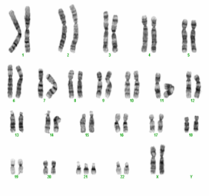
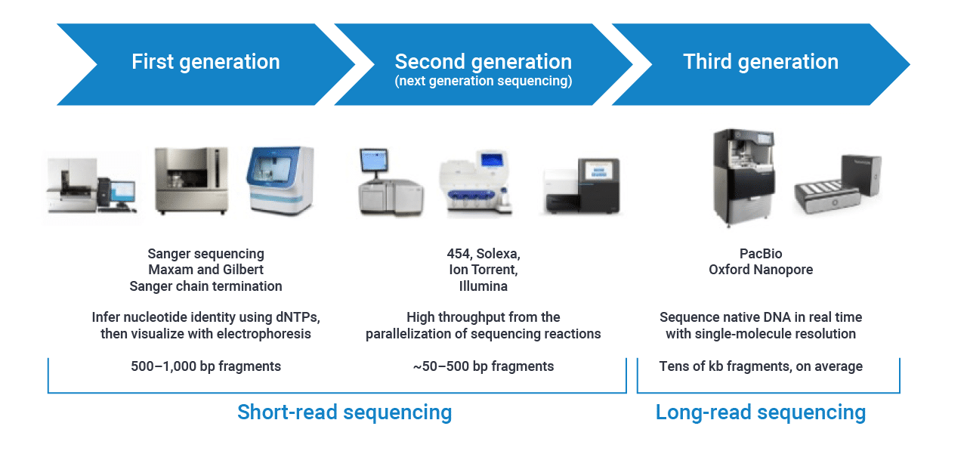
Genetic investigations
Next Generation Sequencing
A massively parallel sequencing technology
Offers ultra-high throughput, scalability, and speed.
Entire genomes or targeted regions of DNA or RNA
Cost rapidly declined
Karyotype
FISH
Sanger sequencing

Slide 5

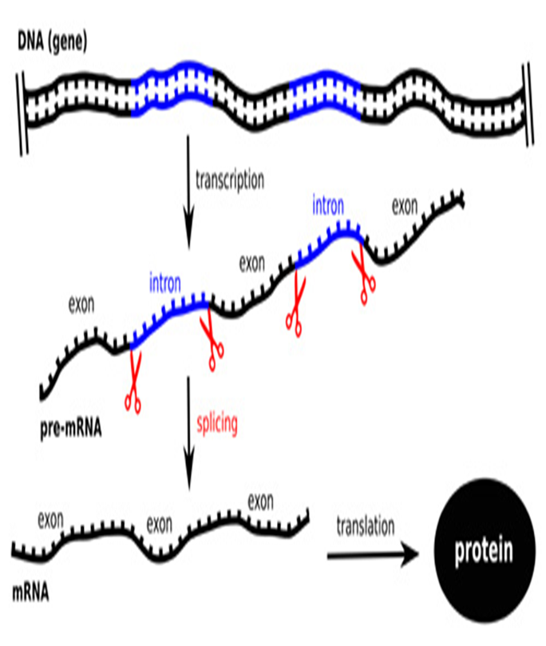
Whole genome sequencing
The human genome is made up of over 20~25,000 genes coded by 3.2 billion nucleotide sequences (A,T,G and C).
The genome includes exons (coding regions) and introns (non-coding) regions.
Genomics – all-encompassing term referring to the complete sequence of an individual's genetic code.
Genomic sequencing technologies look at variation in an individual's genome.
Notes:
The central dogma of molecular biology describes how the nucleotide sequence is transcribed into Mrna which subsequently gets translated into proteins.
Introns are excised prior translation. It was earlier thought that exons are primarily the underlying cause of genetic conditions, however we have now realised that introns can also influence gene expression.

Slide 6

Genomics
Analysing a single gene - If the causative genetic variant is already known in the family (Eg: Family history of breast and ovarian cancer – A known BRCA1 genetic variant)
Whole Genome Sequencing (WGS)– sequencing data is generated from both introns and exons.
Whole Exome Sequencing (WES)– sequencing data is generated only from exons.
Gene Panels
Cancer, cardiology, developmental disorders, endocrinology, fetal, haematology, neurology and many more…..
100,000 genomes from around 85,000 people in England with either rare disease or cancer.
Notes:
About 99.9% of the genome is identical in all humans with a 0.1% variation. Genomic testing homes in on these variations that may be contributing to inherited medical conditions. This 0.1% variation however equates to around 3 million differences so there is a lot of genomic data for scientists to sift through.

Slide 7

Genetic variants
There are 3 possible outcomes to a genetic panel test:
1) Clinically relevant result – Pathogenic/Likely pathogenic genetic variant
2) Uninformative result – no genetic variant identified. Does not rule out a genetic basis
3) Inconclusive/Uncertain Result – Variants of Uncertain Significance (VUS)
Reported
Pathogenic - >99% certainty
Likely pathogenic - >90% certainty
VUS -Consider reporting only when high level of supporting evidence
Not reported
Ellard et al. (2020). ACGS Best Practice Guidelines for Variant Classification in Rare Disease 2020 v4.01
Notes:
Variants are classified using evidence criteria detailed by the ACGS guidelines
Population data - frequency of the genetic variant in controls vs affected individuals
Computational data – In-silico analysis tools that predict effect of genetic variant on gene/gene product
Functional data – Is the genetic variant in a well-studied functional domain with not many reported benign variations.
Segregation data – Is the genetic variant also seen in multiple members of the family with the same medical condition?
Knowing De Novo status can also be useful – is the genetic variant only present in the affected individual and not their parents

Slide 8
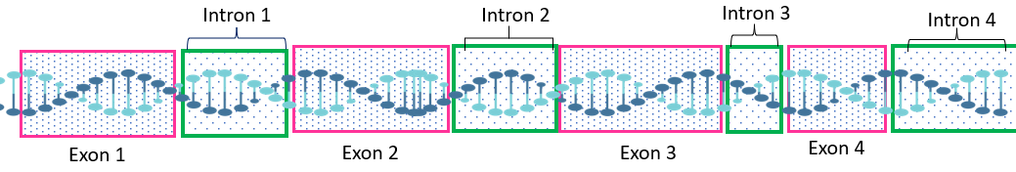
What genomics can do for our patients…
diagnosis
prognosis
treatment
surveillance
management
prevention
clinical decision making
family planning, testing relatives
clinical trials, drug discovery
understanding natural history of diseases
personalised medicine
Coming…
Gene editing/ gene therapies – currently in clinical trials for haemoglobinopathies, vision loss, HD

Slide 9
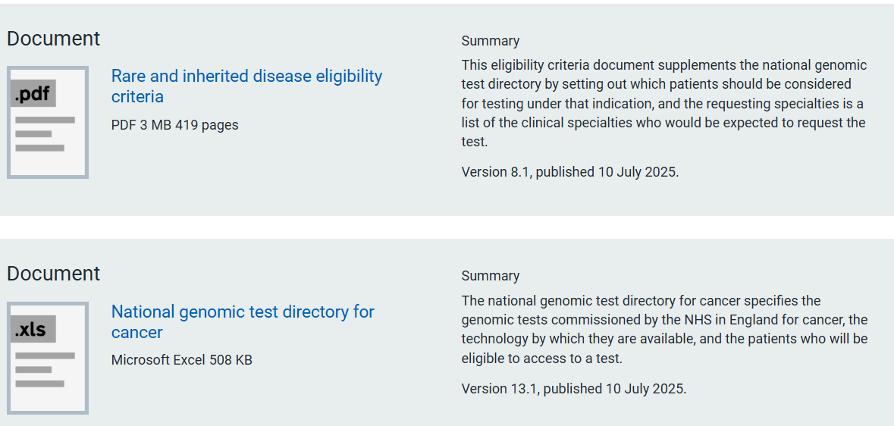
GENOMIC TESTS: Availability set out in National Genomic Test Directory

Slide 10
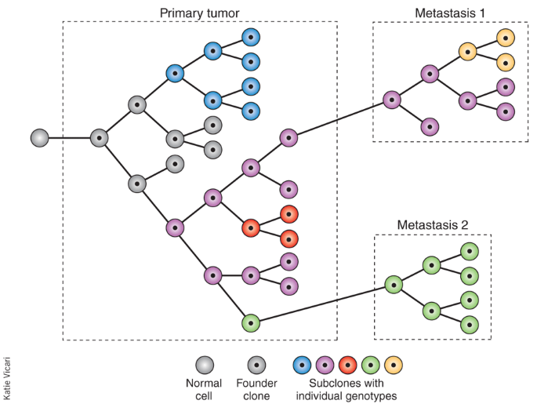
CANCER GENOMICS: SOMATIC VS GERMLINE
Germline Mutations​
Germline mutations are inherited genetic changes present in every cell, passed from parent to offspring.
Somatic Mutations​
Somatic mutations occur in individual cells during life and are not inherited, often linked to cancer development.
In NHS paired somatic and germline genomic analysis available for some patients e.g. childhood cancers, sarcomas

Slide 11
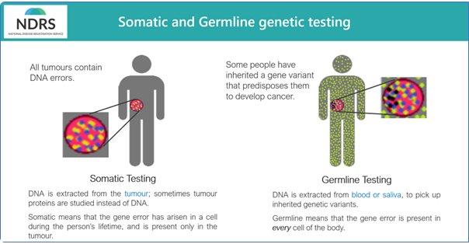
Cancer Genomics: Somatic Vs Germline
Somatic results:
May direct cancer treatment
Prognosis
Do not change risk for relatives
Germline results:
Cancer predisposition genes
Cause of cancer
Risk for future cancer
May direct management of current cancer
Risk for relatives to allow preventative action
Notes:
--- This slide references information from the following file: https://ouhnhsuk.sharepoint.com/sites/ClinicalGenetics/_layouts/15/Doc.aspx?sourcedoc=%7B9D9761D7-1232-452A-A6DB-AE746A7DDB50%7D&file=Introduction%20to%20Clinical%20Genetics.pptx&action=edit&mobileredirect=true,https://ouhnhsuk.sharepoint.com/sites/ClinicalGenetics/_layouts/15/Doc.aspx?sourcedoc=%7B36C1084B-164E-4873-939F-141690074E55%7D&file=Genomic%20Medicine%20SHO%20Training.pptx&action=edit&mobileredirect=true Cancer genetics explores the role of genetic mutations in the development and progression of cancer. It distinguishes between inherited predisposition and acquired somatic changes. Clonal evolution describes how cancer cells accumulate mutations over time, leading to heterogeneity within tumors. Germline mutations in cancer predisposition genes such as BRCA1, BRCA2, TP53, and MLH1 increase the risk of developing specific cancers and inform screening and prevention strategies. Somatic mutations can influence tumor behavior and response to treatment, making them critical for therapeutic planning. Genetic testing in oncology includes both germline and somatic analyses, often using next generation sequencing. The integration of cancer genetics into clinical practice enables risk stratification, targeted therapies, and improved patient outcomes. It also facilitates family counseling and cascade testing for at-risk relatives.

Slide 12
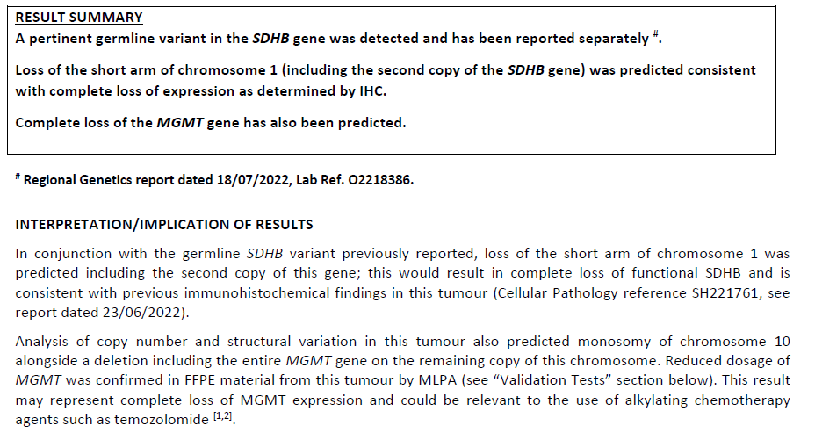
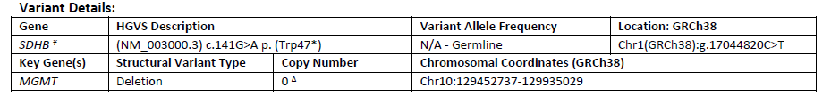
Sarcoma WGS case
GIST aged 40
No family history
Germline SDHB mutation
Risk for phaeochromocytoma, paraganglioma, renal cell cancer
Relatives can be offered testing
Tumour MGMT deletion
Information for oncologist

Slide 13
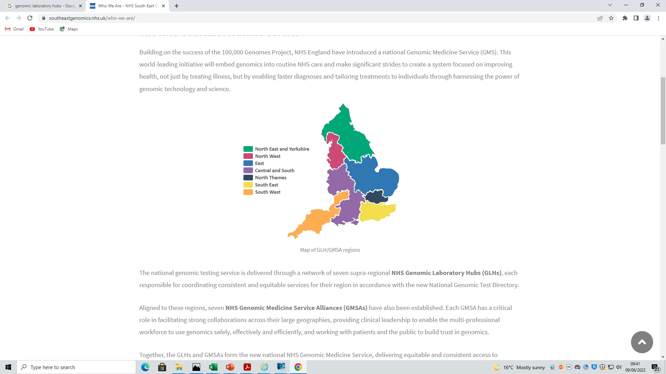
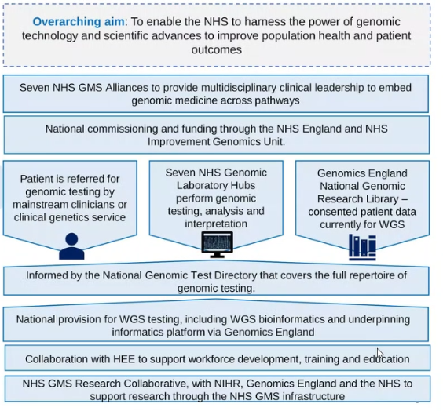
National Genomic Medicine Service
Notes:
Genetics is a relatively small specialty and we work on a national level
NHS Genomic Medicine Service in England has set up seven NHS GMS alliances covering the whole country to standardise genetic testing
We and mainstream clinicians refer patients to our local genomics lab (Oxford) which is within the central and south Thames hub. They work with other GHLs to perform, analyse and interpret genetic tests.

Slide 14
Genomic Medicine Services
In 2018, the Genomic Medicine Service was launched with a vision to provide equitable access to genomic testing across the country and co-ordinate integration of genomics into routine healthcare.
Recognition of how genomics is instrumental in not just attempting to find a diagnosis but also the development of treatment options has led to widespread implementation of genomics across healthcare.
An increasing number of genetic/genomic tests can be ordered in primary and secondary care often referred to as ‘mainstreaming’.
Crucial step in improving access and streamlining patient care.
Notes:
Overview of genomic medicine services – comprised of medical doctors specialised in genetics (consultant geneticists) genetic counsellors and SpR’s
Historically genetic testing could only be requested by specialists working within the regional genetics service, however following the establishment of the GMS service, specialist clinicians working within primary and secondary care can also request GT
Want to make you aware of the GM service incase you order a test for a patient in the future and need help with interpretation or facilitating communication in the family, you can reach out to my genetics colleagues, They continue to offer training, support and education.

Slide 15
Useful Resources
NHS England » National genomic test directory
GeNotes: Genomic notes for clinicians | GEP | NHS England
Welcome to Genomics Education Programme - Genomics Education Programme
SAMPLE FOOTER TEXT
Notes:
--- This slide references information from the following file: https://office.com?path=bcc38b72-9e3c-4058-b3e7-4cd3252e9d49,https://office.com?path=d5a33ea1-8d0e-4cb1-9d83-a1301812600a Several resources support the implementation and understanding of genomic medicine. The Oxford Centre for Genomic Medicine provides clinical services and expertise in genetic disorders. The NHS Genomic Test Directory outlines the eligibility criteria and methodologies for various genomic tests, serving as a guide for clinicians. The Genomics Education Programme offers training materials and courses to enhance genomic literacy among healthcare professionals. Clinical Genetics Services across the UK offer diagnostic and counseling support for patients and families affected by genetic conditions. Additionally, documents such as the Guide to Requesting Whole Genome Sequencing and the Record of Discussion forms facilitate the clinical workflow and ensure informed consent. These resources are essential for maintaining high standards in genomic practice, supporting clinicians in decision-making, and ensuring patients receive accurate and compassionate care.

