Slide 1
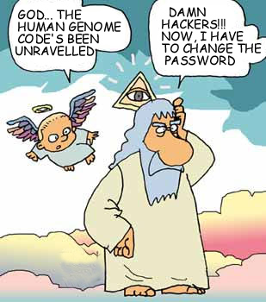
Genomics in Haematology
Personalised diagnosis and
therapy
PN
Dr Pratap Neelakantan
Pathology clinical Director
Medical Lead for Genomics

Slide 2
Case study: CML (Chronic Myeloid Leukaemia)
CML had a median prognosis of 3-5 years in 1995.
Diagnosed with a genetic test- Philadelphia chromosome.
Fast forward 3 years, first experimental therapy for CML
Targeted therapy for Bcr-Abl.
Fast forward 20 years, the same therapy has made CML in to a chronic condition, with life expectancy that of the normal population.
A patient diagnosed at 50- possibly died before turning 55. (pre 1999)
Now the same patient can live to up to 90 years and die of old age.

Slide 3
What I am planning to cover
Why is there so much interest in genomics within cancer?
What are the techniques used?
How does this help in the actual patient management?
Where do we see this going forward?

Slide 4
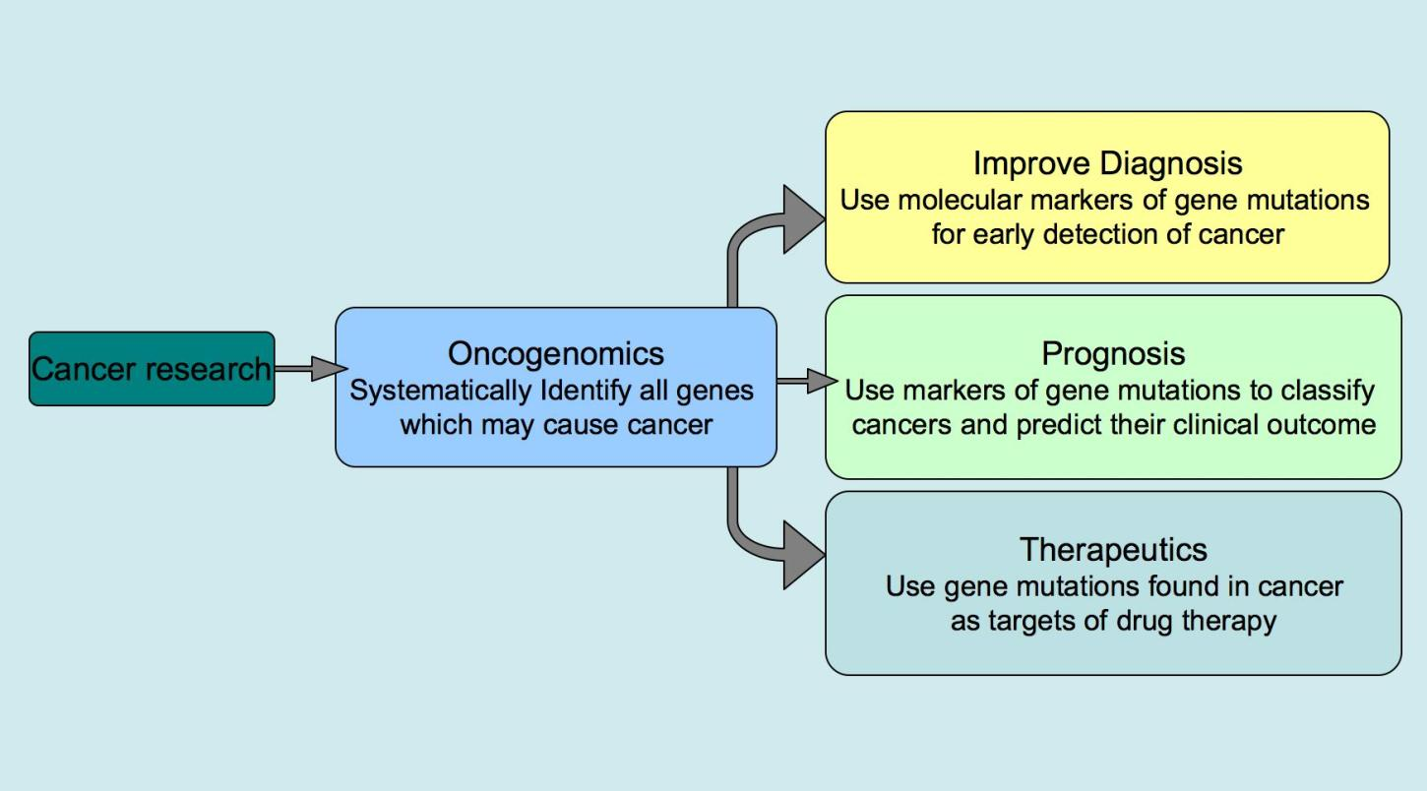
Genomics Education programme ASH 2023

Slide 5
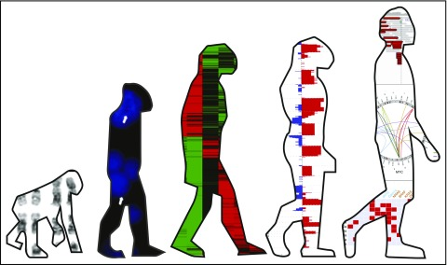
How has it evolved in the last 4 decades
Karyotype
FISH
Gene Expression profiling
NGS
Whole genome sequencing
Charlotte Pawlyn, Blood 2018

Slide 6

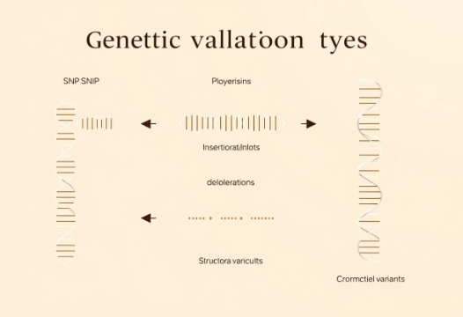

Foundations of Genomics
The human genome has 3 billion base pairs. It contains 20,000-25,000 genes. Genes create proteins, influencing traits and disease. Genetic variations include SNPs and indels. Epigenetics modifies gene expression.
DNA Structure
Genetic Variations
Epigenetic Changes
The blueprint of life, DNA holds all genetic instructions. It forms the core of genomic study.
Differences in DNA sequences lead to unique traits. These variations are key to personalized medicine.
Gene expression can change without altering DNA. This adds another layer of genetic control.

Slide 7
Key Techniques in Genomics
Genomics uses several powerful techniques. Next-Generation Sequencing reads DNA quickly. Microarrays detect gene expression. PCR amplifies DNA for analysis. CRISPR-Cas9 edits genes precisely.
Next-Gen Sequencing
Massively parallel DNA sequencing offers high throughput.
Microarrays
These detect gene expression and variations efficiently.
PCR
Polymerase Chain Reaction amplifies DNA for study.
CRISPR-Cas9
This tool enables precise and powerful gene editing.

Slide 8


Next-Generation Sequencing (NGS)
NGS uses platforms like Illumina and PacBio. It enables whole-genome sequencing (WGS). Whole-exome sequencing (WES) targets protein-coding regions. Targeted gene panels focus on specific diseases. RNA sequencing (RNA-Seq) analyzes gene activity.
Whole-Genome Sequencing
Targeted Sequencing
Sequencing an individual's entire genome for comprehensive insights.
Analyzes specific genes or regions related to particular diseases.
1
2
Whole-Exome Sequencing
RNA Sequencing
Focuses on protein-coding regions, which cause most genetic diseases.
Measures gene expression levels and identifies RNA variants.

Slide 9







Microarrays
Microarrays measure gene expression across the genome. They detect single nucleotide polymorphisms (SNPs). Applications include cancer subtyping and drug response prediction. Limitations include lower sensitivity compared to NGS. They are also probe-dependent.
Gene Expression
Measure activity of thousands of genes simultaneously.
Variant Detection
2
Identify single nucleotide changes for genetic insights.
Cancer Subtyping
Classify tumor types for personalized treatment strategies.
Drug Response
Predict how patients will react to specific medications.

Slide 10
Clinical Applications
Genomic medicine revolutionizes patient care. Oncology uses genomics for targeted therapies. Cardiology applies genetic risk scores. Neurology benefits from genomic diagnosis. Rare diseases receive personalized care.
1
Oncology
Precision treatments based on tumor genetic profiles.
2
Cardiology
Assessing heart disease risk and guiding prevention.
3
Neurology
Diagnosing and managing complex brain disorders.
4
Rare Diseases
Identifying root causes and offering personalized treatments.

Slide 11
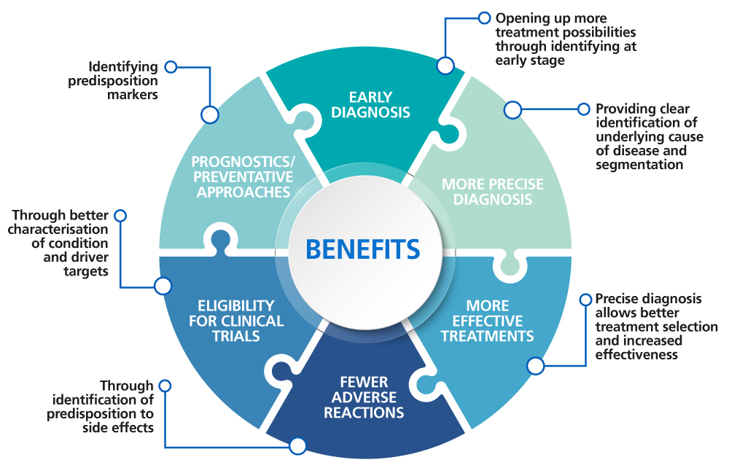
Integrating Genomics: Daily Hematology Practice
Genomic insights are now crucial. They transform routine patient management in hematology. This shift enhances diagnostic accuracy and personalized care.

Slide 12
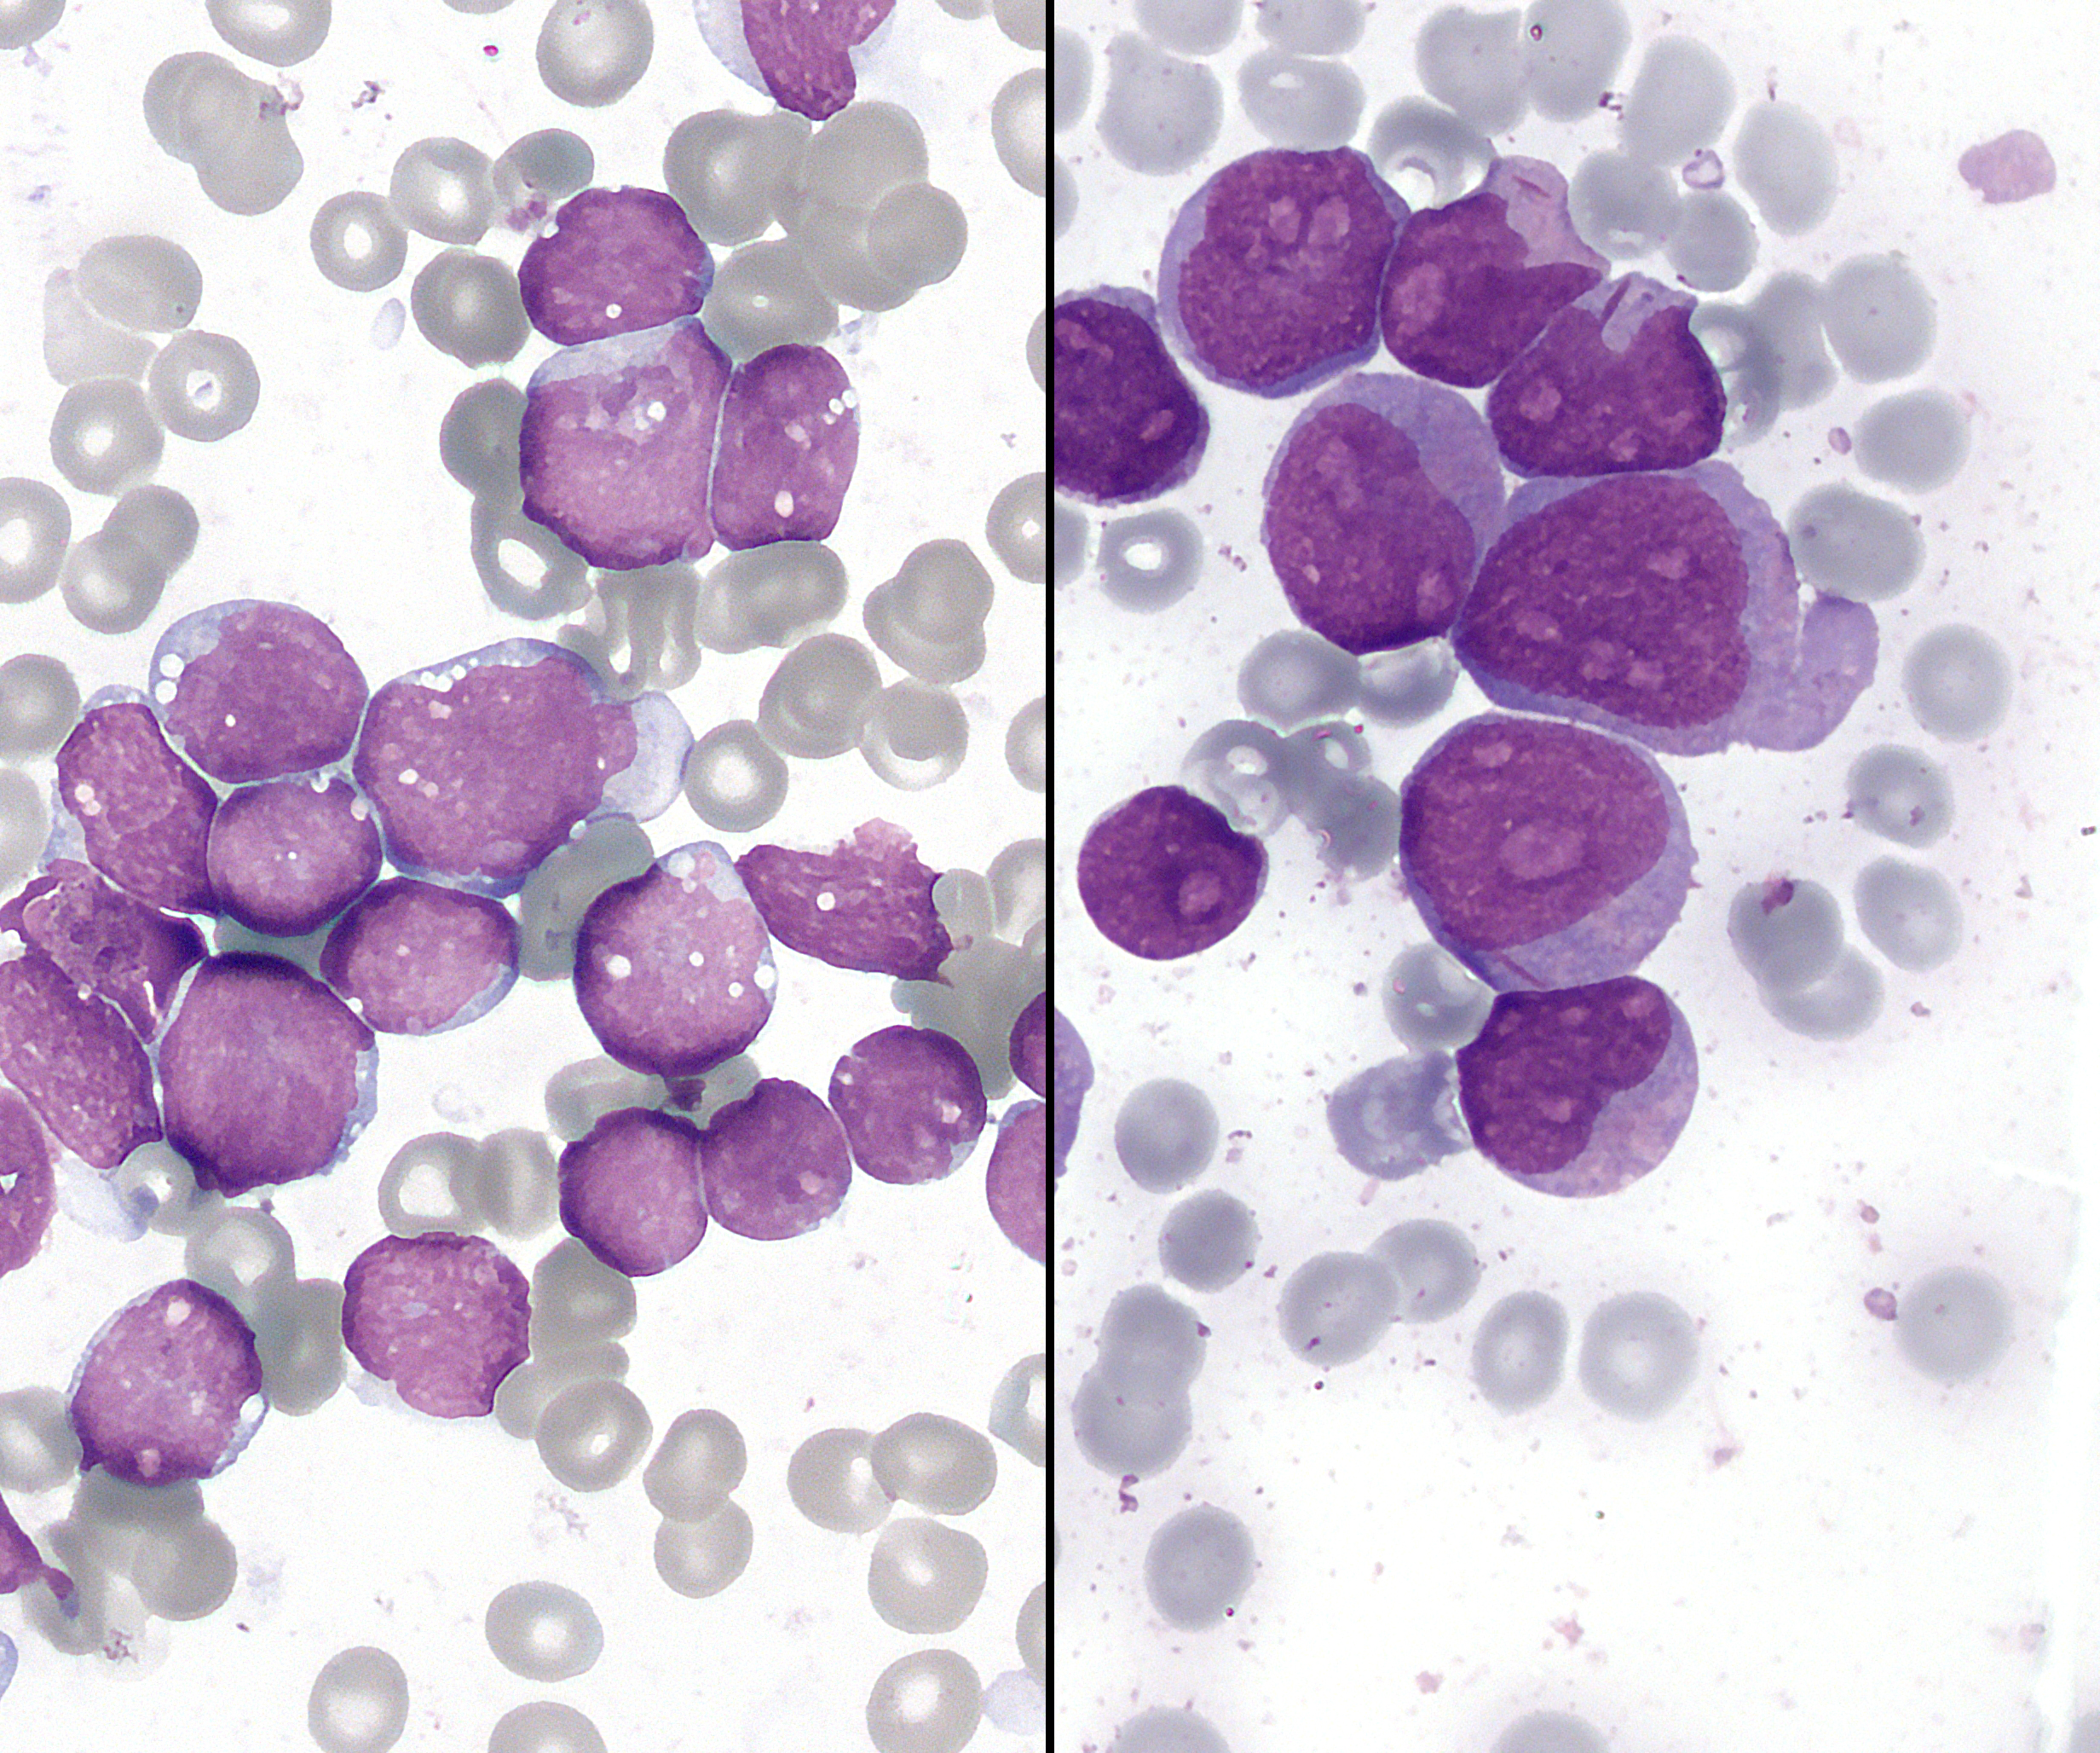
Genomics in Haematological Malignancies
Genomics plays a crucial role. It aids in diagnosing blood cancers. It helps classify subtypes accurately. Genomic analysis informs treatment choices. It also predicts patient prognosis. This precision helps improve patient outcomes.
Diagnosis
Identify specific genetic mutations driving the cancer.
Risk Stratification
Determine aggressive vs. indolent disease types.
Leukemia, Wikipedia Images
Targeted Therapy
Select drugs that specifically attack cancer mutations.

Slide 13
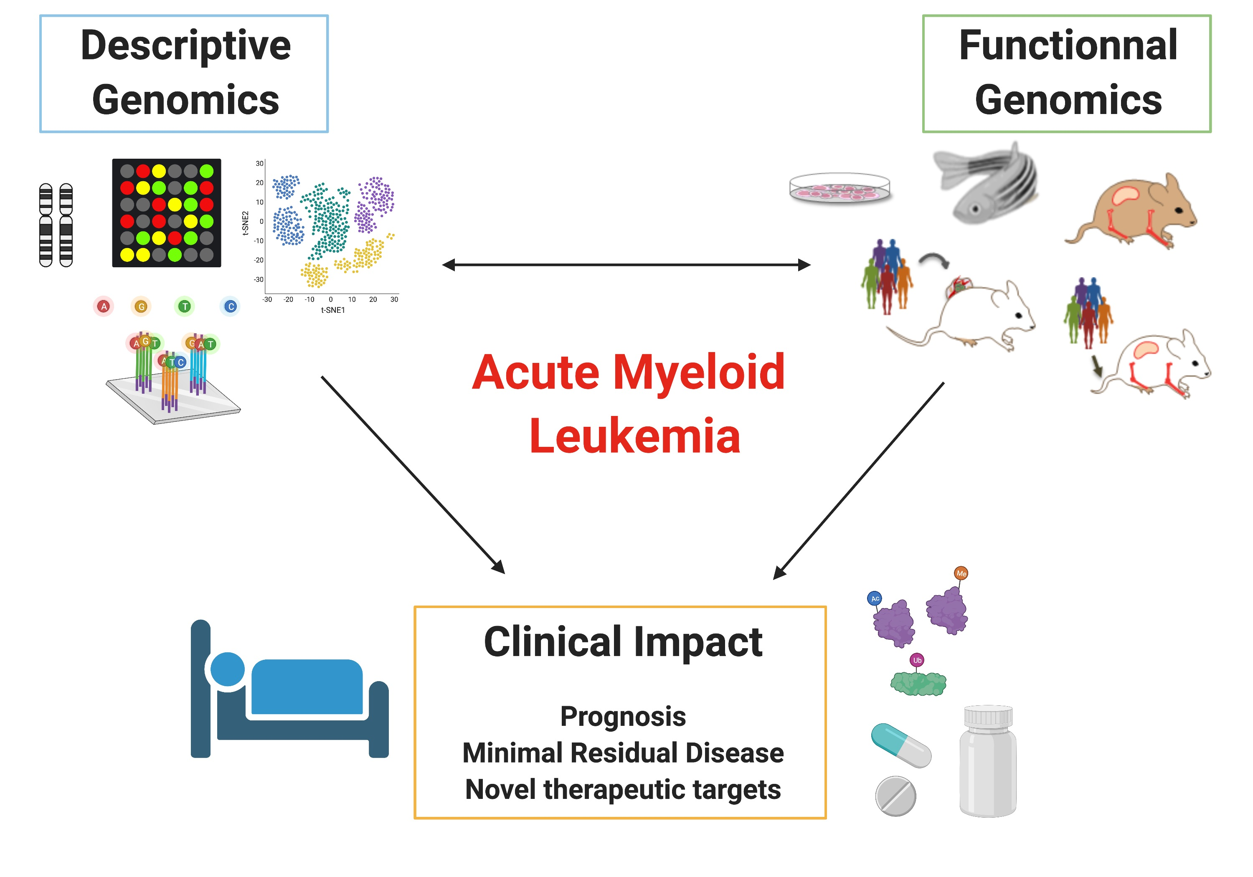




Genomic Techniques in Leukemia Management
Genomic techniques revolutionize leukemia management. NGS identifies specific mutations. This guides targeted therapy decisions. Monitoring minimal residual disease (MRD) is key. CRISPR offers potential for future treatments. These methods significantly improve patient care.
Mutation Detection
NGS identifies specific genetic changes in leukemia cells.
Treatment Guidance
Genetic profiles direct selection of targeted drugs.
MRD Monitoring
Tracking minimal residual disease for relapse prevention.
Novel Therapies
CRISPR and other gene editing for future interventions.

Slide 14
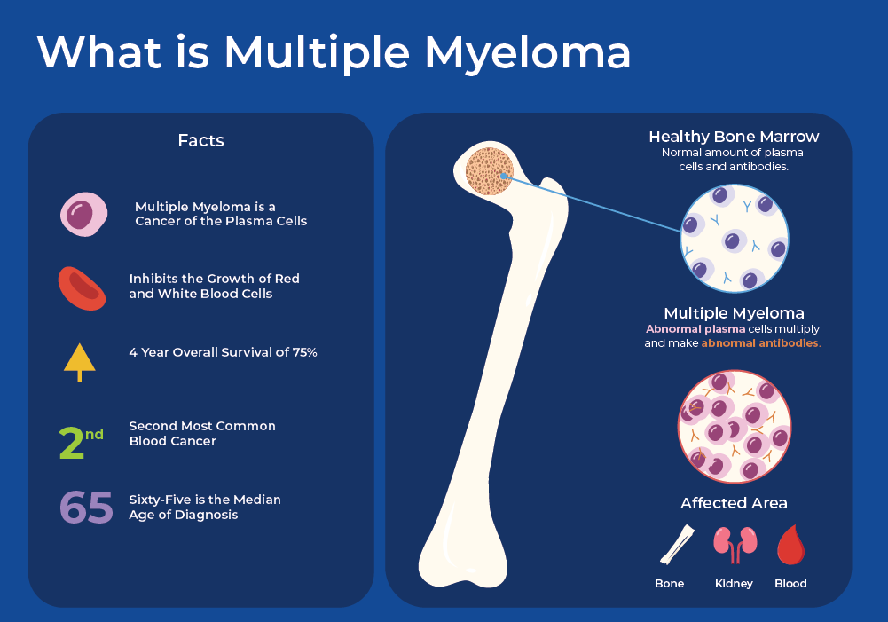



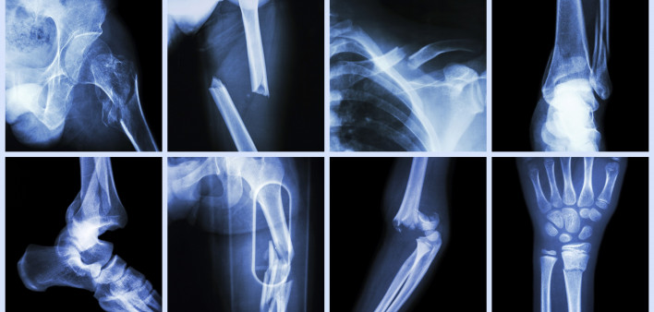

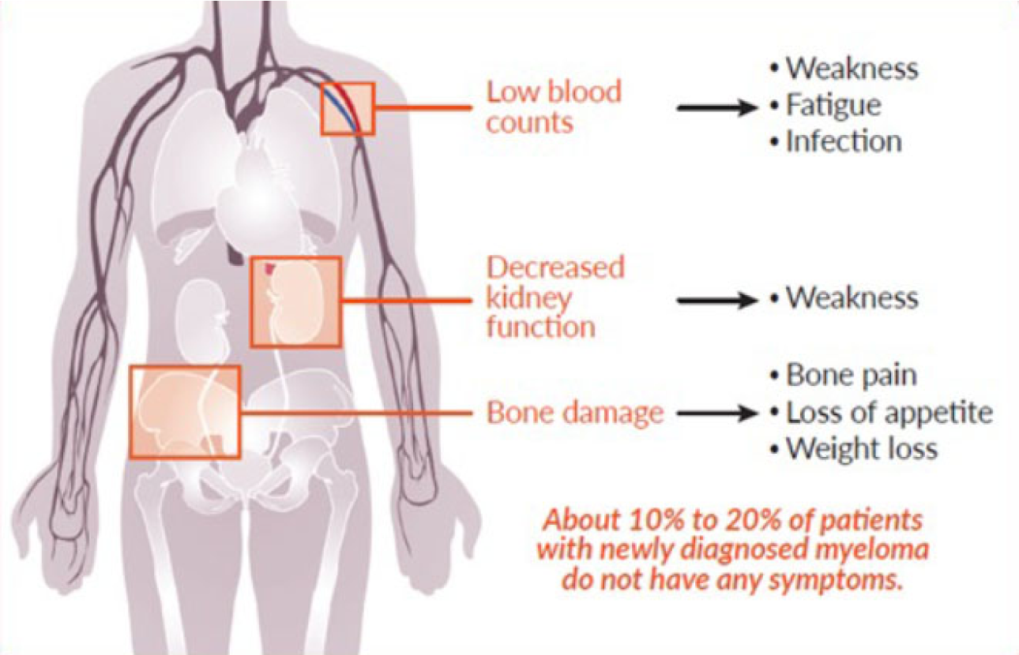
Genomics in Myeloma
Genomic insights are transforming multiple myeloma care. They enable a personalized approach for patients.
Precise Diagnosis
Risk Stratification
Targeted Treatment
Identify specific genetic mutations. This leads to accurate disease classification.
Assess disease aggressiveness. Predict patient outcomes and inform prognosis.
Guide selection of personalized therapies. Drugs can specifically attack cancer mutations.
Disease Monitoring
Track treatment response. Detect minimal residual disease post-treatment.

Slide 15

Myeloma FISH: Guiding Therapy
Fluorescence In Situ Hybridization provides critical insights for myeloma. It precisely identifies genetic abnormalities in cells. This informs tailored treatment strategies. It helps predict patient responses.

Slide 16
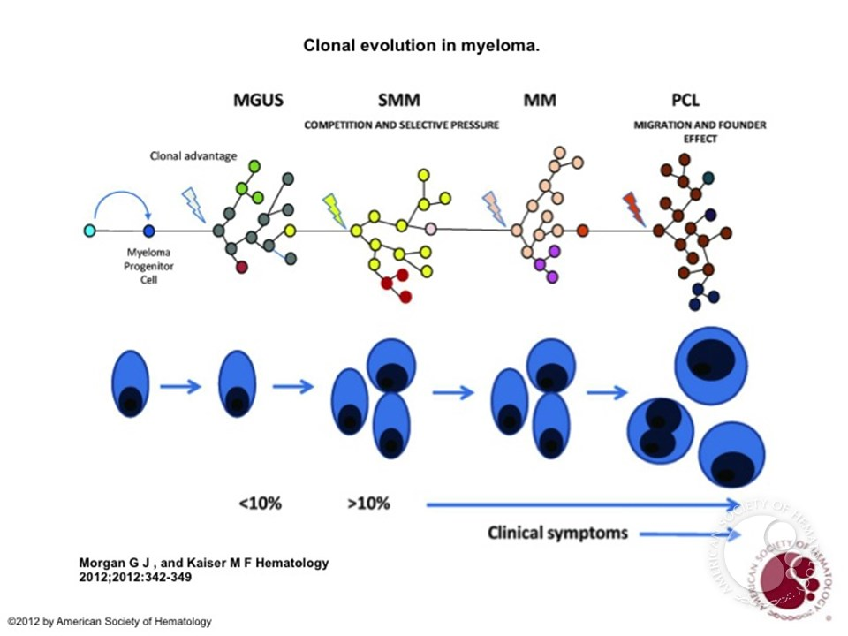
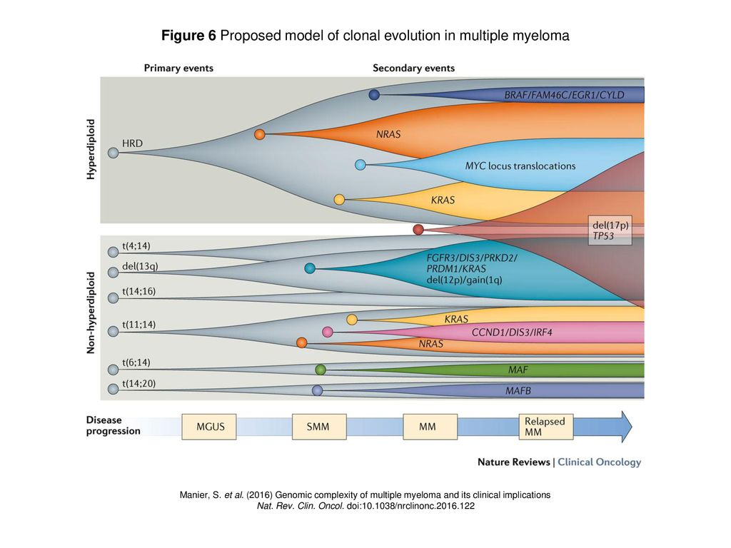
Understanding myeloma
through genomics

Slide 17
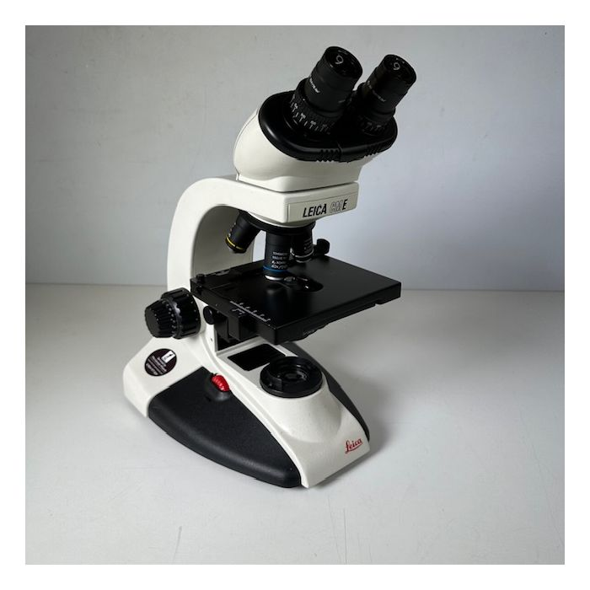
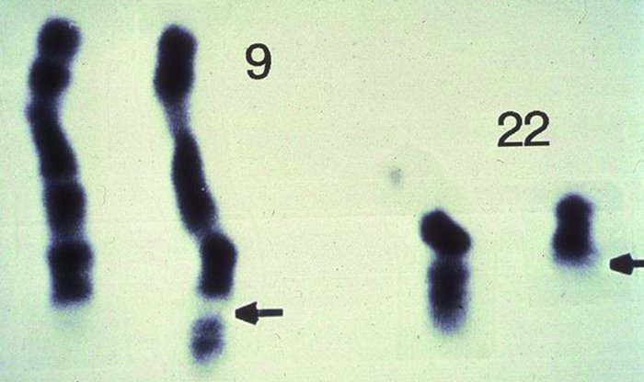
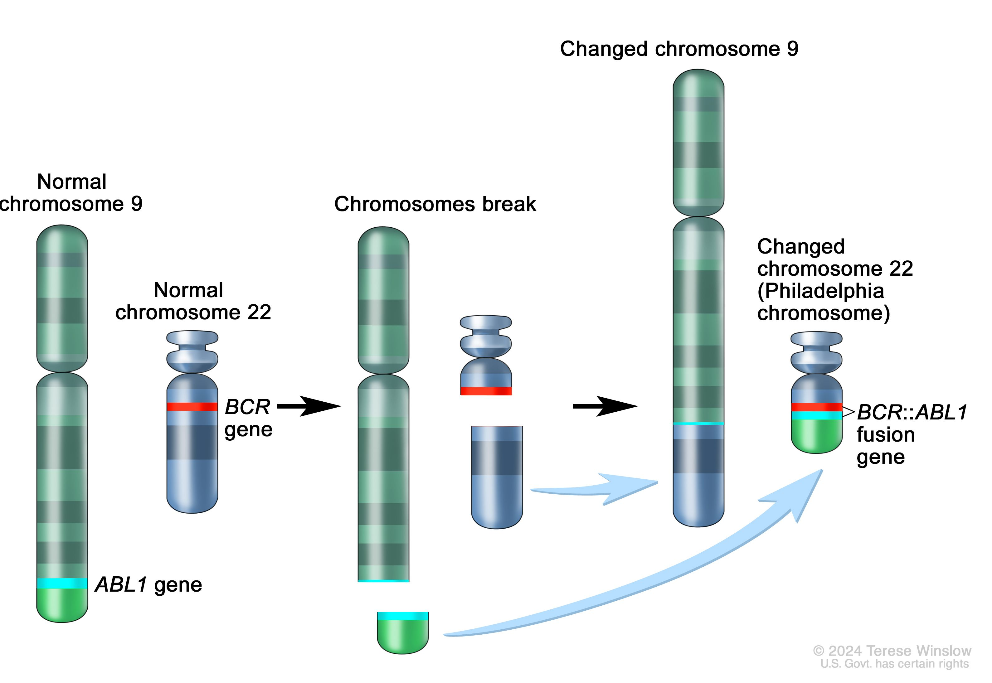
CML
Philadelphia chromosome

Slide 18







Molecular Monitoring in CML Response
Precise monitoring guides chronic myeloid leukemia (CML) treatment. It tracks disease progression and response. This hierarchical approach ensures optimal patient management.
Deep Molecular Response (DMR)
Achieving very low BCR-ABL1 levels. Indicates excellent long-term treatment success.
Major Molecular Response (MMR)
Significant reduction in BCR-ABL1 transcripts. This is a key therapeutic milestone.
Complete Cytogenetic Response (CCyR)
3
No Philadelphia chromosome detected. An important early treatment milestone.
Hematologic Response (HR)
Normalization of blood counts. This is the initial clinical treatment goal.

Slide 19
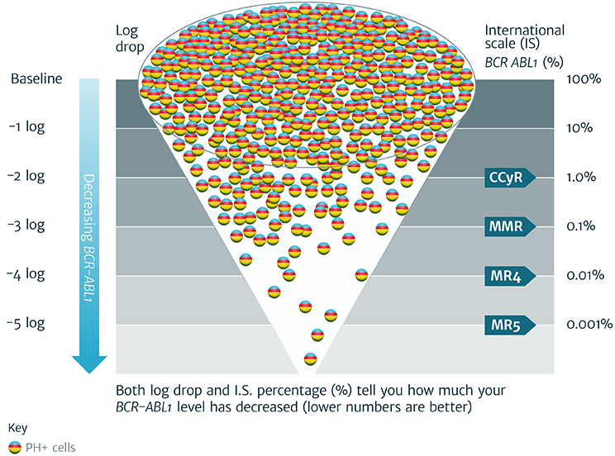
Mutation Testing in CML

Slide 20
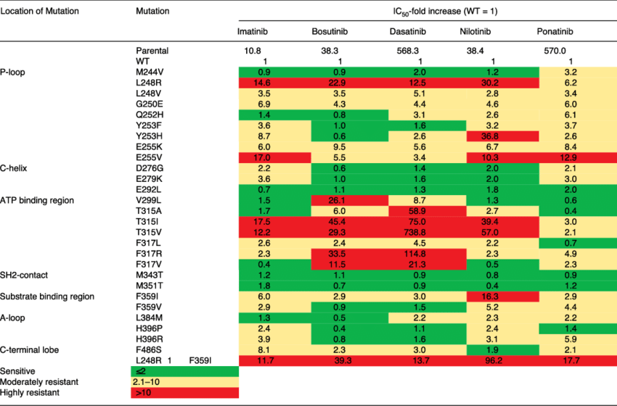
Mutation Testing in CML
Mutation testing is crucial for managing chronic myeloid leukemia (CML). It identifies changes impacting treatment response. This informs personalized therapeutic decisions.
Detect Resistance
Identify BCR-ABL1 kinase domain mutations. These confer resistance to tyrosine kinase inhibitors (TKIs).
Guide Therapy
Inform selection of alternative TKI therapies. Optimize treatment strategies for patients.
Predict Outcome
Assess prognostic implications of specific mutations. Anticipate disease progression risk.
Monitor Disease
Track emergence of new mutations over time. Detect early signs of treatment failure.

Slide 21
CML Mutation Testing: Then and Now
Past Methods
Current Approaches
Early CML mutation testing relied on direct sequencing. This method was labor-intensive. It often lacked high sensitivity for rare variants.
Today, Next-Generation Sequencing is standard. It provides rapid, comprehensive analysis. This approach detects low-level mutations with high precision.

Slide 22
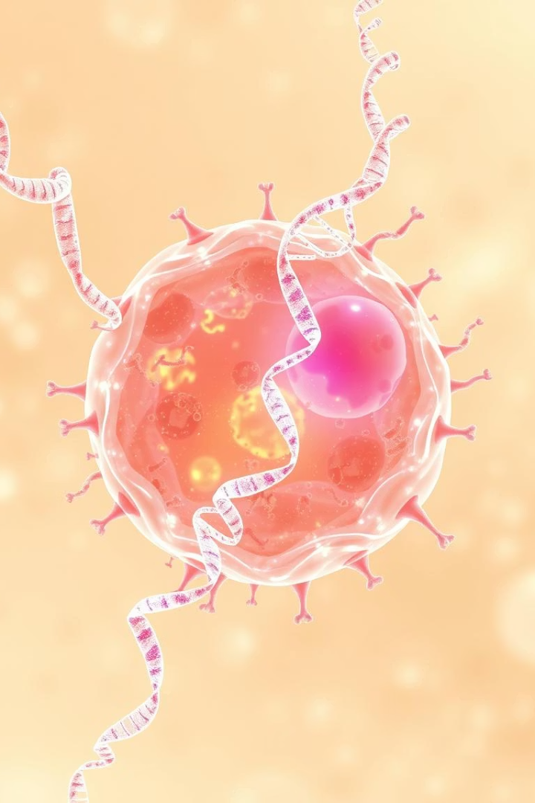
Gene Expression Profiling in Lymphoma
This advanced technique provides deep insights into the molecular characteristics of lymphoma. It helps classify subtypes and predict treatment response. Understanding gene activity guides precision medicine strategies.

Slide 23

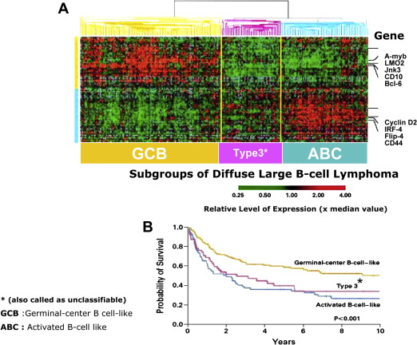
GEP in High-Grade Lymphoma
Gene Expression Profiling (GEP) refines diagnosis for high-grade lymphomas. It distinguishes aggressive subtypes like DLBCL. This helps tailor treatment strategies.
GEP reveals unique molecular signatures. These insights predict disease behavior. It guides personalized therapeutic approaches for improved patient outcomes.

Slide 24
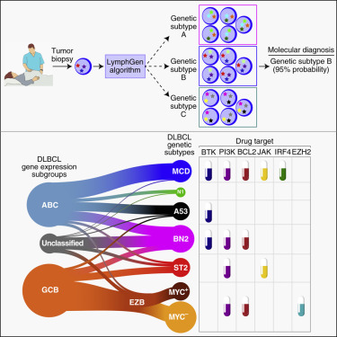
How does genomic info translate into better therapeutics?

Slide 25




CLL Genomics: Driving Better Outcomes
Precise Profiling
Genomic tests identify specific mutations in CLL patients.
Improved Prognosis
Detailed profiles help predict disease progression more accurately.
Tailored Treatments
Insights guide selection of highly effective targeted therapies.
Enhanced Monitoring
Genomics track treatment response and minimal residual disease.

Slide 26
AML MRD Monitoring
Early Detection
Treatment Guidance
Identify minimal residual disease. This is crucial for relapse prevention.
Inform therapy adjustments. It helps optimize patient management.
Relapse Prediction
Personalized Care
Pinpoint high-risk patients. This enables timely intervention.
Tailor post-remission strategies. This improves long-term outcomes.

Slide 27
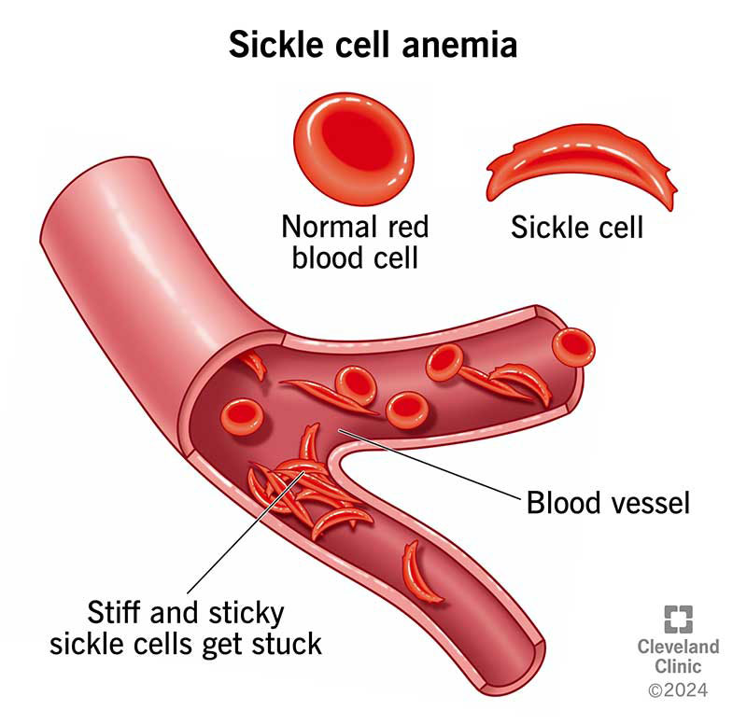
Genomics in Sickle Cell Disease
Genomic advancements are transforming sickle cell care. They offer insights for diagnosis and personalized treatments. This precision approach improves patient outcomes.

Slide 28

Gene Editing for Sickle Cell Disease
Gene editing offers revolutionary potential. It directly targets the genetic cause of sickle cell. This approach could lead to curative therapies.

Slide 29
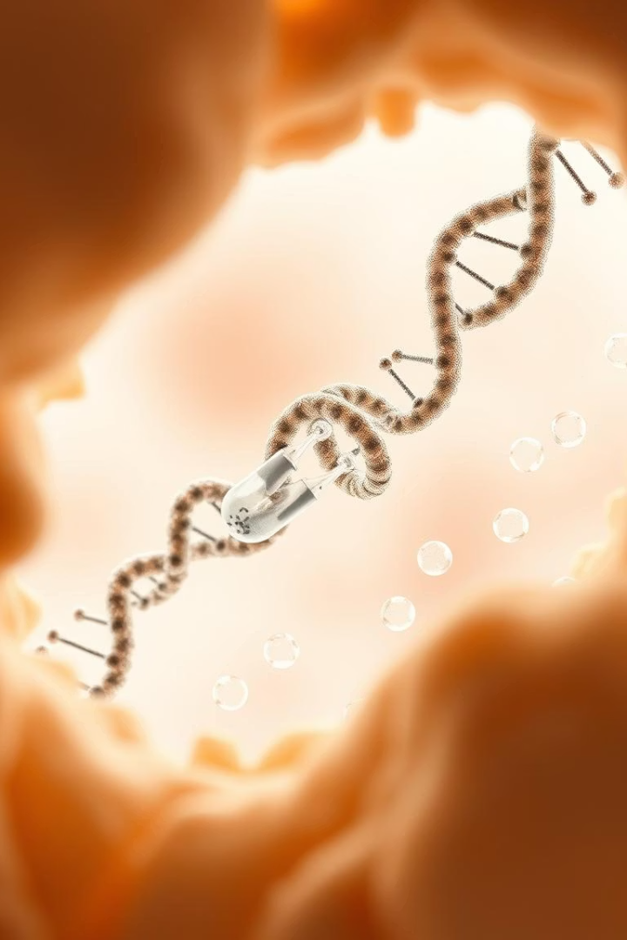
Gene Therapy for Hemophilia
Gene therapy offers a promising new approach. It corrects the genetic defect. This provides long-term benefits.
Targeted Correction
Sustained Factor Production
Delivers functional gene copies. Addresses the genetic cause.
Enables continuous clotting factor production. Reduces frequent infusions.
Improved Quality of Life
Minimizes bleeding episodes. Enhances patient daily living.

Slide 30



Genomics in Hematology: A Multifaceted Impact
Precise Diagnosis
Prognostic Insights
Identifies genetic markers for blood disorders. This enables earlier and more accurate disease identification.
Predicts disease progression and outcomes. It helps in assessing risk for personalized care planning.
Targeted Therapy
Research Advancement
Guides selection of specific treatments. Tailors therapies for optimal patient response and efficacy.
Uncovers underlying disease mechanisms. Accelerates the development of novel interventions and cures.

Slide 31





Ethical Considerations of Genomics in Haematology
Genomic advancements bring complex ethical challenges. Careful management ensures responsible innovation.
Data Privacy
Informed Consent
Equitable Access
Protecting sensitive genetic information is paramount.
Patients must fully understand treatment implications.
Ensure fair distribution of advanced genomic therapies.
Incidental Findings
Managing unexpected genetic discoveries requires clear protocols.

Slide 32
Personalized Medicine Costs
Personalized medicine offers transformative care. Its specialized nature brings unique economic considerations.
High Upfront Investment
Accessibility Challenges
Research, development, and unique therapies are costly.
High costs limit patient access globally.
Long-Term Value
Economic Models
Initial expense can reduce overall healthcare burden.
New payment strategies are evolving to support innovation.

Slide 33








The Future of Genomic Medicine
Genomics will integrate into routine clinical practice. AI and machine learning will enhance data analysis. Personalized prevention and wellness strategies will emerge. Ethical, legal, and social implications (ELSI) remain vital considerations.
Clinical Integration
AI & ML
Genomics becoming a standard part of patient care.
Advanced algorithms for genomic data interpretation.
ELSI
Personalized Wellness
Addressing ethical, legal, and social challenges.
Custom health strategies based on individual genetic risks.

Slide 34
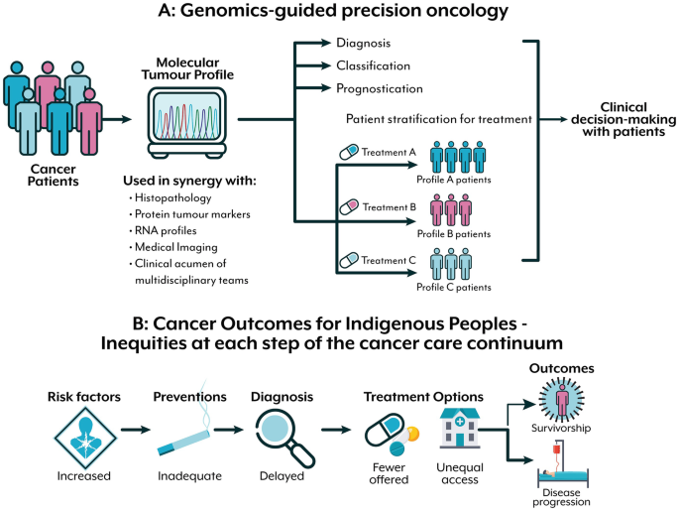
Does this widen existing health inequalities?
Kimiora et al, 2024

