Slide 1

The role of Genomics in treatment planning
1
1

Slide 2
Contents
1. Genomics and treatment
2. Tumour specific examples
3. Variation impacting treatment
4. Genomics Toolkit
5. Where to find resources

Slide 3

Genomics can provide deep insight on a cancer and its treatment.
Genomics is rapidly becoming an integral part of cancer care. Its clinical significance will only increase in time, transitioning into a central pillar of routine cancer treatment.
Genomics testing can provide :
Predictive markers to guide treatment choices and avoid toxicity.
Response markers to determine the efficacy of various treatments.
3
Notes:
Genomics is rapidly becoming an integral part of cancer treatment. Its clinical significance will increase over time as new treatments are all targeted therapies, and with it being within the 10-year plan, so genomics is likely to transition into a central pillar of routine cancer treatment. There are a range of markers that can guide which treatments will work best for a person and how to minimise adverse reactions and we will explore some of these later. However, I wanted to point out that genomics’ is often used as shorthand for a lot of other tests which aren’t officially ‘genomic’ or in the directory but equally support treatment decisions. Biomarker tests which are not officially ‘genomic’ are conducted by regional labs and in-house team in hospitals but there is a plan to integrate histologic and genomic testing pathways with data on turn around times . Its important to ensure that important testing is not inadvertently excluded by using the language of ‘genomics’, being misinterpreted and systems/funding/prioritisation only focusing on what is delivered by the Genomic Laboratory Hubs.

Slide 4
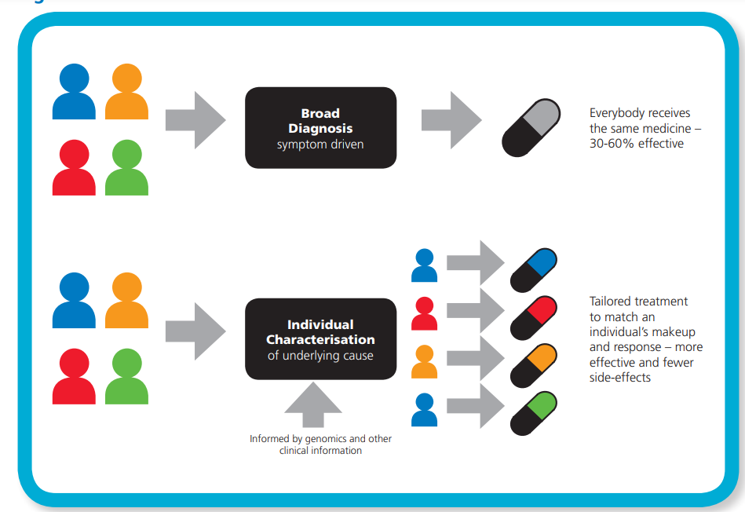
Genomics moves treatment from a one size fits all approach to an understanding that provides population insight and benefit as well as allowing precise treatment for an individual based on their cancer and its genomic profile
4
Notes:
Genomics moves treatment from a one size fits all approach to cancer to an understanding of the cancer at person level allowing personalised treatments based on the individual and their cancer’s own molecular profile.

Slide 5







Biomarker testing is a key enabler in the shift towards precision medicine, which is important in improving cancer patient outcomes and experience
Ideal scenario
We know there are barriers
Patient
Cancer diagnosis
Biomarker testing
Biomarker-guided treatment
✗
1
✗
Patients are given the best treatment when biomarker testing is available
2
3
5
Notes:
Biomarker testing is a key enabler in the shift towards precision medicine, which is important in improving cancer patient outcomes and experience across the pathway by improving effective, timely treatments based on a more precise diagnosis.

Slide 6
For some people, genomics and precision medicine has the potential to radically improve their outcomes.
People will be diagnosed earlier, for some, even before the cancer has developed.
People will know their lifetime risk of cancer (and for some, be able to take action to prevent it).
People will understand what drives their cancer and which treatments will work best.
People will have less invasive and more accurate real-time monitoring to track recurrence (e.g. liquid biopsies).
Most people will experience less side effects from their treatment.
People will live longer (with more progression free years) and for some, there will be treatment options where there were none.
6
Notes:
As stated For some people, genomics and precision medicine has the potential to radically improve their outcomes if the potential of genomics is realised and fully implemented.
For example:
People will be diagnosed earlier, for some, even before the cancer has developed if hereditary risk testing is implemented widely.
Then, People will know their lifetime risk of cancer (and for some, be able to take action to prevent it).
People will understand what drives their cancer and which treatments will work best.
People will have less invasive and more accurate real-time monitoring to track recurrence (e.g. liquid biopsies).
Most people will experience less side effects from their treatment.
People will live longer (with more progression free years) and for some, there will be treatment options where there were none.

Slide 7
Why does biomarker (genomic) testing matter?
Notes:
a naturally occurring molecule, gene, or characteristic by which a particular pathological or physiological process, disease, etc. can be identified. They are found in blood, other body fluids, tumours or tissues, help doctors understand what's happening in the body and can be used to diagnose disease, track its progression, predict prognosis, or guide drug development and treatment decisions
not all biomarkers are genomic tests, as a biomarker can be any measurable indicator of a biological state, including non-genomic markers like protein expression, cell surface proteins, and other molecular or physiological characteristics. Genomic testing focuses specifically on analyzing the DNA or RNA makeup of a sample to find alterations like mutations, fusions, or gene expression levels

Slide 8
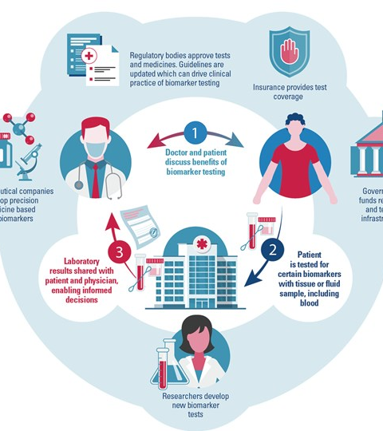
BIOMARKERS
Genomic Biomarkers:
These look at the genetic material (DNA or RNA) of a tumor or other cells to identify specific changes, such as mutations, gene alterations, or gene expression levels.
Non-Genomic Biomarkers:
These are also measurable substances but are not derived from the genetic code itself. Examples include:
Protein expression:
Analyse specific proteins which can predict response to immunotherapy, or proteins involved in liver function.
Cell markers:
Identify specific types of cells or proteins on the surface of cells, such as the CD4 protein found on T-lymphocytes.
Physiological markers:
Other molecular characteristics that are not part of the genome.

Slide 9
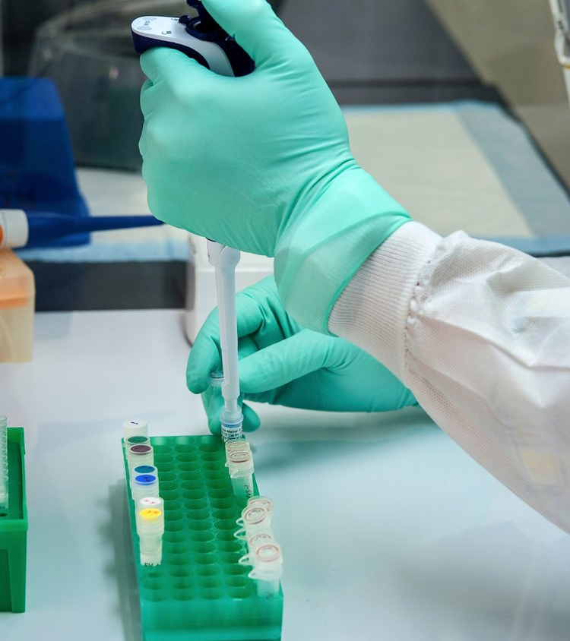
Biomarker testing matters in cancer treatment because it reveals a tumour's unique molecular profile, allowing doctors to select the most effective treatments, avoid unnecessary or ineffective ones, and participation in relevant clinical trials. This approach, known as precision medicine
Identifying Targets:
Biomarker testing analyses a tumour sample (from tissue, blood, or other fluids) for specific genes, proteins, or other molecules
Personalised Treatment Selection:
Based on the identified biomarkers, doctors can determine which targeted therapies or immunotherapies are most likely to be effective for that specific tumour
Precision Oncology:
It enables precision treatments by matching specific drugs to the unique molecular features of a patient's cancer.
By targeting treatments to the root cause of the cancer, it can lead to better treatment responses and overall patient health
Notes:
Biomarker testing matters in cancer treatment because it reveals a tumour's unique molecular profile, allowing doctors to select the most effective treatments, avoid unnecessary or ineffective ones, and participation in relevant clinical trials.
Biomarker testing analyses a tumour sample (from tissue, blood, or other fluids) for specific genes, proteins, or other molecules
Based on the identified biomarkers, doctors can determine which targeted therapies or immunotherapies are most likely to be effective for that specific tumour
This enables precision treatments by matching specific drugs to the unique molecular features of a patient's cancer.
By targeting treatments to the root cause of the cancer, it can lead to better treatment responses and overall patient health

Slide 10



Clinical trials and the Future of Cancer Biomarkers
Notes:
Researchers are now focusing on how best to treat cancer based on biomarkers by investigating many biomarkers in clinical trials. The major clinical trials underway based on biomarkers are:
NCI-MATCH Trial - MATCH enrolled people with advanced solid tumors, lymphoma, or myeloma that progressed on standard treatment or people with a rare cancer for which there is no standard treatment. This trial showed that people with advanced cancer may benefit from genomic sequencing to help plan their treatment.
Lung-MAP designed to quickly and efficiently test new treatments for advanced non-small cell lung cancers. Launched in 2014 with a focus on squamous cell lung cancers, the trial expanded to include all histologic types of non-small cell lung cancers in 2019 and has registered more than 5,000 patients. Lung-MAP gives broad access throughout the United States to investigational treatments for lung cancer.
In 2024, genomic testing options for the trial were broadened significantly
TAPUR Study .- uses precision medicine to test off-label treatments for different types of cancers. To match a patient to a treatment option using genomic testing to identify gene alterations
The increasing use of biomarkers in cancer care is an exciting advance in personalised medicine in cancer and improved outcomes for patients. Researchers are working hard to improve biomarker testing and to understand how the information gained from biomarker testing can be used across all tumor types; this presents a radically new approach to patient care that is focused on personalized care of each individual patient.
Biomarker research is led from the Cancer Research UK Manchester Institute Cancer Biomarker Centre (CBC)

Slide 11
Some tumour specific examples

Slide 12
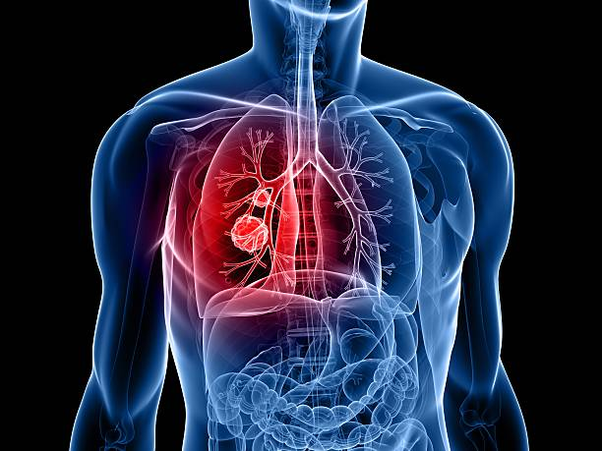
Lung Cancer
Somatic gene variants (mutations) found in lung cancer include EGFR, ALK, MET, ROS1, BRAF, RET, KRAS, NTRK, PD-L1 and HER2.
There are targeted treatments for patients diagnosed with EGFR mutated, ALK or ROS1 rearranged NSCLC which can greatly improve outcomes
Notes:
Molecular testing to assess for somatic mutation is available to patients diagnosed with advanced stage non-small cell lung cancer (NSCLC). There are targeted treatments for patients diagnosed with EGFR mutated, ALK or ROS1 rearranged NSCLC which can greatly improve outcomes. In addition, there are multiple other mutations which may be investigated in individual patients.

Slide 13
Non-Small Cell Lung Cancer
Multitarget NGS panel small variant – EGFR, ALK, BRAF, KRAS, MET
All NSCLC eligible, with selected squamous
cell with clinical features consistent with higher likelihood of a targeted mutation – e.g., non-smokers younger than 50 years old
Multitarget panel with structural variant – ROS1, RET, EML4-ALK, NTRK1, NTRK2, NTRK3, MET
EGFR hotspot tumour
Multitarget NGS panel – MET
If molecular assessment will aid diagnosis or management.
RS01 rearrangement
RET rearrangement
EGFR hotspot ctDNA
If biopsy unavailable and detecting EGFR in
ctDNA if patient eligible for tyrosine kinase
inhibitor.
ALK hotspot ctDNA
All NSCLC eligible. Mutation, knowledge of
ALK mutations would alter management

Slide 14

Small Cell Lung Cancer Mesothelioma
Multitarget NGS panel RB1
CDKN2A
When making a diagnosis not possible via routine morphological or radiological criteria.
Diagnostic uncertainty re
mesothelioma or benign or reactive
mesothelial proliferations
Multitarget panel NTRK1, NTRK2, NTRK3
Multitarget NGS panel NTRK1,
NTRK2, NTRK3
Clinical status means eligible for NTRK inhibitor if NTRK variation detected.
Clinical status means eligible for NTRK
inhibitor if NTRK variation detected.
Multitarget NGS panel (CDKN2A)
Diagnostic uncertainty re
mesothelioma or benign or reactive
mesothelial proliferations.
Notes:
Other somatic markers
PDL
TMB
HER2
Only about 8% of lung cancers run in families. For people who have two or more first-degree relatives (brothers, sisters, parents or children) who developed lung cancer, the chances of developing lung cancer are even higher.
However, there is currently no formal indication for germline genomic testing for patients with lung cancer.
So lung cancer patients at a young age should be asked about family history of Li-Fraumeni related cancers – soft tissue sarcoma, adrenocortical carcinoma, choroid plexus cancer, premenopausal breast cancer, brain cancer and childhood cancer. Those meeting the Chompret criteria may be eligible for genomic testing of the TP53 gene after appropriate counselling.
Some researchers suggest that there is an increased lung cancer risk in those with pathogenic variants in BRCA2 or other cancer susceptibility genes, but further data is required to clarify disease association.
Whilst somatic testing in lung cancer is well established the inherited component to lung cancer is less well understood and complex.

Slide 15
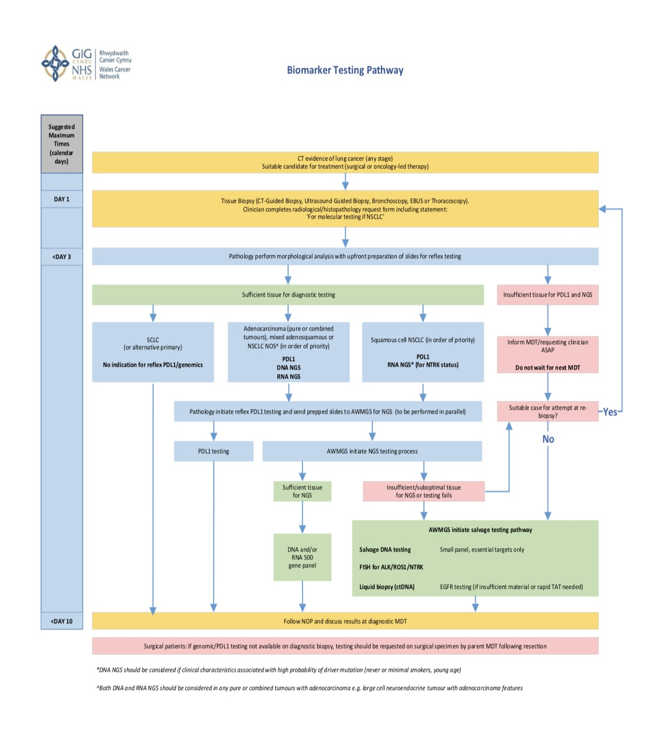
All Wales Lung cancer Biomarker Testing Pathway
The process is designed to standardise and accelerate the testing protocol to provide patients with more rapid access to targeted therapies
Based on the All Wales Non-small cell lung cancer (NSCLC) biomarker testing pathway, biomarker testing is initiated automatically (via a process called reflex testing) after a histopathological diagnosis has been made from a tissue biopsy

Slide 16
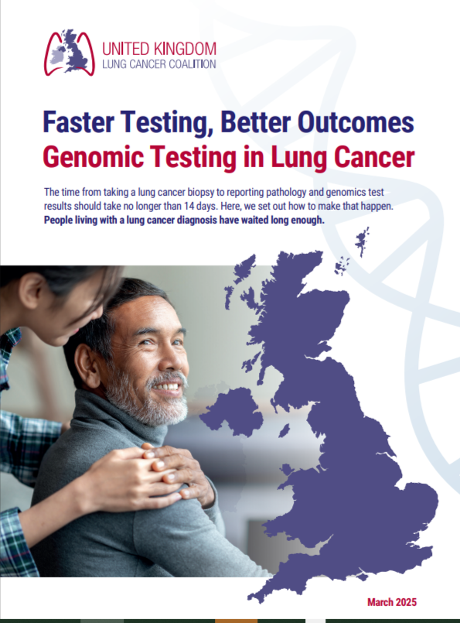
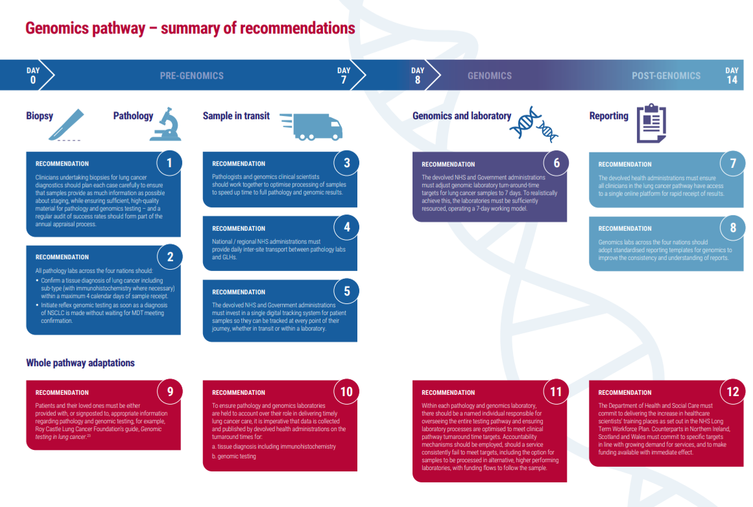

Slide 17
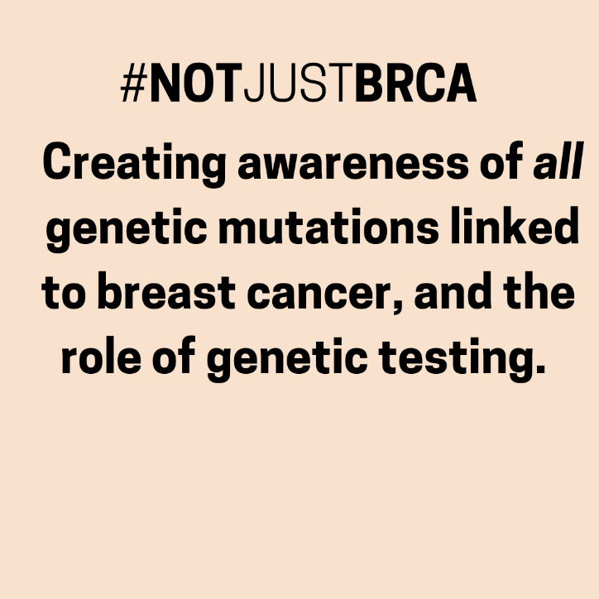


Both sisters have a PALB 2 alteration.
Donna has had breast cancer and Jade has had risk –reducing surgery

Slide 18
Breast cancer biomarker testing
Biomarker testing for breast cancer analyses a tumour's unique genes and proteins to personalize treatment, guiding the selection of targeted therapies, hormonal therapies, or immunotherapies that are more likely to be effective for a patient's specific cancer.
Key breast cancer biomarkers include:
Estrogen Receptor (ER) and
Progesterone Receptor (PR) status for hormone-sensitive cancers HER2 and PD-L1 status for other treatment approaches.
Testing can be comprehensive, such as using Next-Generation Sequencing (NGS), to identify multiple genetic changes and inform treatment choices for a more precise and effective outcome
Notes:
Hormone Receptor-Positive (ER-Positive) vs. ER-Negative:ER-Positive: These cancers have the ER protein and are fueled by estrogen, making them candidates for hormone therapy.
ER-Negative: These cancers lack the ER protein and do not respond to estrogen, and are more likely to be treated with chemotherapy

Slide 19
What are the Breast Cancer Susceptibility Genes?
Breast cancer susceptibility genes are a group of genes that protect the body from developing a breast cancer, usually through correcting DNA mistakes and repairing DNA copies.
Breast cancer
PALB2
Precision treatment options may be available for patients with cancers that have pathogenic PALB2
BRCA1 & BRCA2
These gene mutations make tumours more sensitive to PARP inhibitors and platinum-based chemotherapy, enabling more targeted treatments.
CHEK2
CHEK2 mutations have varied implications in breast cancer treatment, potentially affecting response to certain chemotherapies and hormonal therapies in specific patient groups. Some studies indicate resistance to anthracycline-based chemotherapy, while others suggest potential sensitivity to platinum and alkylating agents. May benefit from PARP inhibitors. May respond better to immunotherapy, such as PD-1 inhibitors, or that combining CHEK2 inhibitors with existing immunotherapies could enhance their effects
Notes:
Breast cancer susceptibility genes are a group of genes that protect the body from developing a breast cancer, usually through correcting DNA mistakes and repairing DNA copies.
If there’s a pathogenic change in one of these genes, it means they won’t be able to function properly. With a gene not working properly, some of that protection against cancer is lost.
Over time, DNA mistakes can accumulate which puts someone with a change in one of these genes at risk of developing breast and other related cancers over their lifetime.
Mutation may affect your treatment options or eligibility for clinical trials studying which treatments work best

Slide 20
ATM
Can lead to increased genomic instability, which may enhance the response to immunotherapy in some breast cancer patients. ATM deficiency can make tumour cells resistant to chemo-radiation therapy, but this also suggests ATM-targeted therapies, such as ATR-Chk1 cascade inhibitors, could overcome resistance in these tumours. Radiation decisions should consider the patient's specific ATM variant status. As deficiency can lead to sensitivity to ionizing radiation.
RAD51C
High RAD51C expression in tumours is associated with poorer survival. suggesting it may serve as a prognostic marker for disease severity. PARP inhibitors and other DNA-damaging agents may be effective in tumours withRAD51C mutations. ER-positive breast cancers , high RAD51C expression could indicate increased genomic instability and worse outcomes. Pathogenic variants in RAD51C are associated with an increased lifetime risk of breast cancer, contributing to hereditary breast and ovarian cancer syndromes.
RAD51D
RAD51D mutations are more strongly linked to triple-negative and high-grade breast cancers, and may lead to poorer outcomes. Mutations in RAD51D can make cancers more sensitive to treatments like PARP inhibitors.

Slide 21
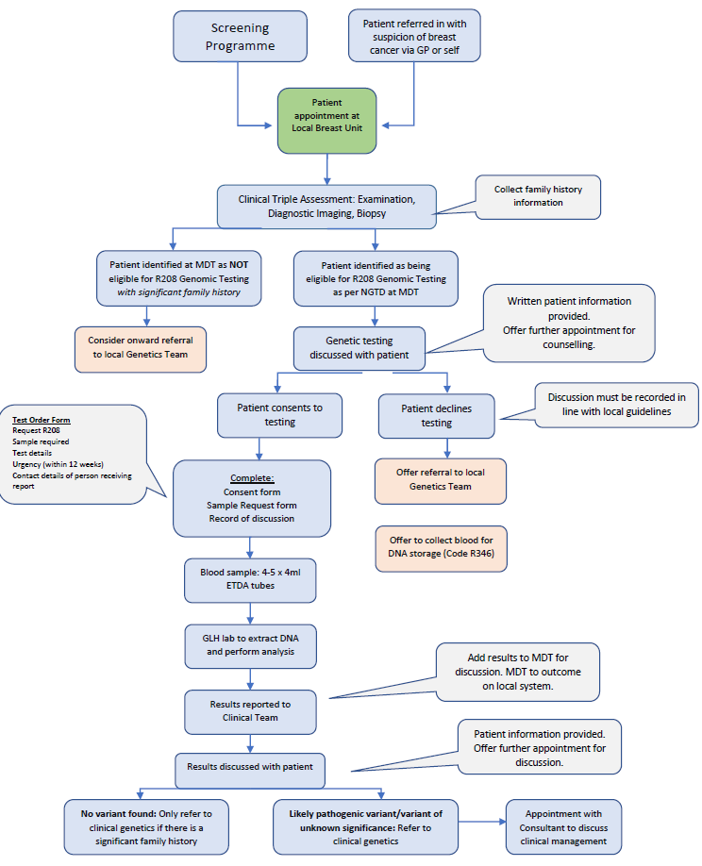
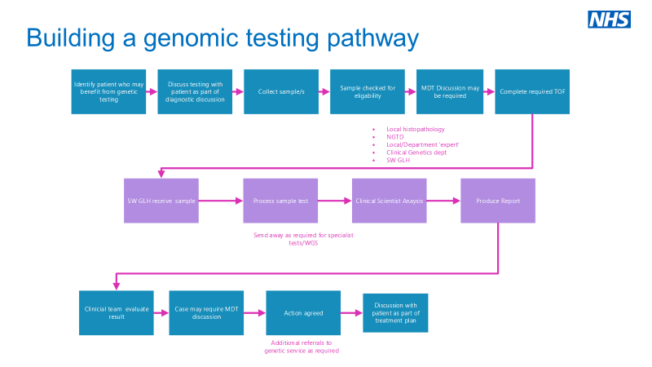
Patient Pathways
Primary Care
Secondary Care
Every breast unit will have variations on how patients navigate their pathway, please see below some examples of how genomic mainstreaming can fit into Secondary Care based on current clinical practice in NHS Hospitals.
The Royal College of General Practitioners has developed a pathway for clinicians to direct people without a personal history of breast cancer to the right place based on their personal risk. This is based on NICE guideline CG164 ‘Familial Breast Cancer: classification, care and managing breast cancer and related risks in people with a family history of breast cancer’.
See their full clinical toolkit for genomics.
Back to Breast Homepage
Notes:
There is information about patient pathways booth in primary and secondary care

Slide 22

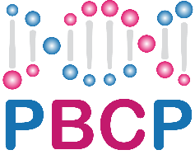






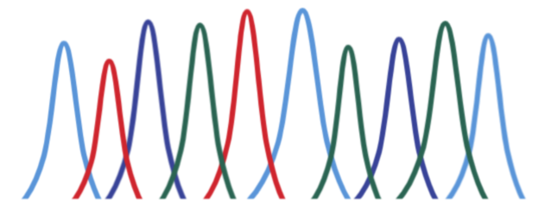








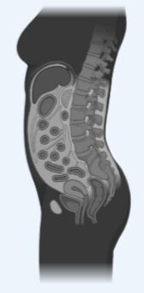

An Exemplar Research Programme:
Whole Genome Sequencing in Breast Cancer
Patient with early stage or later stage breast cancer
Tumour & Blood
WGS & RNA-seq
Consent
Oncogenomics Review Board
ORB
Tumour (100x)
Normal (30x)
RNA (100 M)
Clinical impact
Result validation
Data Sharing & Collaboration
Personalised treatment
Results to clinician and patient
Matched
treatment
Prophylactic surgery
Trial inclusion
Different types of DNA/RNA variations
Mutational signatures
Tumour mutational burden
Breast cancer molecular subtypes
Risk of drug toxicity
Hereditary Risk
Screening Breast cancer / other cancers
Family
screening
Clinical Genetics
Notes:
A ground-breaking breast cancer treatment programme, funded by Cancer Research UK, that could potentially save thousands of lives has opened in Norfolk and Norwich University Hospitals NHS Foundation Trust this week.
Patients who join the Personalised Breast Cancer Programme (PBCP), which was pioneered at Addenbrooke's Hospital in Cambridge, have their DNA read like a barcode, with the whole genome of their tumour sequenced and the results returned to inform treatment planning. The DNA will be analysed from the same routine biopsy and blood tests, meaning that there are no more tests or appointments than usual and no delays in starting treatment.

Slide 23
what are the unwarranted variations?
Notes:
Despite the promise of genomics and the implementation of mainstreaming, there are some challenges and subsequently we see unwarranted variation by geography and by tumour site across the UK

Slide 24
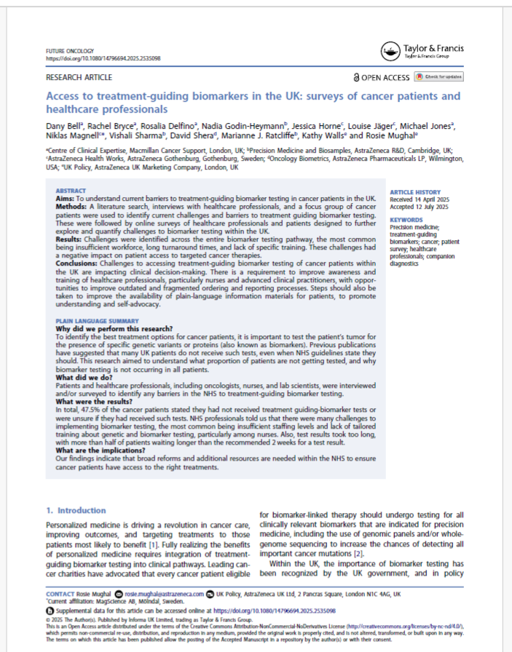

Notes:
Some cancer charities have undertaken research to look at the challenges and variation. Sarcoma UK published their report last year and Tessa Jowell research Commission also published a report last year. This year Macmillan in collaboration with AZ published finding from their research that explored challenges and barriers of testing across 6 cancer types from patients, professionals and a system perspective.

Slide 25







Barriers – there are a range of unwarranted variations based on where you live
Data are not collected systematically, or reported at a test level, making it hard to understand the performance of different regions/nations
Turnaround times for biomarker test results are too long. Some results are too late to be clinically useful
Services vary across England and between nations, so access depends on where you live
Genomic Laboratory Hub
Patients require more support and plain language materials
Inconsistency in result reporting make it harder for clinical teams to make standardised recommendations
Insufficient/
unequal workforce education and awareness
There are systemic issues – capacity, old IT systems, staffing gaps and infrastructure
Notes:
Unwarranted variation based on where you live

Slide 26
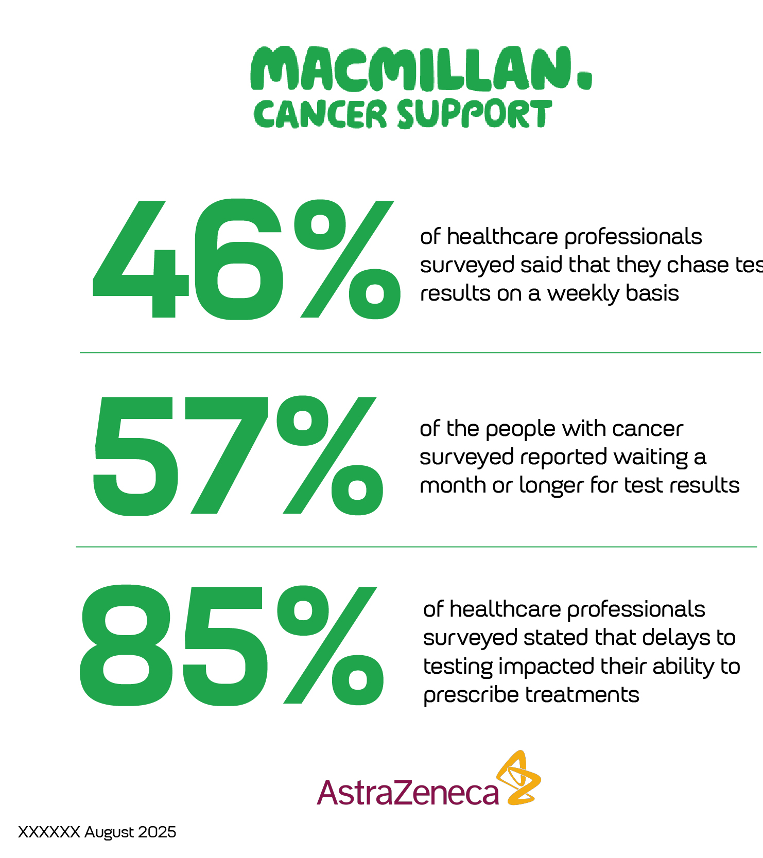

Access to treatment-guiding biomarkers in the UK: surveys of cancer patients and healthcare professionals
Results:
Challenges were identified across the entire biomarker testing pathway, the most common being insufficient workforce, long turnaround times, and lack of specific training. These challenges had a negative impact on patient access to targeted cancer therapies.

Slide 29
Needs of patients
Patients would like more written information on treatment guiding biomarkers given to them at their appointments
Patients need the opportunity for further discussions about biomarker testing in their clinic appointments
Patients who did receive information all found it useful and understood its content
More research is needed in what specifically patients need to support them, and to understand the variation of care which exists across the UK
66% did not receive information but 100% of those who did receive materials found them helpful

Slide 30

Bowel Cancer
variation in MMR testing (mismatch repair) on a bowel cancer tumour identifies if the body's DNA repair system is faulty, which can indicate Lynch syndrome, an inherited condition that increases the risk of several cancers, including bowel cancer
The latest results from the UK's National Bowel Cancer Audit (NBOCA), managed by the National Cancer Audit Collaborating Centre (NATCAN), do not have specific, high-level findings on biomarker testing but rather show the need for it.
Testing for Lynch syndrome, a hereditary cancer risk , testing is improving, with 57% of bowel cancer patients in England tested in 2021, up from 54% in 2020
Notes:
National audits produce granular information on diagnosis, treatment and surgery, to allow us to assess how we can improve care in England and Wales. The bowel cancer audit showed variation in MMR testing (mismatch repair) on a bowel cancer tumour identifies if the body's DNA repair system is faulty, which can indicate Lynch syndrome, an inherited condition that increases the risk of several cancers, including bowel cancer

Slide 31

Gynaecological cancer
National audits show variation in genomic testing for gynaecological cancers in the UK, with factors like ethnicity, location, and type of cancer influencing test rates and access
There can be a need for different approaches, with both tumour testing and germline testing being crucial. Tumour testing alone can miss patients with germline rearrangements (LGRs), while germline testing alone misses patients with somatic variant
Notes:
Studies by Health Data Insight (HDI) and the UK Audit and Research Collaborative in Obstetrics and Gynaecology (UK ARCOG) have revealed gaps in testing for hereditary genetic risk factors, particularly for Lynch syndrome and BRCA mutations, and highlight the need for improved mainstreaming of testing to ensure equitable access and better patient outcomes.
There is variation in testing rates and the ability to meet national targets for genomic testing across different hospital centres and Cancer Alliances in the UK.

Slide 32
Education and Training Resources for Healthcare Professionals

Slide 33
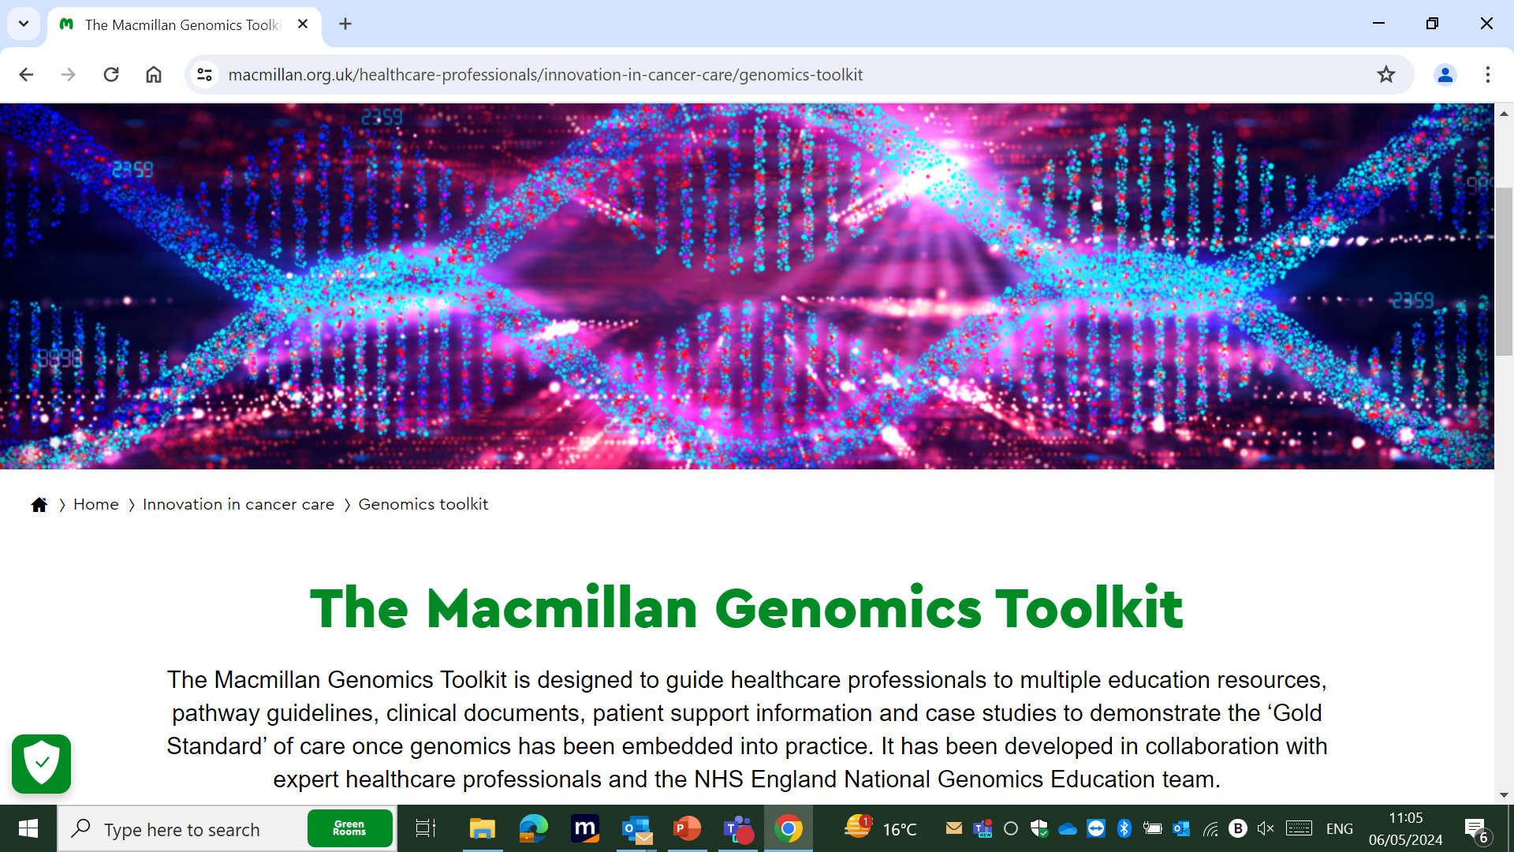
Macmillan website professionals' resources
Notes:
This is how it looks on our website

Slide 34
Select Your Specialty
Breast
Colorectal
Gynaecology
Lung
Prostate
Primary Care
Back to contents

Slide 35
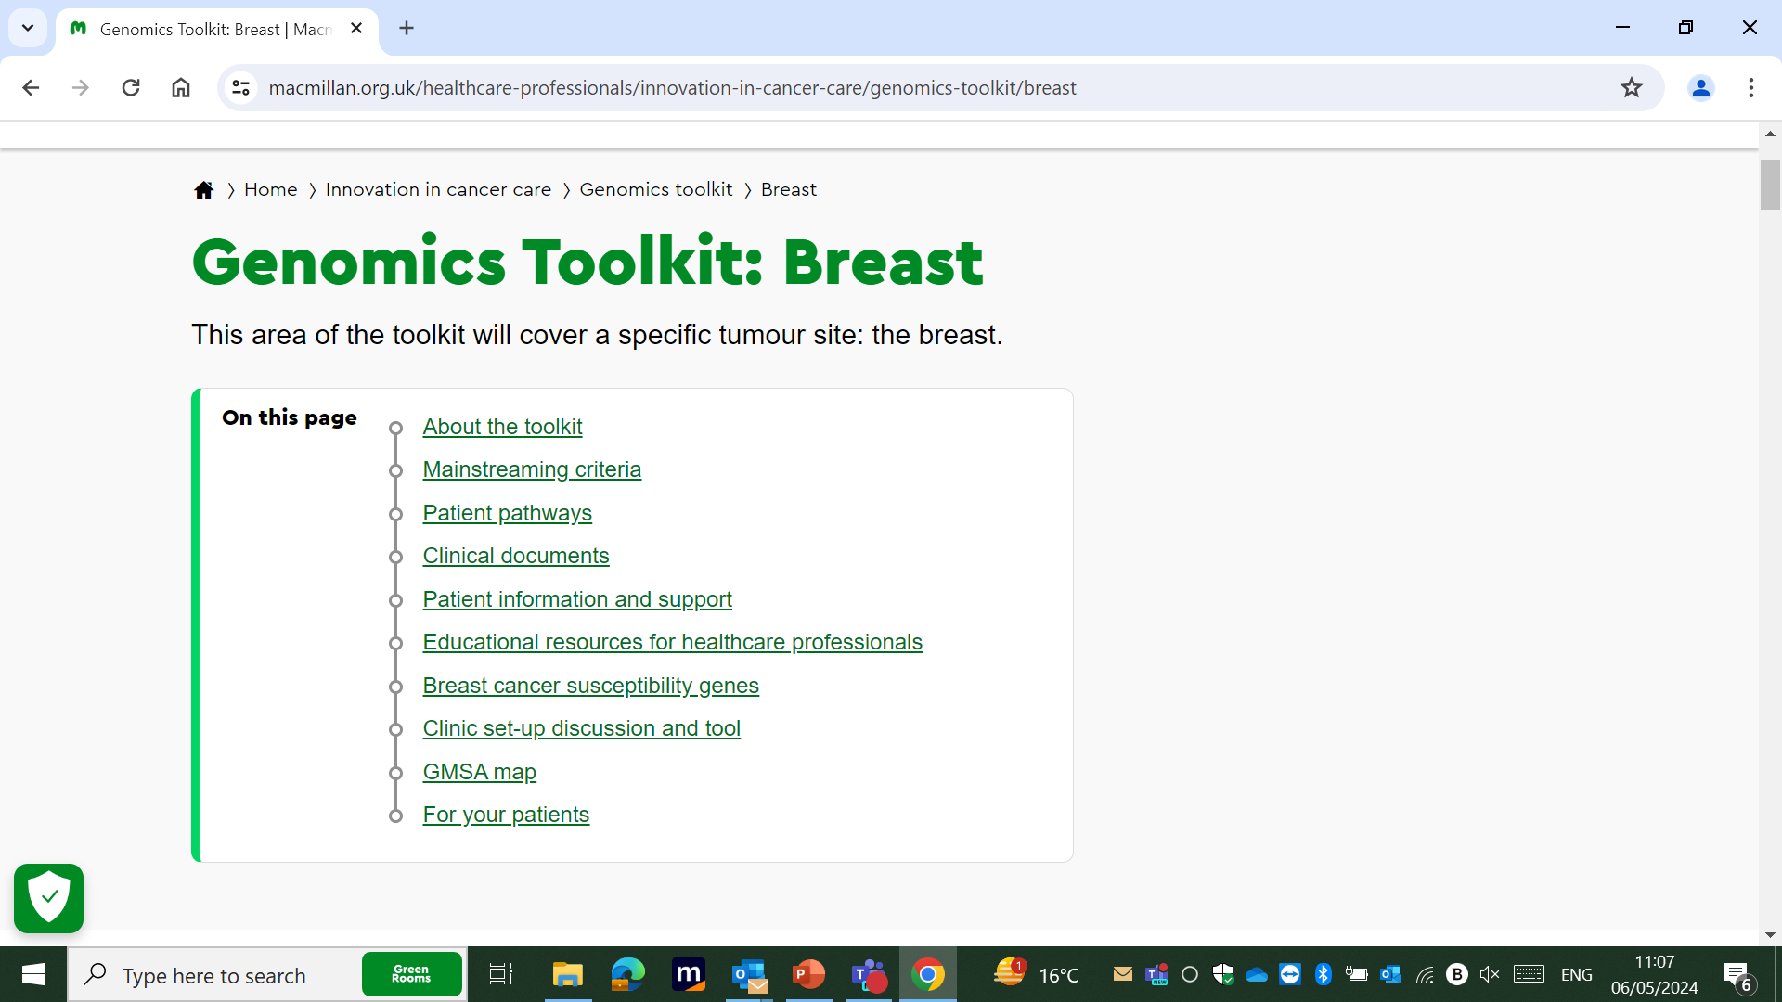
Macmillan website professionals' resources
Notes:
With the menu, which is the same whichever tumour site you choose

Slide 36
Watch & Listen
Podcasts
Video tutorials
Glance & Bookmark
Quick Guides
FAQs
Read & Digest
Reading List
Further Education Opportunities: courses, modules, MSc
Pre-recorded Webinars & Lectures
Service Design Toolkits
Infographics & Posters
Articles
Resources:

Slide 37


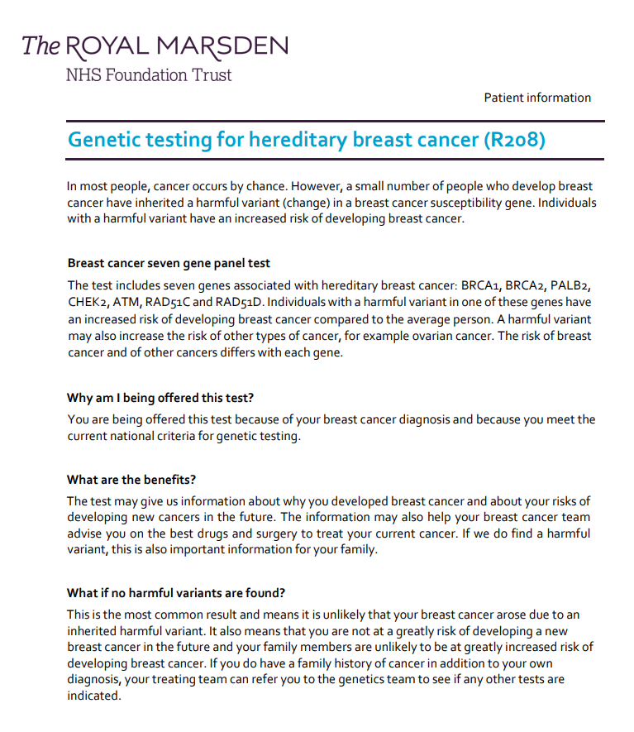





Patient Support
Macmillan helpline 0808 808 00 00 (open 7 days a week, 8am to 8pm.
Patient Information:
Inherited genes and cancer types | Cancer Research UK
Breast Cancer Now: Family History
Royal Marsden, Genetic testing for hereditary breast cancer (R208) | Royal Marsden Patient Information Library
Macmillan Chatline: Chat online | Macmillan Cancer Support
Breast Cancer Now ‘Someone Like Me’
Jnetics- Improving the prevention and management of Jewish genetic disorders in the UK
FORCE-Facing our Risk of Cancer Empowered
Keeping Abreast/Flat Friends/Fabulously Flat Fashion
Daisy Network (premature menopause)
Social Media: Not Just BRCA; BRCA Chatter
Eve Appeal
Genetic Alliance
Prevent Breast Cancer Charity UK | Predict Prevent Protect
Back to Breast Homepage
Notes:
Signposting and links to patient support and information

Slide 38

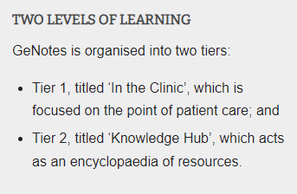
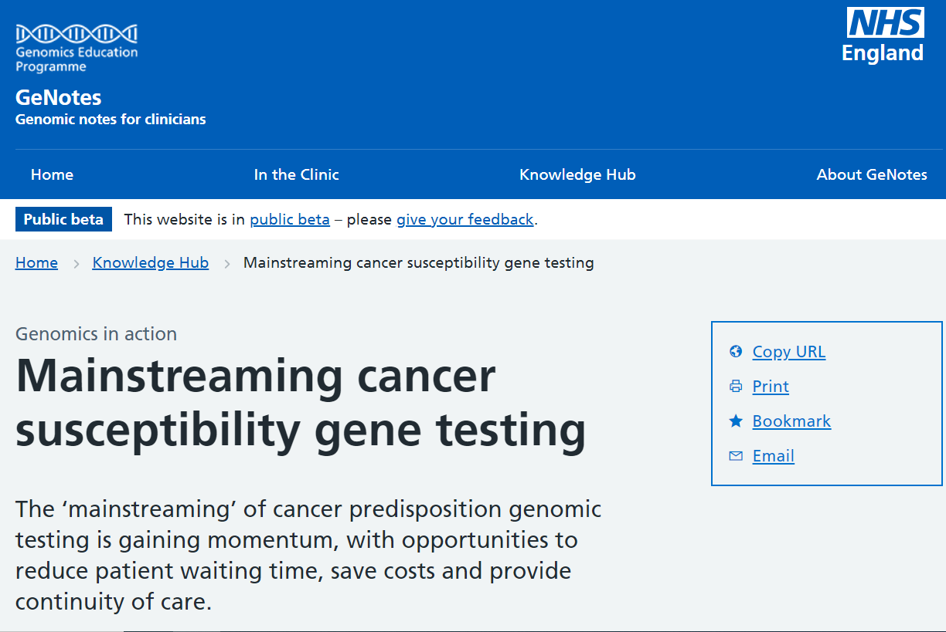
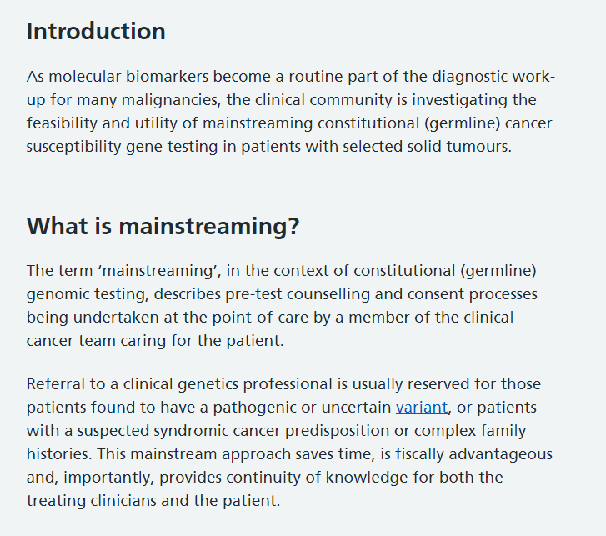
GeNotes!
https://www.genomicseducation.hee.nhs.uk/genotes/knowledge-hub/mainstreaming-cancer-susceptibility-gene-testing/

Slide 39
Thank you

