Slide 1



Primary Care Bowel Cancer Screening Improvement Toolkit: An information and resource pack to support with bowel cancer screening awareness and uptake
Version: 2.0 (updated resources)
Date of publication: November 2025
Date of review: November 2026

Slide 2
Contents
This information toolkit offers an overview of the PCN Network Directed Enhanced Service 25/26. It is designed for primary and community care colleagues and provides a variety of information, resources, and educational opportunities to help improve uptake of bowel cancer screening.
Topic | Slide number
Why is diagnosing cancer early so important? | 3
PCN Directed Enhanced Service - overview | 4 - 7
Bowel cancer screening programme overview | 8
Developing a plan | 9
Practice actions: Identifying non-responders | 10
Practice actions: opportunistic conversations | 11-12
Practice actions: communication tools | 13
Supporting priority groups: learning disabilities | 14
Supporting priority groups: LGBTQ and Traveller community | 15
Supporting priority groups: Language and accessibility | 16-17
Resources for your waiting room | 18
The role of the cancer care coordinator | 19-20

Slide 3
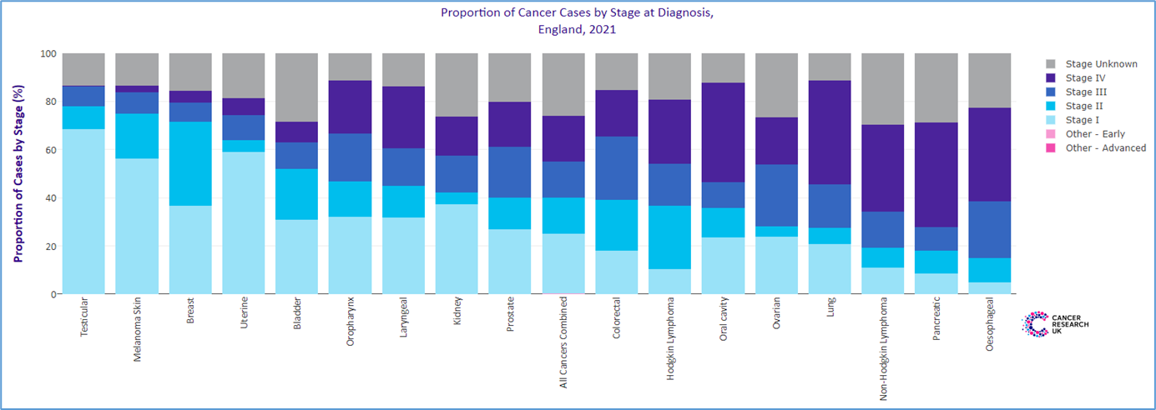
Why is diagnosing cancer early so important?
If a cancer is diagnosed at an early stage, there is a much greater chance of being able to treat the disease successfully, often with less invasive procedures and fewer long-term side effects. But too many people are being diagnosed with cancer at later stages.
It is also important that we diagnose cancers as fast as possible so that treatment can start quickly and as accurately as possible - for example, identifying the genetic make-up of an individual’s tumour tells us how best to treat it.
People diagnosed earlier with cancer are not only more likely to survive, but importantly also to have better experiences of care, lower treatment morbidity, and improved quality of life compared with those diagnosed late.

Slide 4
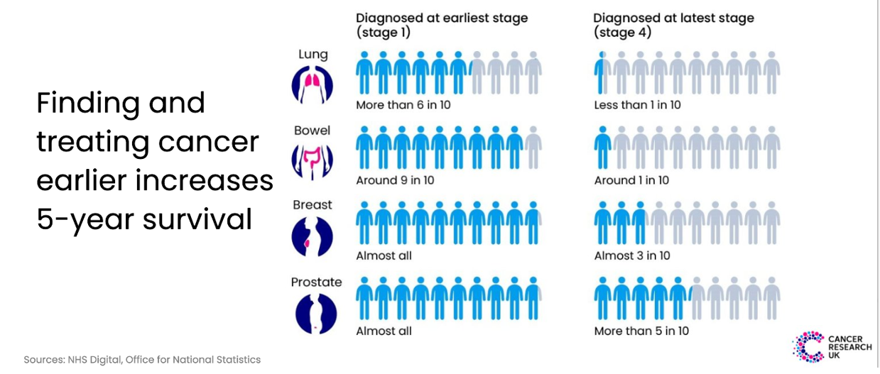
Reducing late-stage diagnosis is vital

Slide 5

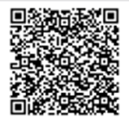
PCN Directed Enhanced Service
The Network Contract Direct Enhanced Service (DES) underpins the role of PCNs in empowering general practice within the wider NHS and improving the range and effectiveness of primary care services.
At a PCN level, practices can discuss variation, build consensus, implement best practice and hold each other to account. They can potentially benefit from operational economies of scale and a shared primary care workforce.
Essential Resources:
PCN DES specifications for 2025-26
PCN DES Video Mini-Series 25/26
CRUK GP Contract Hub 25/26
CRUK PCN top tips (2022)
Note: there are no national requirements for monitoring of the early cancer element of the PCN DES and the only monitoring and direct funding is for IIF element. However, we would encourage PCNs to feedback using the Des checklist at the end of this toolkit so we collate learning and exchange ideas.
Send to england.tvcaadmin@nhs.net

Slide 6

PCN Directed Enhanced Service: Early cancer diagnosis 25/26 – No change
The PCN Directed Enhanced Service ask for two things focused on cancer:
The Des also focuses on health inequalities:
2.1.6 A PCN should “actively seek to reduce health inequalities across its Core Network Practices in line with guidance and the CORE20PLUS5 approach.”
2.1.7 A PCN should work in partnership within local communities to address health inequalities that are amenable to primary care interventions. The CORE20PLUS5 approach provides a helpful focal point for galvanising action and guiding targeting and outreach regarding conditions which disproportionately affect people from areas of greater deprivation.
2.1.8 Two of the five clinical areas set out in the of CORE20PLUS5 approach for adults focus on improving cardiovascular disease (CVD) prevention and diagnosis, and early cancer diagnosis.
1. Review referral practice to improve early detection with clear actions and milestones
2. Work with partners to improve screening uptake (this toolkit)

Slide 7

Improving bowel cancer screening uptake

Slide 8
NHS Bowel Cancer Screening Programme: Overview
Eligibility:
Bowel screening is available to anyone between the ages of 54 and 74. Bowel extension to age 50 years is currently being rolled out. All eligible people who are registered with a GP will automatically be sent a FIT kit through the post every 2 years.
Individuals aged 75 or over can request a home test kit every 2 years by calling the bowel cancer screening helpline on 0800 707 60 60.
People with hearing or speech difficulties, you can use the Relay UK service. Dial 18001 then 0800 707 60 60 from your textphone or use the Relay UK app.
Why is bowel cancer screening so important?
According to Cancer Research UK 2024, bowel cancer is the 4th most common cancer with around 44,100 people diagnosed in the UK each year.
Bowel cancer is the 2nd most common cause of cancer death in the UK
Bowel screening finds abnormal cells before they turn into cancer, allowing early treatment
Screening appointments encourage conversations and education about bowel health and lifestyle adjustments.

Slide 9
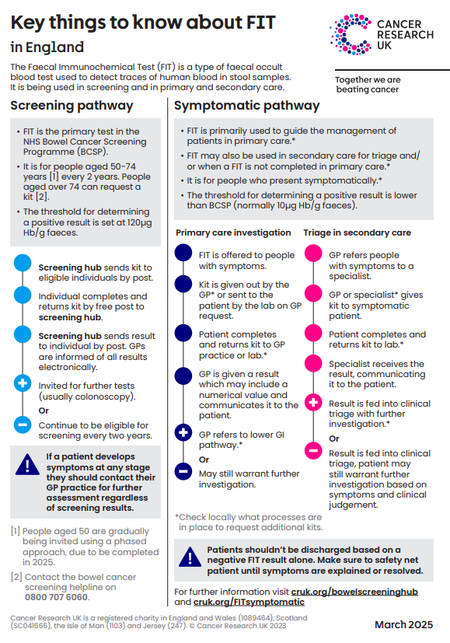
Screening and symptomatic FIT at a glance
 | Screening | Symptomatic
Who | Assumed asymptomatic patients With age extension, 50-74 years | Symptomatic LGI patients aged 18 years and over
When | Offered every 2 years | Offered when patients present with eligible signs and symptoms of lower gastrointestinal cancer
Threshold | Threshold 120µg Hb/g for investigation eg ‘positive screen’* | Threshold 10µg Hb/g for investigation eg ‘positive result’
*A national programme is in development to lower the screening threshold to 80µg Hb/g (FIT@80). More detail will be shared as it is made available.
Any patient presenting with symptoms of suspected colorectal cancer with a negative screening FIT result, even if very recent, MUST be clinically assessed and have a symptomatic FIT if eligible.
DO NOT be falsely reassured by a negative screening FIT result because screening assumes that the patient has no symptoms and a positive screening FIT result is significantly higher

Slide 10
Developing a plan
It only takes small steps to improve - example
STEP 1 | Baseline analysis identifies x% of people eligible for cancer screening have not responded to invites.
STEP 2 | Conduct a review or engagement to understand the reasons behind non-attendance
STEP 3 | SMART aim: The PCN/ Practice aims to contact x% of non-responders over the next six months
STEP 4 | Think about how you will do this e.g. phone call/AccuRx/text message/NHS App/ care coordinator
STEP 5 | How will you change practice e.g. with videos/ leaflet, myth busting etc/ clinic times/ use of extended access
STEP 6 | Repeat analysis to evaluate impact of changes and share learning
It’s important to review and understand your screening data – use PCN level reports from OHID Fingertips, and Gov.uk
Resources and tools for health professional:
CRUK bowel cancer screening good practice guide
CRUK Bowel cancer screening hub
CRUK Bowel cancer screening grid tool - summarises evidence on interventions to address inequalities in bowel cancer uptake.
Macmillan Cancer Screening Quality Improvement Toolkit
Help Us Help You bowel cancer screening campaign
Screening Saves Lives which can be delivered locally
CRUK Symptomatic versus asymptomatic (screening) FIT
CRUK Video - How to do the bowel screening test

Slide 11
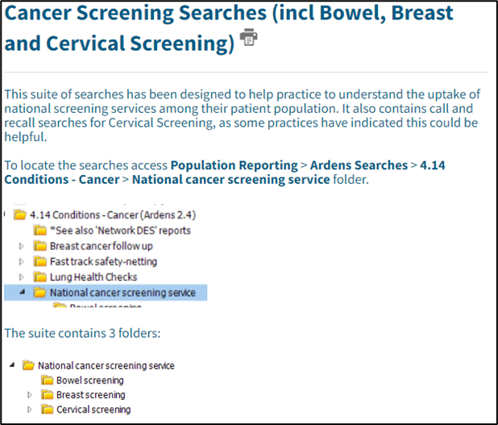
Practice level actions: Identifying non
responders
Ardens:
Ardens have produced a suite of searches designed to help practices to understand the uptake of national screening services among their patient population. Use Ardens to run a search for eligible patients who have not been screened in the last 2 years, including newly eligible patients.
Ardens also contains call and recall searches for bowel screening, as some practices have indicated this could be helpful.
To locate the searches access Population Reporting > Ardens Searches > 4.14 Conditions –Cancer > National cancer screening service folder.
TOP TIP: Use SNOMED codes to monitor the impact of any interventions
Ardens Support Desk: Monday - Friday (08:30 - 18:30) www.ardens.org.uk/
Ardens SystmOne Support: support-systmone@ardens.org.uk
Ardens Manager Support: support-manager@ardens.org.uk

Slide 12

Practice level actions: opportunistic
Conversations (1)
Making Every Contact Count (MECC) encourages health professionals to use everyday interactions to promote positive health behaviours, including cancer screening. Coding these conversations can support local audits and quality improvement initiatives.
MECC is not limited to GPs and nurses. Health care assistants, pharmacists, receptionists, social prescribers, and volunteers also have valuable opportunities to share health-positive messages.
Integrating MECC into routine care helps healthcare providers identify people who are overdue for screenings and motivates timely participation
What you can do:
Systematic Screening Checks: Implement prompts that automatically display a patient's screening status during GP visits.
Staff Training: Equip healthcare professionals with the skills to routinely ask about cancer screenings during consultations, making it a regular part of the conversation.
Automated Reminders: Utilise AccuRx / SMS, the NHS App, email, or patient portals to send personalised screening reminders ahead of appointments.
Opportunistic Outreach: Encourage staff to review screening history and promote participation during all healthcare interactions, whether addressing minor illnesses, managing chronic conditions, or administering vaccinations.
Click on the image above to access e-learning for health training resources and MECC toolkit

Slide 13
Practice level actions: opportunistic
Conversations (2)
You can use the MECC approach to improve screening uptake: example
Start the conversation | use routine appointments such as vaccine clinics, blood pressure checks and chronic condition reviews to ask patients if they are up to date with their bowel cancer screening. “I noticed you’re due for your bowel screening; it’s a quick test that can prevent bowel cancer. Would you like me to help book an appointment?”
Normalise and reassure | Keep the conversation casual, normalise talking about the screening process. “Have you had any recent changes to your poo?”
Address concerns | Provide clear information about the test, how to do it and why it’s important. “The test is simple to do and you can complete it at home. There are lots of resources available to support you through the process, and it really helps catch problems early.”
Address barriers | Barriers such as fear, embarrassment and concerns about hygiene should be considered. Offer practical support, such as information on how to use the kit. “If you want, I can help you request a test kit or explain how to complete it hygienically.”
Signpost and support | Signpost patients to helplines and guidance. Eligible patients can request a test kit if they have not received one or if they have lost the kit they received. Bowel cancer screening helpline on 0800 707 6060, or consider the TVCA bowel screening videos. “Here’s some information you can look at, and I’m here to answer any questions whenever you’re ready.”

Slide 14

Practice level actions: Communication tools
AccuRx:
AccuRx is a communication platform for healthcare professionals and patients and is primarily used in GP practices and reduces the number of calls made to patients.
Increase uptake on invites through SMS Text service
Enables information to be sent directly to patients
Messages can be saved and coded, and usage can be tracked.
Text messaging, telephone calls and the NHS App:
Batch text messaging is available at practice level using SystmOne and EMIS (at a cost) and can be used to post/host a URL link. Free messaging is available via NHS App. See gov.uk principles of screening text messages.
Example texts: “You may have received an NHS bowel screening kit. Please complete and return it – it’s simple and could save your life. Questions? Call 0800 707 60 60. For more information visit: www.nhs.uk/conditions/bowel-cancer-screening”
OR
“You may have received a kit for bowel cancer screening. For more information watch this Thames Valley Cancer Alliance video about bowel cancer screening bowel screening video”
Example call script: “You’ve been sent an invitation for bowel screening. Just checking if you have any questions or need help with anything?”

Slide 15
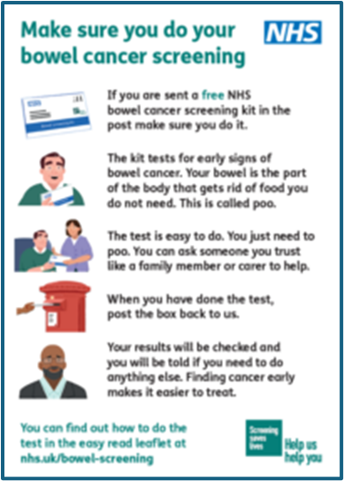
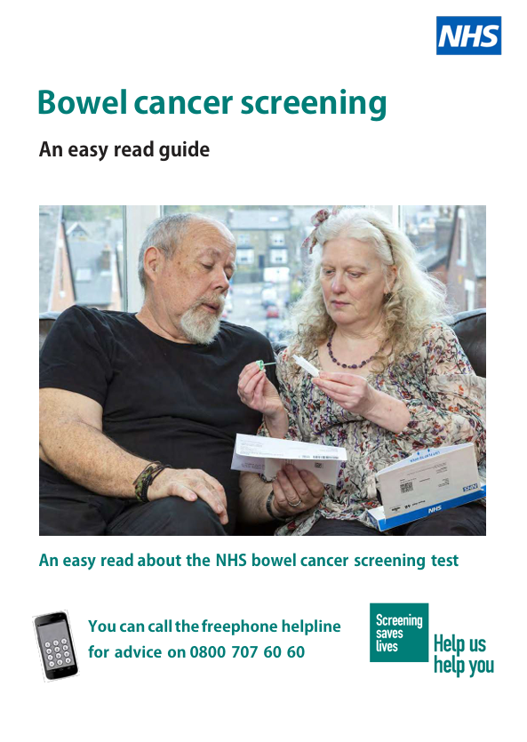
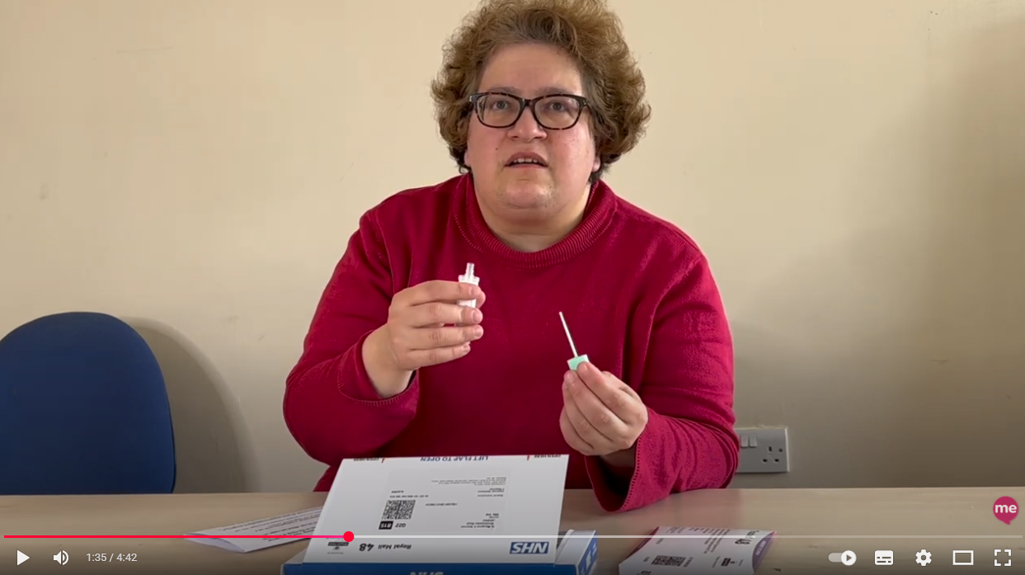
Supporting priority groups: learning disabilities
Evidence shows that eligible people with a learning disability are less likely to complete their bowel cancer screening compared to those without, leaving them at risk of undetected bowel cancer.
Sutton Mencap in partnership with the NHS has produced a video about bowel screening for people with learning disabilities.
NHS England have produced an easy read leaflet, and Beyond Words have produced a picture leaflet to support people with learning disabilities to access bowel screening.
Learning Disability bowel cancer screening videos with subtitles – with thanks to West Yorkshire and Harrogate Cancer Alliance: Polish, Punjabi, Urdu, British Sign Language
The South East London Cancer Alliance, has collaborated with the Baked Bean Charity and the Guys Cancer Academy, Learning disabilities and cancer educational module. The training module is designed to help healthcare professionals better support people with learning disabilities in accessing cancer care and screening services
Click on the image to access resource

Slide 16


Supporting priority groups: LGBTQ+ and
non binary communities
There are a number of resources available for the trans community to help understand more about cancer screening and whether they should be screened:
NHS population screening: Information for trans and non-binary people
Cancer Research UK public information to include trans and non-binary
OUTpatients, the UKs leading LGBTQ+ charity Cancer risk and screening
You can also access training and resources:
Gateway C cancer keys - Barriers to early cancer diagnosis in the trans community
Ardens have templates and resources to support at practice level Ardens LGBTQ, Non-Binary and Gender Dysphoria resources – screening

Slide 17


Supporting priority groups: language
and accessibility (1)
Using your Bowel Cancer Screening Kit is a range of NHS subtitled videos available on Vimeo. The short animation explains how to use your bowel cancer screening kit. Subtitles are available in English, as well as Arabic, Bengali, Chinese (simplified and traditional), Farsi, Gujarati, Polish, Portuguese, Punjabi and Urdu. A British Sign Language version is also available.
The NHS England bowel cancer screening letter is available in 30 languages. Click here to access
An NHS audio podcast is also available for people with low literacy or visual impairment.
Traveller community:
The Friends, Families and Travellers organisation have worked with the Gypsie and Traveller community to develop a guide to reducing the risk of cancer.
You can also view Cancer Awareness videos by visiting the Friends, Families and Travellers YouTube Channel, including a video about bowel cancer screening.
Click on the image to access resource

Slide 18
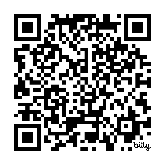
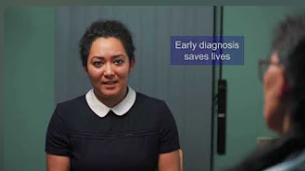

Supporting priority groups: language
and accessibility (2)
A new set of educational videos has been created to support Primary Care and help patients understand the importance of cancer screening.
The videos explain:
How to use the symptomatic faecal immunochemical test (FIT)
Cervical screening
Breast screening
Bowel screening
To make this information accessible to more people across the Thames Valley, the videos are available in:
British Sign Language (BSL)
Hindi
Polish
Gujarati
Nepali
Punjabi
Link and QR code to full length videos: https://bit.ly/screeningvideos
YouTube link to reels for social or your waiting room display board https://www.youtube.com/playlist?list=PLEm1CvSoQcDLK9EiVyfCa1dXWwLs9-Dbj)

Slide 19
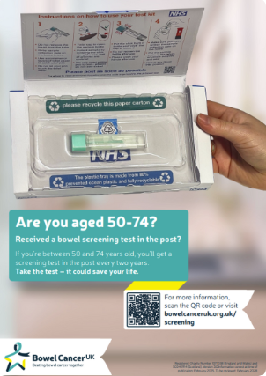
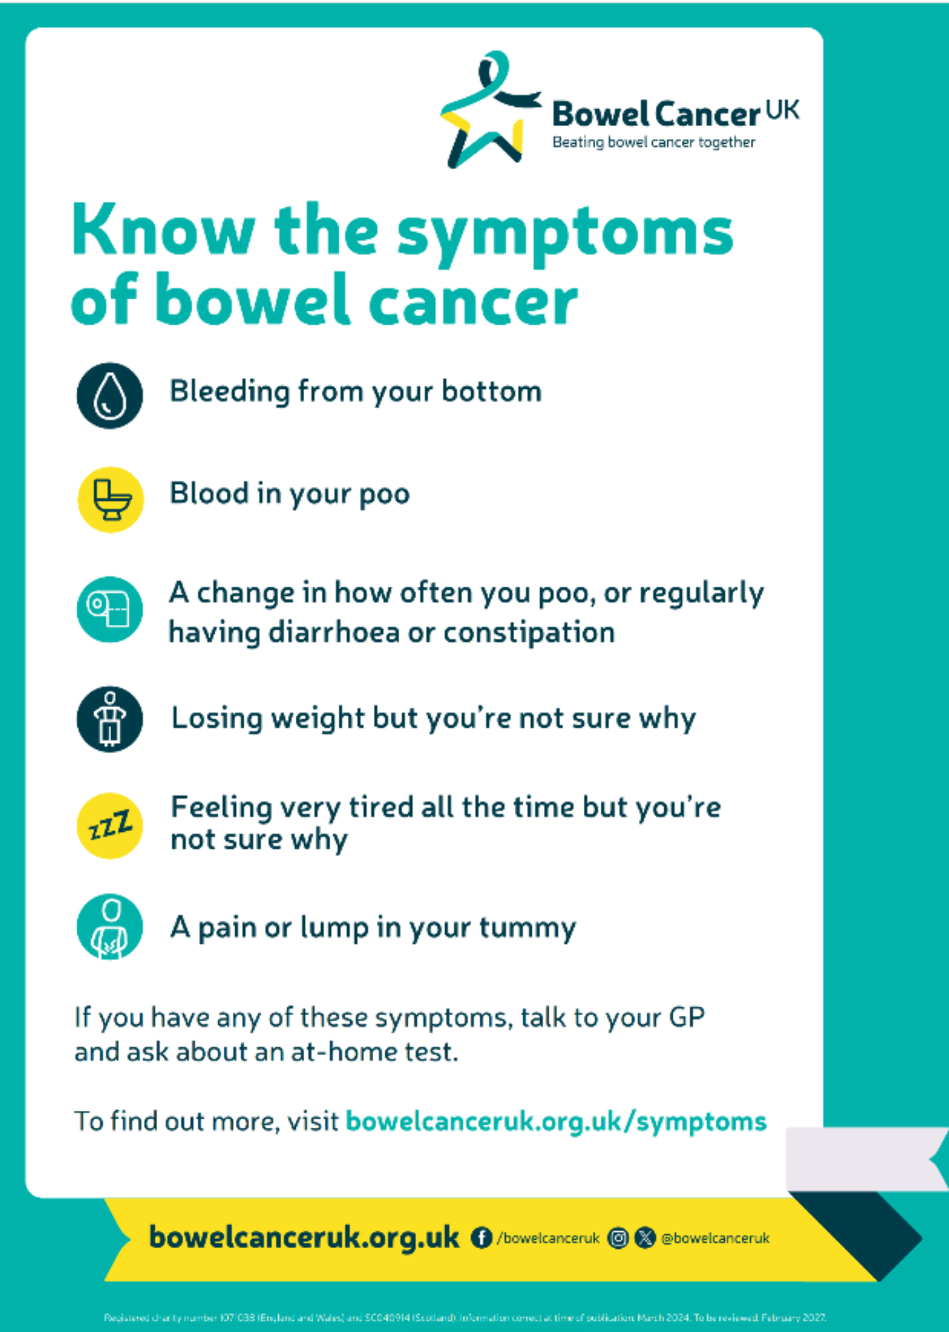
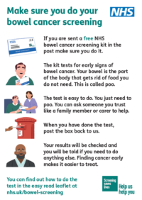
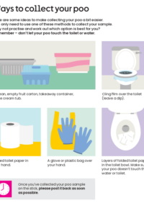


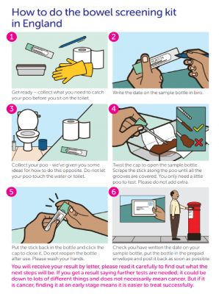

Resources for your waiting room
Click on the image to access resource
YouTube link to reels for social media or your waiting room display board

Slide 20
The role of the Cancer Care Coordinator
The Care Co-ordinators role requirements stated in the Network DES Contract can help to deliver many of the objectives expected of Primary Care for Cancer patients
A cancer care co-ordinators can:
Support the delivery of cancer priorities within the Network Contract DES
Support achievement of Quality Outcome Framework (QoF) Indicator
Provide opportunities to support personalised care planning throughout the cancer pathway
They can do this by:
Providing extra time and capacity, with a personalised patient centred approach;
Providing expertise to support patients when preparing for clinical conversations;
Following up discussions with primary care professionals;
Working closely with the GPs and other primary care colleagues within the primary care network (PCN) to identify and manage a caseload of identified patients; and by
Ensuring that a patient's changing needs are addressed.
For more information about Cancer Care Co-ordinators please click here to watch a webinar from Wessex Cancer Alliance

Slide 21
How can a cancer care co-ordinators support your patients?
Prevention:
Identify at risk populations through QoF Register: including obesity and smoking
Lead on advertising preventative advice within surgeries, social media and websites
Signposting to services (lifestyle/support)
Coding
Screening:
Identify low screening rates, non-responders, low participation groups
Run searches through GP systems
Make contact with patients to provide information and support/encourage uptake
Early diagnosis and safety netting:
Arranging follow-up GP appointments, providing information and leaflets to patients
Promote use of digital tools to aid decision making and safety netting
Follow up patient groups that may not attend appointments
Monitor completion of FIT
Monitor suspected cancer referral and escalate breaches
Audit PCN Safety Netting process
Care navigation
Personalised Care:
Coordinate care for anyone diagnosed with cancer in the practice (signposting)
Prepare the patient for cancer care reviews
Help maintain the palliative care register
For more information about the ARR roles please click on the links below:
Network Contract Directed Enhanced Service - Contract specification 2023/24 – PCN Requirements and Entitlements (england.nhs.uk)
Care Co-coordinator recruitment pack This contains a sample JD, person specification, sample advert and example interview questions
Workforce development framework
Competency framework

