Slide 1


Primary Care Toolkit: Symptomatic FIT and the Lower GI pathway
An information and resource pack to support with suspected lower GI cancers and the use of symptomatic FIT
Version: 1.0
Date of publication: December 2025
Date of review: December 2026

Slide 2
FIT Overview
Guidance:
NICE have reviewed the Lower GI NG12 guidelines, and a revision was published 24 August 2023.
National Cancer Waiting Times Monitoring Dataset Guidance v12.1. Refer to section 5.7.3 Specific guidance around application of Cancer Waiting Times guidance to FIT implementation
What is the potential of FIT in the management of patients with possible colorectal cancer?
To access the correct pathway first time
To reassure patients of their low personal risk of bowel cancer
To triage those at greatest risk of bowel cancer to more urgent investigation
To reduce the numbers of people accessing colorectal investigations which may be unnecessary and carry a risk

Slide 3
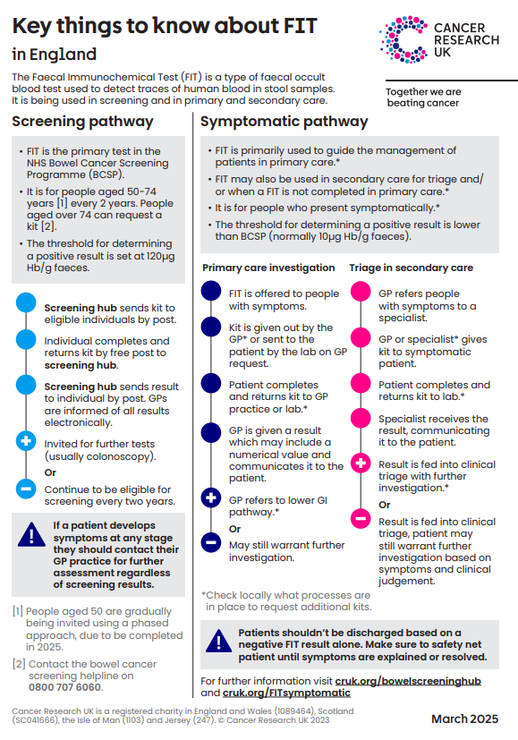
Screening and symptomatic FIT at a glance
 | Screening | Symptomatic
Who | Assumed asymptomatic patients With age extension, 50-74 years | Symptomatic LGI patients aged 18 years and over
When | Offered every 2 years | Offered when patients present with eligible signs and symptoms of lower gastrointestinal cancer
Threshold | Threshold 120µg Hb/g for investigation eg ‘positive screen’* | Threshold 10µg Hb/g for investigation eg ‘positive result’
*A national programme is in development to lower the screening threshold to 80µg Hb/g (FIT@80). More detail will be shared as it is made available.
Any patient presenting with symptoms of suspected colorectal cancer with a negative screening FIT result, even if very recent, MUST be clinically assessed and have a symptomatic FIT if eligible.
DO NOT be falsely reassured by a negative screening FIT result because screening assumes that the patient has no symptoms and a positive screening FIT result is significantly higher

Slide 4
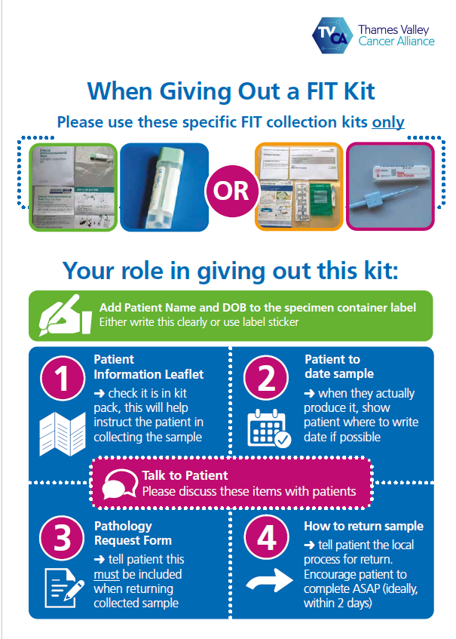
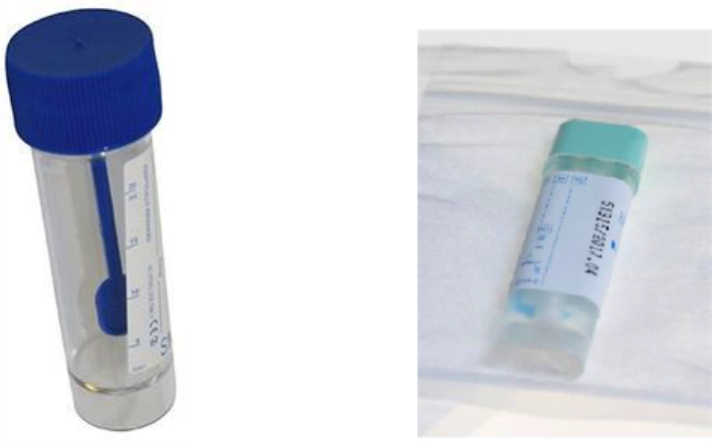



TVCA Lower GI Urgent Suspected Cancer
Pathway: FIT use
Top tip! Download the TVCA FIT admin poster
Practice level actions:
Ensure you have a good supply of kits
Make sure the correct tests are used
Download our FIT poster
Explain the importance of the test to patients to encourage them to complete.
Explain that symptomatic patients should still complete a FIT even if they have recently attended their bowel screening. See CRUK's FIT Screening vs Symptomatic infographic
Labelling: Add Patient Name and DOB to the specimen container label. Either write this clearly or use label sticker. Show the patient where to write the date on the sample
  this is important as if the date the sample was taken is not recorded clearly, the lab may assign the date the request was made. The haemoglobin degrades in the FIT tubes after 14 days. Labs can’t take the risk of assigning the date of sample collection to the date it arrives in the lab because if this is a few days after the sample was taken and it falls outside the 14 day stability window, then there is the risk of false negative results being reported.
Patient leaflet: check it is in kit pack - this will help instruct the patient in collecting the sample or share patient resources that explain how to complete a FIT kit
Pathology Request Form: tell patient this must be included when returning collected sample
Health professional education
Support your teams to understand the difference between screening FIT and symptomatic FIT by signposting to the following education opportunities:
GatewayC FIT resources, GatewayC Colorectal Cancer module
Check out Cancer Research UK Symptomatic FIT page
Be clear on the difference between screening FIT and symptomatic FIT

Slide 5
TVCA Lower GI Urgent Suspected Cancer Pathway
FIT & Calprotectin
Have different roles in the patient with colorectal symptoms.
• FIT detects red cells to help decision making in suspected colorectal cancer
• Faecal calprotectin detects white cells to help decide between IBS & IBD. A negative calprotectin is 98% predictive for the absence of IBD. It is not
helpful if colorectal cancer is suspected as may be raised in presence of colorectal cancer
Refer to your local IBS/IBD pathway
Check faecal calprotectin test if appropriate
Suspected IBS/IBD
Adult presents with persistent bowel symptoms
Rectal mass
OR anal mass or anal ulceration. *Request LGI investigations
Triage by secondary care team taking into account tests including FIT level with red flag symptoms.
Secondary care to take forward appropriate investigations e.g. CTC, colonoscopy
NG12 Lower GI symptoms with high suspicion of colorectal cancer:
Abdominal mass OR
Persistent Change in Bowel Habit (CIBH), OR
iron deficiency anaemia (IDA)
≥ 40 years with unexplained weight loss AND abdominal pain, OR
< 50 years with rectal bleeding AND either unexplained abdominal pain OR unexplained weight loss
≥50 years with any of the following unexplained symptoms: rectal bleeding OR abdominal pain OR weight loss
≥60 with anaemia even in the absence of Iron Deficiency
ASSESS, EXAMINE AND REQUEST LGI INVESTIGATIONS*
Refer on LGI USC pathway
FIT ≥ 10
GP to request and assess FIT result before referral to secondary care
Consider other cancer pathway or Non-Specific Symptoms pathway (NSSP) where available
FIT < 10
Cancer still
suspected
FIT should be offered even if the person has previously had a normal FIT result through the NHS bowel cancer screening programme since different thresholds apply.
GP Safety netting: If symptoms persist, consider Advice and Guidance, urgent/routine colorectal or other pathways
Referral to an appropriate secondary care should not be delayed in the absence of a FIT result if there is strong clinical concern.
Refer to local system pathway where available e.g. IDA or rectal bleeding Rectal bleeding
*LGI investigations:
FIT, FBC, U&E, CRP, Ferritin, Cealiac
Primary care
Secondary care

Slide 6
TVCA Lower GI Urgent Suspected Cancer
Pathway: Safety-netting
Safety-netting overview:
Symptomatic patients should be tested as per local cancer referral guidelines regardless of their participation and results in bowel cancer screening programme.
Equally patients should be encouraged to participate in bowel screening at their normal interval when they are invited even if they have had a negative FIT symptomatic test.
Patients should be encouraged to notify primary and/or secondary care clinicians if their symptoms persist, change, or worsen (even where they have had a FIT result <10µgHb/g and have been discharged).
Patients should not be left on patient tracking lists indefinitely, and there should be robust monitoring of numbers of patients categorised at different levels of priority and swift progression to follow on testing for all those who need it.
In some cases, patients who have a FIT result >10µgHb/g or FIT result <10µgHb/g result, could have an underlying non-GI cancer. It is therefore important to be alert to the risk of non-GI cancer (for example ovarian or pancreatic cancer) in patients with unresolved symptoms.
Safety-netting and referral resources:
CRUK Safety netting webpages
E-safety-netting tools webpage
CRUK Safety netting flow chart
CRUK Safety netting summary of actions and top tips
GatewayC Improving the Quality of Your Referral
What is the potential of FIT in the management of patients with possible colorectal cancer?
To access the correct pathway first time
To reassure patients of their low personal risk of bowel cancer
To triage those at greatest risk of bowel cancer to more urgent investigation
To reduce the numbers of people accessing colorectal investigations which may be unnecessary and carry a risk

Slide 7
TVCA Lower GI Urgent Suspected Cancer
Pathway: Safety-netting
Safety-netting when a FIT test has been requested
Code FIT test requested in the notes (tick box in Ardens Symptoms analyser) and run a practice report regularly looking for patients where no result has been received within 14 days
Use of scheduled task as a reminder to look for the results- this could be by the individual clinician, cancer care coordinator or specific admin team
Use of AccuRx to prompt patient to do the tests
When a FIT ≥ 10µgHb/g result has been received
A report can be run regularly by the practice looking for patients with FIT ≥10µgHb/g who have not been referred via Urgent Suspected Cancer (USC) route.
A report can be run by the practice to identify patients referred via USC where no correspondence has been received from the hospital 4 weeks after referral.
Use of scheduled tasks by the clinician, Cancer Care Coordinator or specific administrative team to ensure patient has attended.
Use of AccuRx to check patient attendance.
Contact the patient to discuss results
Make a USC referral and ensure bloods and FIT result attached

Slide 8
TVCA Lower GI Urgent Suspected Cancer
Pathway: Safety-netting options
When a FIT < 10µgHb/g result has been received
All patients should receive information about when to seek help.
Refer:
Patients with an fHb <10 µg Hb/g but with persistent and unexplained symptoms for whom the GP has concern of cancer should be referred to secondary care for evaluation;
  refer on a LGI suspected cancer pathway if there is very high clinical suspicion of colorectal cancer - this is the exception and the reasons for concern must be stated clearly on the referral form.
  where cancers other than colorectal are suspected please refer on appropriate suspected cancer referral form
    consider possibility of upper GI cancers in patients with iron deficiency anaemia
    consider pancreatic cancer in patients with weight loss and change in bowel habit
    consider possibility of an ovarian cancer in women over 50 where there is a change in bowel habit (perform vaginal exam, request CA125 and trans vaginal ultrasound
  If patient is presenting with vague symptoms not suggestive of a specific tumour site, please refer to a Non-Specific Symptoms Pathway (NSSP)
  If concerning symptoms persist consider alternative fast track pathways where available, eg Iron Deficiency Anaemia
Repeat FIT:
It is not necessary to ask all patients with a FIT <10 µg Hb/g result to repeat their test, only those for whom you have ongoing clinical concern of cancer. Recent research has shown that patients with two FIT< 10 µg Hb/g results have a colorectal cancer risk of <0.04% (Hunt et al, 2021).
If there is ongoing clinical concerns, consider a repeat FIT and reassess the patient in 8-10 weeks. Consider other causes of bowel change, check faecal calprotectin, consider other investigations/imaging e.g. CA125/ultrasound
A scheduled task at 6 weeks could be set up by the clinician, cancer care coordinator or specific admin team to remind the patient to have the necessary repeat testing and further task set to ensure results received.
Consider advice and guidance

Slide 9
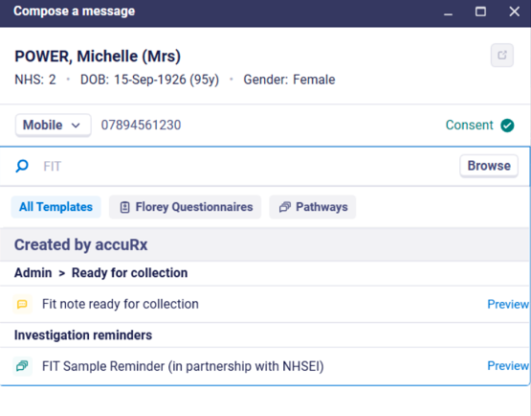
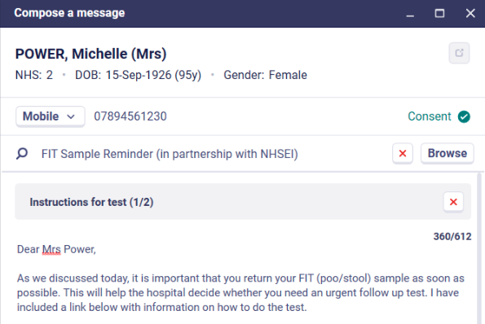
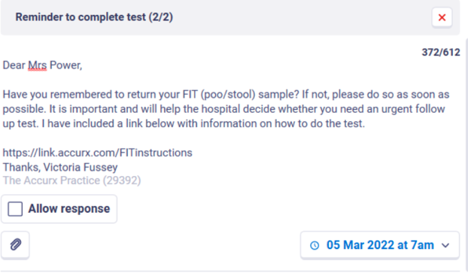
TVCA Lower GI Urgent Suspected Cancer Pathway: Safety-netting
Make the most of AccuRx - Sample Reminder Pathway
To help improve patient compliance of returning their FIT kit, there is an automated Sample Reminder Pathway now live nationally through the GP communication tool AccuRx. This means patients will receive a text reminding them to return their FIT test if they have not returned their sample after a certain time period.
This is a form of safety-netting and to use this, primary care health professionals will need to follow the FIT Reminder Step-by-step Guide when ordering a FIT test. This guide also shows a video of the steps on screen.
Top tip! – include a link to the TVCA Symptomatic FIT Video in your text message – “For more information watch the Thames Valley Cancer Alliance video about bowel cancer screening” Link to full length videos

Slide 10
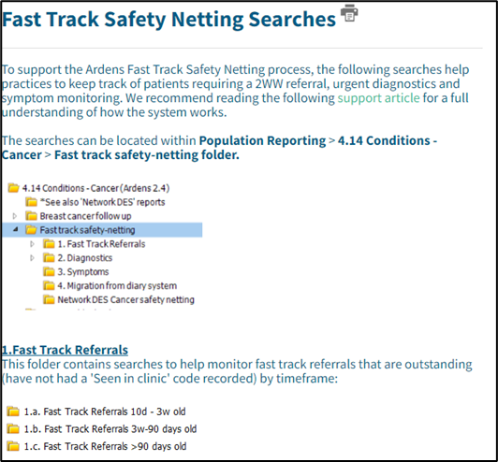
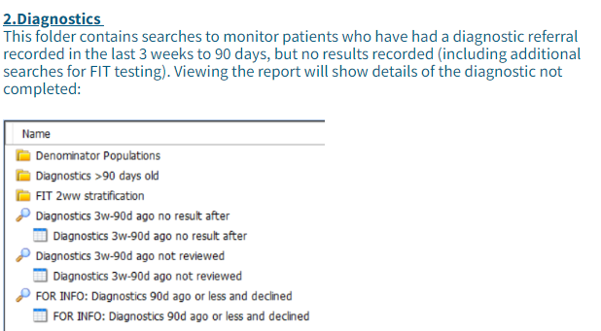
Ardens FIT searches:
ARDENS Safety-netting searches - FIT
Ardens have produce a suite of searches designed to help practices to safety-net patients requiring an urgent suspected cancer (2WW) referral, urgent diagnostics and symptom monitoring among their patient population.
To locate the searches access Population Reporting > Ardens Searches > 4.14 Conditions –Cancer > Fast Track Safety-netting folder
Ardens Support Desk 08:30-18:30 Monday-Friday- https://www.ardens.org.uk/
Ardens SystmOne Support: support-systmone@ardens.org.uk
Ardens Manager Support: support-manager@ardens.org.uk

Slide 11
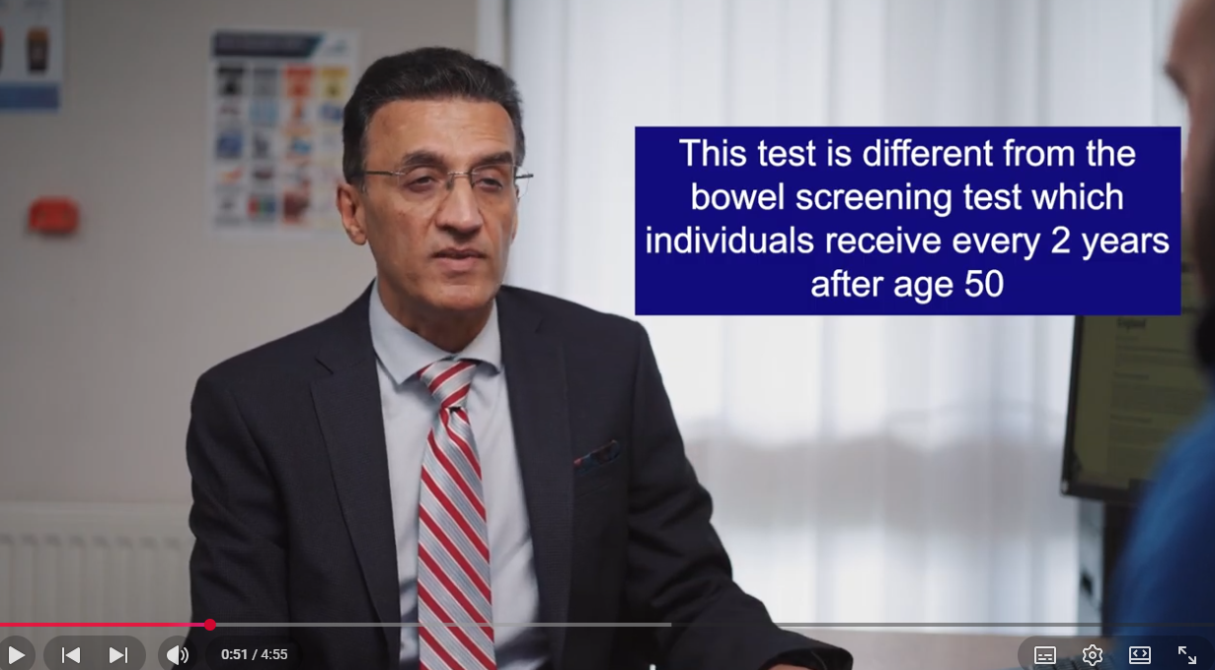

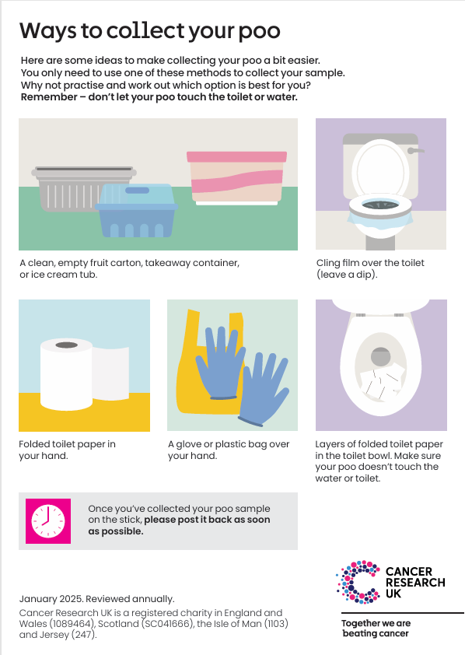
Accessible FIT communication resources:
A new set of educational videos has been created to support Primary Care and help patients understand the importance of the correct and timely completion of symptomatic FIT testing. To make this information accessible to more people across the Thames Valley, the videos are available in:
British Sign Language (BSL)
Hindi
Polish
Gujarati
Nepali
Punjabi
Other resources:
The Southeast London Cancer Alliance have created FIT animations for both screening and symptomatic patients, available in 21 languages. To access, follow the link FIT Testing
CRUK How to do a symptomatic FIT poster
Signpost your patients to helpful information on the Cancer Research UK website
Cheshire and Merseyside cancer alliance have created an Easy Read FIT information leaflet
Link to full length videos: https://bit.ly/screeningvideos
YouTube link to reels for social or your waiting room display board

Slide 12
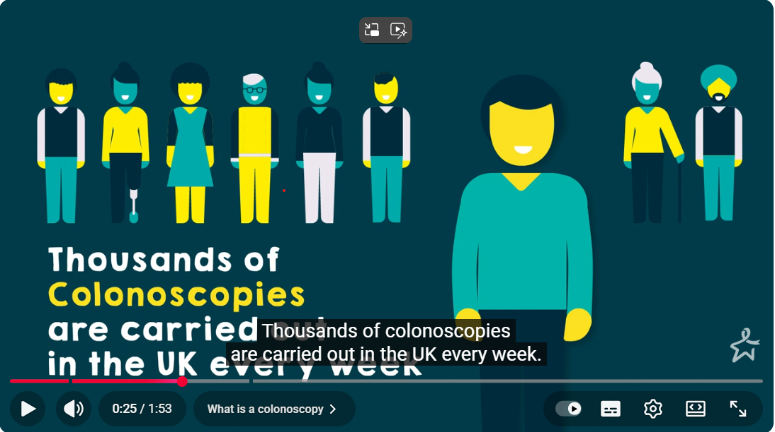

Patient resource: Going for a colonoscopy:
Your patient might feel anxious about attending a colonoscopy appointment. Bowel cancer UK have produced an animation to explain what a colonoscopy is and what’s involved. Click on the image to access.
You could also signpost your patient to the Bowel Cancer website page
Colonoscopy Confidence, or offer this helpful factsheet available in
Welsh, Urdu, Bengali, Chinese (Mandarin) and Arabic.
This video is also available to watch with Welsh, Urdu, Bengali, Chinese (Mandarin) and Arabic subtitles. To change the language, click on 'Settings' and then 'Subtitles'

Slide 13
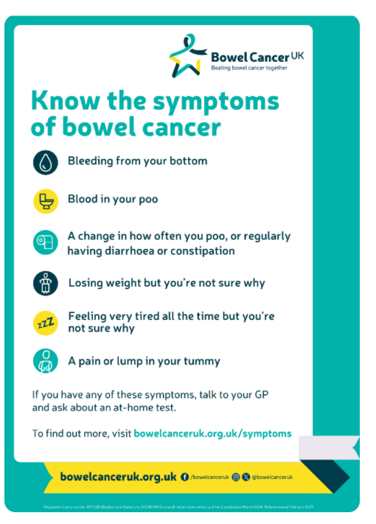
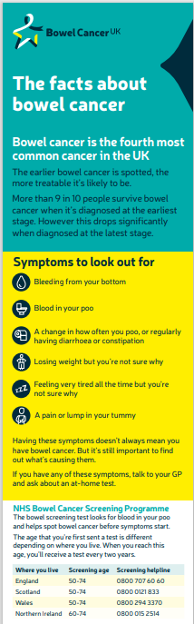
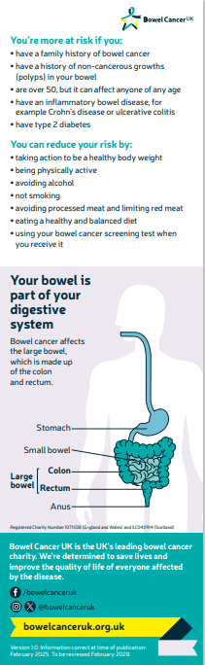
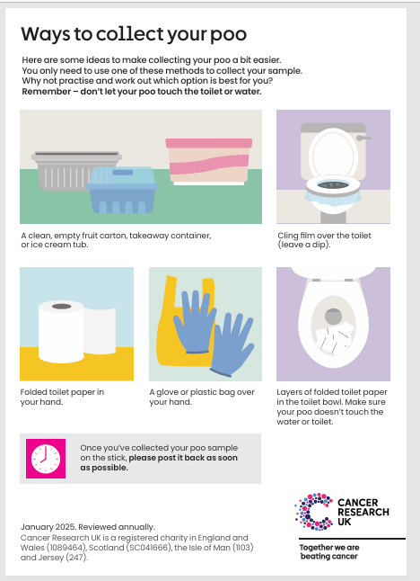
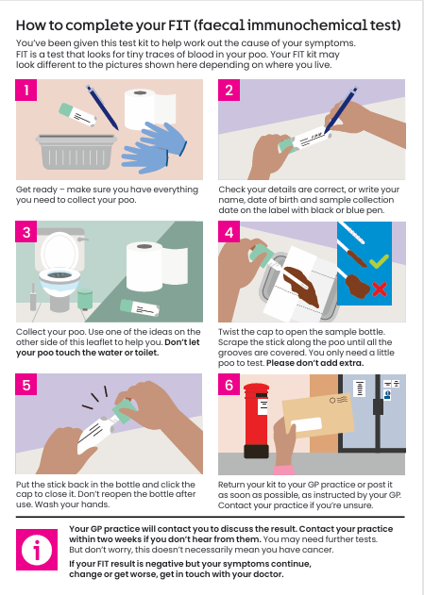
Bowel cancer and FIT resources:
Click on the images below to access
Translated material:
Bowel cancer UK offer information in other languages including: Polish, Punjabi, Romanian, and Welsh.
Click here to access

Slide 14
FIT in the future: ColoFIT
COLOFIT is a risk-based algorithm intended for use in the pathway to assessing colorectal cancer. It is a development beyond the standard faecal immunochemical test (FIT) by combining the FIT result with other factors such as age, sex, and blood test results (like platelet count, mean cell volume) to create a more precise probability of cancer. The algorithm produces a probability that the person has colorectal cancer, which could help optimise the use of FIT to guide referral decisions for people with suspected colorectal cancer in primary care. This could ensure that people with the highest risk of colorectal cancer are referred, while people unlikely to have colorectal cancer can avoid colonoscopy, and so reduce the strain on colonoscopy services.
Next steps:
The National Lower GI Risk Stratification Expert Advisory Group (EAG) is working with the British Society of Gastroenterology and The Association of Coloproctology of Great Britain and Ireland to publish initial guidance for ColoFIT use within the pathway. The national EAG constitutes many representatives from across the NHS, professional societies and the patient voices panel
National guidance/ letter will recommend services initially implementing ColoFIT at 1%, however as more evidence is generated through service evaluation this threshold is likely to increase
Services will be asked to develop local plans for threshold rises beyond 1%, seeking national input on plans to amend their local pathways (linking to the EAG), with clear evaluation goals in place to enable service evaluation ​
The EAG will also be coordination an application for this to appear in future NICE guidance
Note: This information is correct as of publication of this document however could be subject to change. Further updates and revisions will be made as new information or guidance is communicated to cancer alliances.

Slide 15
IIF and coding
CAN-04: The proportion of patients who have had a lower gastrointestinal urgent suspected cancer referral in the reporting year where at least one urgent suspected cancer referral was accompanied by a faecal immunochemical test result, with the result recorded in the 21 days leading up to the referral.

Slide 16
IIF FIT – measure definition:
The schematic below shows how the numerator and denominator for the PCN DES/IIF indicator for FIT are calculated.
Number of FIT test results recorded for patients who have had a fast-track referral for suspected lower GI cancer.
Could be coded manually by the practice on receipt of result, or automatically by the lab when they process the test or send the result to the practice.
The number of test kits handed/posted to patients has no effect on the numerator.
The test result (positive, negative, 25μg/g, etc.) has no effect on the numerator.
Numerator
17
e.g.
= 82%
Number of patients who have had a fast-track referral for suspected lower GI cancer.
21
Denominator

Slide 17
IIF FIT – measure definition:
The schematic below shows how the numerator and denominator for the PCN DES/IIF indicator for FIT are calculated.
[1049361000000101] Quantitative faecal immunochemical test (observable entity)
AND
[276401000000108] Fast track referral for suspected colorectal cancer (procedure)
OR
[892201000000106] Fast track referral for suspected lower gastrointestinal cancer (procedure)
Numerator
[276401000000108] Fast track referral for suspected colorectal cancer (procedure)
OR
[892201000000106] Fast track referral for suspected lower gastrointestinal cancer (procedure)
Denominator

Slide 18
SNOMED codes:
There are a number of extra FIT-related SNOMED codes included in the NHS Digital raw data extracted from GP Extraction Service (GPES), which relate to patients who decline or should not routinely be offered a FIT test.
The use of these codes has no direct effect on the numerator or denominator described in previous slides. Inclusion in the numerator or denominator is based solely on the code ending 0101 from previous slides.
NOTE: patients with the codes listed below may occasionally have a FIT test anyway. If this happens then they will be given the code ending 0101 as described on previous slides and will therefore be included in the numerator on that basis.
NOTE: there is no exclusion code for abdominal mass.
Use Ardens ‘Match the FIT Test Result to a SNOMED code’
Ardens have provided searches to monitor FIT IIF activity, and some practices may find patients who have had a FIT test result within the correct timeframe; however, they are not appearing in the results of the CAN-04/ LGI Urgent Suspected Cancer referral with FIT referral search.
This may be that the result is coming into your system not matched to a clinical code. To find out how to match codes click here for more detail

Slide 19
SNOMED codes:
Cluster description | SNOMED concept ID | Code description
Codes for faecal immunochemical test not indicated | 140536008 | O/E - PR - rectal mass (finding)
 | 163326007 | On examination - per rectum - rectal mass (finding)
 | 197225001 | Anal ulcer unspecified (disorder)
 | 197227009 | Anal and rectal ulcer NOS (disorder)
 | 20928004 | Ulcer of anus (disorder)
 | 248523006 | Rectal mass (finding)
 | 641331000000104 | Anal ulcer unspecified (disorder)
 | 91105001 | Stercoral ulcer of anus (disorder)
 | 254585003 | Tumour of anal canal (disorder)

Slide 20
The role of the Cancer Care Coordinator
The Care Co-ordinators role requirements stated in the Network DES Contract can help to deliver many of the objectives expected of Primary Care for Cancer patients
A cancer care co-ordinators can:
Support the delivery of cancer priorities within the Network Contract DES
Support achievement of Quality Outcome Framework (QoF) Indicator
Provide opportunities to support personalised care planning throughout the cancer pathway
They can do this by:
Providing extra time and capacity, with a personalised patient centred approach;
Providing expertise to support patients when preparing for clinical conversations;
Following up discussions with primary care professionals;
Working closely with the GPs and other primary care colleagues within the primary care network (PCN) to identify and manage a caseload of identified patients; and by
Ensuring that a patient's changing needs are addressed.
For more information about Cancer Care Co-ordinators please click here to watch a webinar from Wessex Cancer Alliance

Slide 21
How can a cancer care co-ordinators support
your patients?
Prevention:
Identify at risk populations through QoF Register: including obesity and smoking
Lead on advertising preventative advice within surgeries, social media and websites
Signposting to services (lifestyle/support)
Coding
Screening:
Identify low screening rates, non-responders, low participation groups
Run searches through GP systems
Make contact with patients to provide information and support/encourage uptake
Early diagnosis and safety netting:
Arranging follow-up GP appointments, providing information and leaflets to patients
Promote use of digital tools to aid decision making and safety netting
Follow up patient groups that may not attend appointments
Monitor completion of FIT
Monitor suspected cancer referral and escalate breaches
Audit PCN Safety Netting process
Care navigation
Personalised Care:
Coordinate care for anyone diagnosed with cancer in the practice (signposting)
Prepare the patient for cancer care reviews
Help maintain the palliative care register
For more information about the ARR roles please click on the links below:
Network Contract Directed Enhanced Service - Contract specification 2023/24 – PCN Requirements and Entitlements (england.nhs.uk)
Care Co-coordinator recruitment pack This contains a sample JD, person specification, sample advert and example interview questions
Workforce development framework
Competency framework

