Slide 1



Primary Care Cervical Cancer Screening Improvement Toolkit: An information and resource pack to support with cervical cancer screening awareness and uptake
Version: 3.0 (updated resources)
Date of publication: December 2025
Date of review: December 2026

Slide 2
Contents
This information toolkit offers an overview of the PCN Network Directed Enhanced Service 25/26. It is designed for primary and community care colleagues and provides a variety of information, resources, and educational opportunities to help improve uptake of cervical cancer screening.
Topic | Slide number
Why is diagnosing cancer early so important? | 3
PCN Directed Enhanced Service - overview | 4 - 7
Cervical cancer screening programme overview | 8
Developing a plan | 9
Practice actions: Identifying non-responders | 10
Practice actions: opportunistic conversations | 11-12
Practice actions: communication tools | 13
Supporting priority groups: learning disabilities | 14
Supporting priority groups: LGBTQ and Traveller community | 15
Supporting priority groups: Language and accessibility | 16-17
Resources for your waiting room | 18
The role of the cancer care coordinator | 19-20

Slide 3
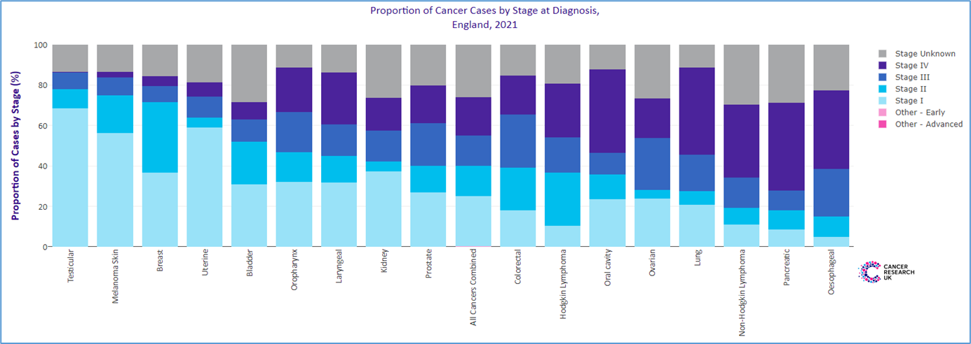
Why is diagnosing cancer early so important?
If a cancer is diagnosed at an early stage, there is a much greater chance of being able to treat the disease successfully, often with less invasive procedures and fewer long-term side effects. But too many people are being diagnosed with cancer at later stages.
It is also important that we diagnose cancers as fast as possible so that treatment can start quickly and as accurately as possible - for example, identifying the genetic make-up of an individual’s tumour tells us how best to treat it.
People diagnosed earlier with cancer are not only more likely to survive, but importantly also to have better experiences of care, lower treatment morbidity, and improved quality of life compared with those diagnosed late.

Slide 4
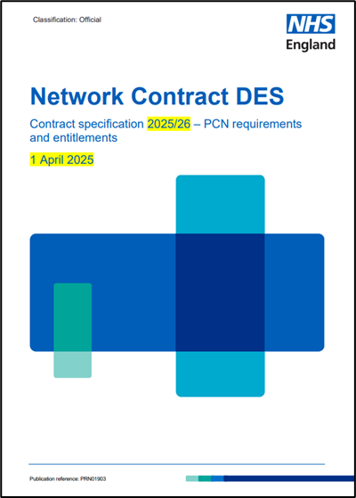

PCN Directed Enhanced Service
The Network Contract Direct Enhanced Service (DES) underpins the role of PCNs in empowering general practice within the wider NHS and improving the range and effectiveness of primary care services.
At a PCN level, practices can discuss variation, build consensus, implement best practice and hold each other to account. They can potentially benefit from operational economies of scale and a shared primary care workforce.
Essential Resources:
PCN DES specifications for 2025-26
PCN DES Video Mini-Series 25/26
CRUK GP Contract Hub 25/26
CRUK PCN top tips (2022)
Note: there are no national requirements for monitoring of the early cancer element of the PCN DES and the only monitoring and direct funding is for IIF element. However, we would encourage PCNs to feedback using the Des checklist at the end of this toolkit so we collate learning and exchange ideas.
Send to england.tvcaadmin@nhs.net

Slide 5

PCN Directed Enhanced Service: Early cancer diagnosis 25/26 – No change
The PCN Directed Enhanced Service ask for two things focused on cancer:
The Des also focuses on health inequalities:
2.1.6 A PCN should “actively seek to reduce health inequalities across its Core Network Practices in line with guidance and the CORE20PLUS5 approach.”
2.1.7 A PCN should work in partnership within local communities to address health inequalities that are amenable to primary care interventions. The CORE20PLUS5 approach provides a helpful focal point for galvanising action and guiding targeting and outreach regarding conditions which disproportionately affect people from areas of greater deprivation.
2.1.8 Two of the five clinical areas set out in the of CORE20PLUS5 approach for adults focus on improving cardiovascular disease (CVD) prevention and diagnosis, and early cancer diagnosis.
1. Review referral practice to improve early detection with clear actions and milestones
2. Work with partners to improve screening uptake (this toolkit)

Slide 6
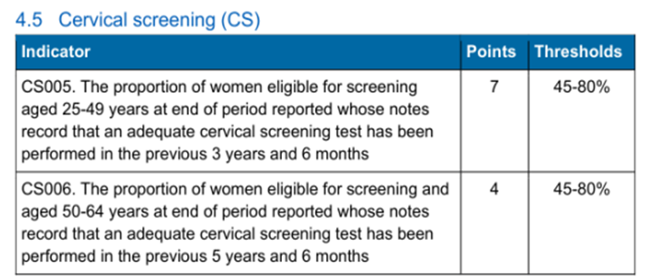
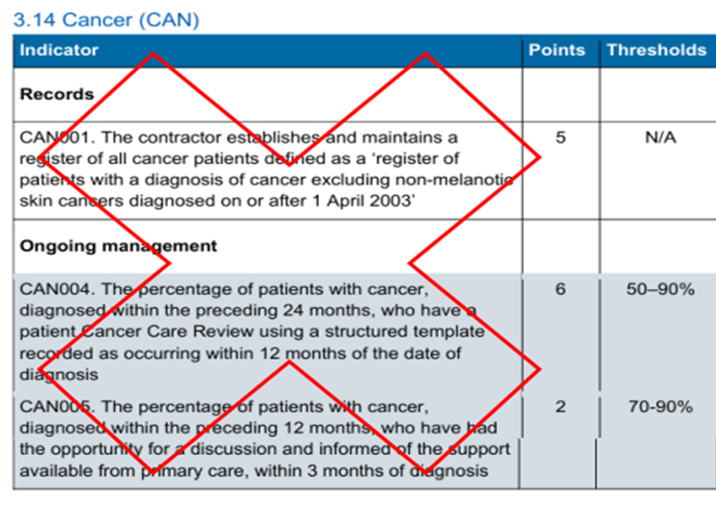
Quality Outcomes Framework 25/26
QOF CS005 CS006 – Cervical Screening: NO CHANGE
CAN001,CAN004,CAN005: RETIRED

Slide 7

Improving cervical cancer screening uptake

Slide 8
NHS Cervical Cancer Screening Programme: Overview
Eligibility:
Cervical screening is available to women and people with a cervix aged 25 to 64 in England. Screening is recommended regardless of sexual orientation or sexual history. Individuals who have had the human papillomavirus (HPV) vaccination should still attend for cervical screening.
Eligible people registered with a GP (as female) will automatically receive an invitation by mail. Trans men (assigned female at birth) do not receive invitations if registered as male with their GP but are still entitled to screening if they have a cervix - CSAS screening opt in form Forms – NHS Cervical Screening Administration Service. Pregnant women will not usually need to have cervical screening until at least 12 weeks after they’ve given birth.
The screening interval has changed from three to five years in the younger age group (25 - 49) because the screening test has changed to HPV primary testing. If no high-risk HPV is detected, the risk of developing cervical cancer over the next 10 years is very low. If high-risk HPV is detected, patients will be followed up more closely.
From September 2025, the NHS Cervical Screening Programme will send normal results digitally via the NHS App. Patients will receive an app message and notification. If unread within 72 hours, or if the patient does not have the app, a letter will be sent. Abnormal results will continue to be sent by post.
Why is cervical cancer screening so important?
Cervical screening finds abnormal cells before they turn into cancer, allowing early treatment.
It checks for high-risk HPV, the virus that causes most cervical cancers. Treating cell changes early can prevent cancer from developing.
In England cervical screening currently prevents 70% of cervical cancer deaths. If everyone attended screening regularly, 83% could be prevented.
Screening appointments encourage conversations about cervical health and HPV prevention.
Will help achieve the cervical cancer elimination plan for England

Slide 9
Developing a plan
It only takes small steps to improve - example
STEP 1 | Baseline analysis identifies x% of people eligible for cancer screening have not responded to invites.
STEP 2 | Conduct a review or engagement to understand the reasons behind non-attendance
STEP 3 | SMART aim: The PCN/ Practice aims to contact x% of non-responders over the next six months
STEP 4 | Think about how you will do this e.g. phone call/AccuRx/text message/NHS App/ care coordinator
STEP 5 | How will you change practice e.g. with videos/ leaflet, myth busting etc/ clinic times/ use of extended access
STEP 6 | Repeat analysis to evaluate impact of changes and share learning
Resources and tools for health professional:
CRUK Primary Care Good Practice Guide: Cervical Screening
CRUK Health Professional Resources
Macmillan Cancer Screening Quality Improvement Toolkit
Help Us Help You cervical cancer screening resources
Screening Saves Lives which can be delivered locally
National Screening Programmes: Cervical Screening - GatewayC
It’s important to review and understand your screening data – use PCN level reports from OHID Fingertips, Power Bi Cervical Screening dashboard, and Gov.uk

Slide 10
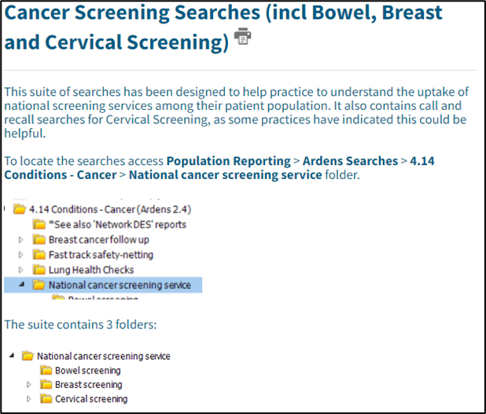
Practice level actions: Identifying non
responders
Use the Cervical Screening Management System (CSMS) to check screening status and follow up with non-responders. The system can also be used to download the electronic screening test request forms.
Ardens:
Ardens have produced a suite of searches designed to help practices to understand the uptake of national screening services among their patient population. Use Ardens to run a search for eligible patients who have not been screened in the last 3 years for the younger cohort and 5 years for the older cohort, including newly eligible patients.
To locate the searches access Population Reporting > Ardens Searches > 4.14 Conditions –Cancer > National cancer screening service folder.
Additionally, Ardens have produced cervical smear letters to support practices
Ardens Support Desk: Monday - Friday (08:30 - 18:30)
Ardens EMIS Support Support : Ardens EMIS Web
Ardens SystmOne Support: Support : Ardens
Ardens Manager Support: Support : Ardens Manager
TOP TIP:
Use SNOMED codes to monitor the impact of any interventions

Slide 11

Practice level actions: opportunistic
Conversations (1)
Making Every Contact Count (MECC) encourages health professionals to use everyday interactions to promote positive health behaviours, including cancer screening. Coding these conversations can support local audits and quality improvement initiatives.
MECC is not limited to GPs and nurses. Health care assistants, pharmacists, receptionists, social prescribers, and volunteers also have valuable opportunities to share health-positive messages.
Integrating MECC into routine care helps healthcare providers identify people who are overdue for screenings and motivates timely participation
What you can do:
Systematic Screening Checks: Implement prompts that automatically display a patient's screening status during GP visits.
Staff Training: Equip healthcare professionals with the skills to routinely ask about cancer screenings during consultations, making it a regular part of the conversation.
Automated Reminders: Utilise AccuRx / SMS, the NHS App, email, or patient portals to send personalised screening reminders ahead of appointments.
Opportunistic Outreach: Encourage staff to review screening history and promote participation during all healthcare interactions, whether addressing minor illnesses, managing chronic conditions, or administering vaccinations.
Click on the image above to access e-learning for health training resources and MECC toolkit

Slide 12
Practice level actions: opportunistic
Conversations (2)
You can use the MECC approach to improve screening uptake: example
Start the conversation | Use routine appointments such as vaccine clinics, blood pressure checks and chronic condition reviews to ask patients if they are up to date with their cervical screening. The postnatal check is an opportunity to remind women who will not have had screening during pregnancy. “I noticed you’re due for a cervical screen; it’s a quick test that can prevent cervical cancer. Would you like me to help book an appointment?”
Normalise and reassure | Keep the conversation casual, normalise talking about the screening process. “Have you noticed any recent changes?”
Address concerns | Provide clear information about the test, how to do it and why it’s important. “The test is quick and done by a trained nurse or doctor. Many women find it uncomfortable but not painful, and it really helps catch problems early.”
Address barriers | Barriers such as fear, embarrassment and concerns about sexual connotations should be considered. Offer practical support, such as information on female practitioners, clinic times, or transport help. “If you want, I can help book an appointment that suits you, including options for female practitioners or weekend clinics.”
Signpost and support | Signpost patients to helplines and guidance such as the TVCA cervical screening videos. Eligible patients can book their cervical screening appointment by contacting their GP surgery. “Here’s some information you can look at, and I’m here to answer any questions whenever you’re ready.”

Slide 13

Practice level actions: Communication tools
AccuRx:
AccuRx is a communication platform for healthcare professionals and patients and is primarily used in GP practices and reduces the number of calls made to patients.
Increase uptake on invites through SMS Text service
Enables information to be sent directly to patients
Messages can be saved and coded, and usage can be tracked.
Text messaging, telephone calls and the NHS App:
Batch text messaging is available at practice level using SystmOne and EMIS (at a cost) and can be used to post/host a URL link. Free messaging is available via NHS App. See gov.uk principles of screening text messages.
Example texts: “You may have received an invitation for cervical screening. Please contact your GP to book – it’s simple and could save your life. For more information watch this Thames Valley Cancer Alliance video about cervical cancer screening cervical screening video”
“You may have received an invitation for cervical screening. Please contact your GP to book – it’s simple and could save your life. For more information visit: www.nhs.uk/tests-and-treatments/cervical-screening/”
“You are overdue for your routine smear test. Please book an appointment with the practice nurse by calling XXXXX XXX XXX. “You can find more information on smear tests here: www.nhs.uk/conditions/cervical-screening”
Example call script: “You’ve been sent an invitation for cervical screening. Just checking if you have any questions or need help with booking your appointment.”

Slide 14
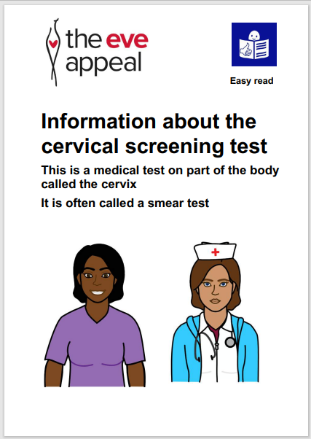
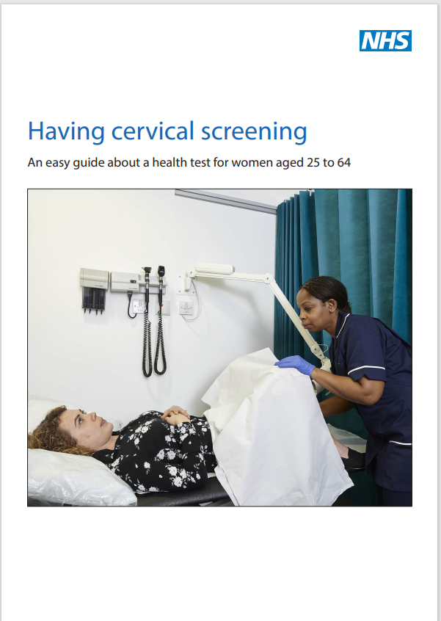
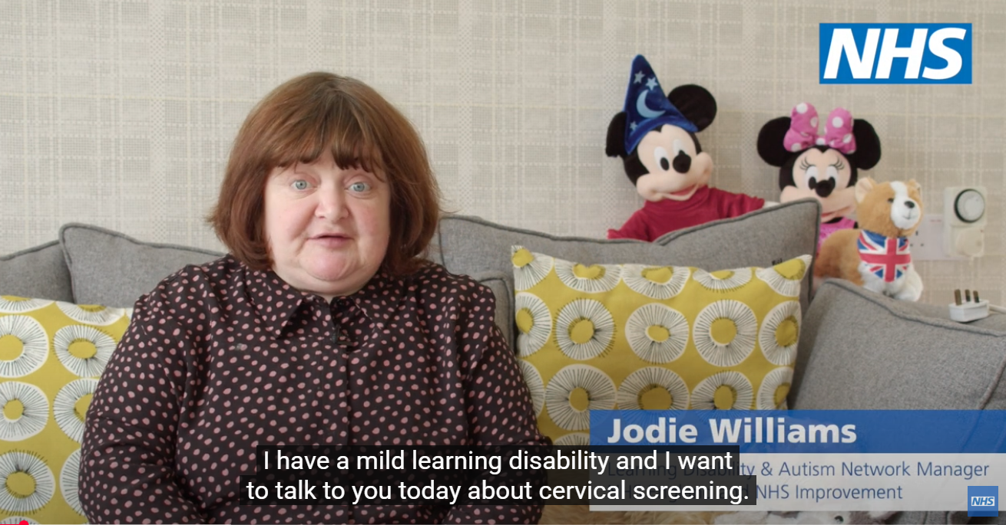
Supporting priority groups: learning disabilities
Evidence shows that eligible people with a learning disability are less likely to complete their cervical screening compared to those without, leaving them at risk of undetected cervical cancer.
NHS England have produced a short video on accessing cervical screening with the right support for people with a learning disability.
Greater Manchester Cancer Alliance has produced a series of videos for people with learning disabilities.
Both NHS England have produced an easy read leaflet, and Eve Appeal have produced an easy read leaflet to support people with learning disabilities to access cervical screening.
Surrey Heartlands ICB in collaboration with The Sunnybank Trust have developed an emotive animation highlighting the challenges people with learning disabilities face when accessing Primary Care.
The South East London Cancer Alliance, has collaborated with the Baked Bean Charity and the Guys Cancer Academy, Learning disabilities and cancer educational module. The training module is designed to help healthcare professionals better support people with learning disabilities in accessing cancer care and screening services
Click on the image to access resource

Slide 15


Supporting priority groups: LGBTQ+ and
non binary communities
There are a number of resources available for the trans community to help understand more about cancer screening and whether they should be screened:
NHS population screening: Information for trans and non-binary people
Cancer Research UK public information to include trans and non-binary
OUTpatients, the UKs leading LGBTQ+ charity Cancer risk and screening
You can also access training and resources:
Gateway C cancer keys - Barriers to cervical screening in the LGBTQIA+ community
Ardens have templates and resources to support at practice level Ardens LGBTQ, Non-Binary and Gender Dysphoria resources – screening

Slide 16
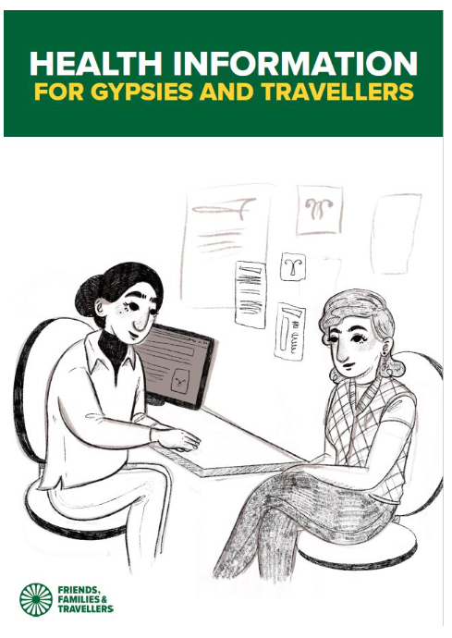

Supporting priority groups: language
and accessibility (1)
The NHS cervical screening information leaflet for women is available in a number of accessible formats. Click here to access the leaflet in Arabic, Bengali, simplified Chinese, traditional Chinese, French, Gujarati, Polish, Portuguese, Punjabi and Urdu. Alternative formats (such as braille) can be made available on request.
NHS audio recording about cervical cancer screening is available for people with low literacy or visual impairment
The South East region screening and immunisation team have developed a Nepalese Cervical Screening Leaflet.
Additionally, a simple animation showing the screening tests offered to women throughout their lives, including cervical screening, is available in English as well as 10 other most requested languages.
The Eve Appeal has developed an information resource on cervical screening after sexual violence.
Traveller community:
The Friends, Families and Travellers organisation have worked with the Gypsy and Traveller community to develop a cervical cancer screening resource as well as a guide to reducing the risk of cancer.
You can also view Cancer Awareness videos by visiting the Friends, Families and Travellers YouTube Channel, including a video about cervical cancer screening
Click on the image to access resource

Slide 17
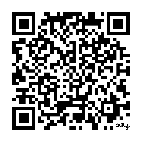
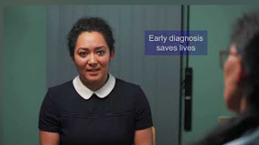

Supporting priority groups: language
and accessibility (2)
A new set of educational videos has been created to support Primary Care and help patients understand the importance of cancer screening.
The videos explain:
How to use the symptomatic faecal immunochemical test (FIT)
Cervical screening
Breast screening
Bowel screening
To make this information accessible to more people across the Thames Valley, the videos are available in:
British Sign Language (BSL)
Hindi
Polish
Gujarati
Nepali
Punjabi
Link and QR code to full length videos: https://bit.ly/screeningvideos
YouTube link to reels for social or your waiting room display board https://www.youtube.com/playlist?list=PLEm1CvSoQcDLK9EiVyfCa1dXWwLs9-Dbj)

Slide 18




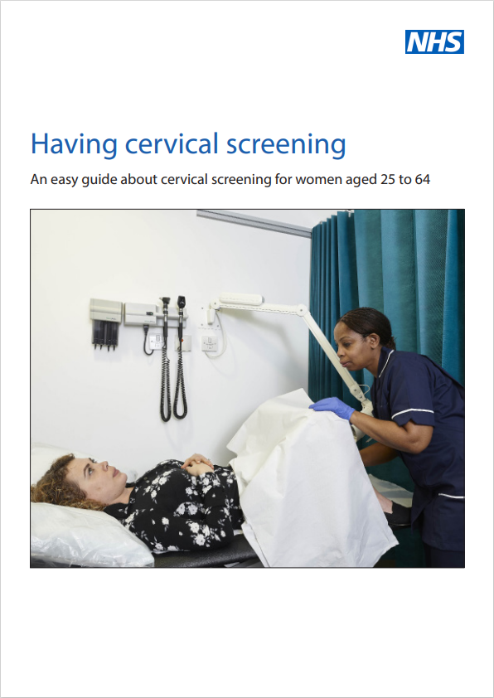


Resources for your waiting room
Click on the image to access resource
YouTube link to reels for social media or your waiting room display board

Slide 19
The role of the Cancer Care Coordinator
The Care Co-ordinators role requirements stated in the Network DES Contract can help to deliver many of the objectives expected of Primary Care for Cancer patients
A cancer care co-ordinators can:
Support the delivery of cancer priorities within the Network Contract DES
Support achievement of Quality Outcome Framework (QoF) Indicator
Provide opportunities to support personalised care planning throughout the cancer pathway
They can do this by:
Providing extra time and capacity, with a personalised patient centred approach;
Providing expertise to support patients when preparing for clinical conversations;
Following up discussions with primary care professionals;
Working closely with the GPs and other primary care colleagues within the primary care network (PCN) to identify and manage a caseload of identified patients; and by
Ensuring that a patient's changing needs are addressed.
For more information about Cancer Care Co-ordinators please click here to watch a webinar from Wessex Cancer Alliance

Slide 20
How can a cancer care co-ordinators support your patients?
Prevention:
Identify at risk populations through QoF Register: including obesity and smoking
Lead on advertising preventative advice within surgeries, social media and websites
Signposting to services (lifestyle/support)
Coding
Screening:
Identify low screening rates, non-responders, low participation groups
Run searches through GP systems
Make contact with patients to provide information and support/encourage uptake
Early diagnosis and safety netting:
Arranging follow-up GP appointments, providing information and leaflets to patients
Promote use of digital tools to aid decision making and safety netting
Follow up patient groups that may not attend appointments
Monitor completion of FIT
Monitor suspected cancer referral and escalate breaches
Audit PCN Safety Netting process
Care navigation
Personalised Care:
Coordinate care for anyone diagnosed with cancer in the practice (signposting)
Prepare the patient for cancer care reviews
Help maintain the palliative care register
For more information about the ARR roles please click on the links below:
Network Contract Directed Enhanced Service - Contract specification 2023/24 – PCN Requirements and Entitlements (england.nhs.uk)
Care Co-coordinator recruitment pack This contains a sample JD, person specification, sample advert and example interview questions
Workforce development framework
Competency framework

