Slide 1

Lung Cancer Screening
Communications toolkit 1.0
October 2025

Slide 2
LUNG CANCER SCREENING ASSETS
Assets showcase
  Pull ups
  Banners
  Posters
  Flyers/ leaflets
  Digi screens
  Social media
  In their words
  Press release
  National materials
1.

Slide 3
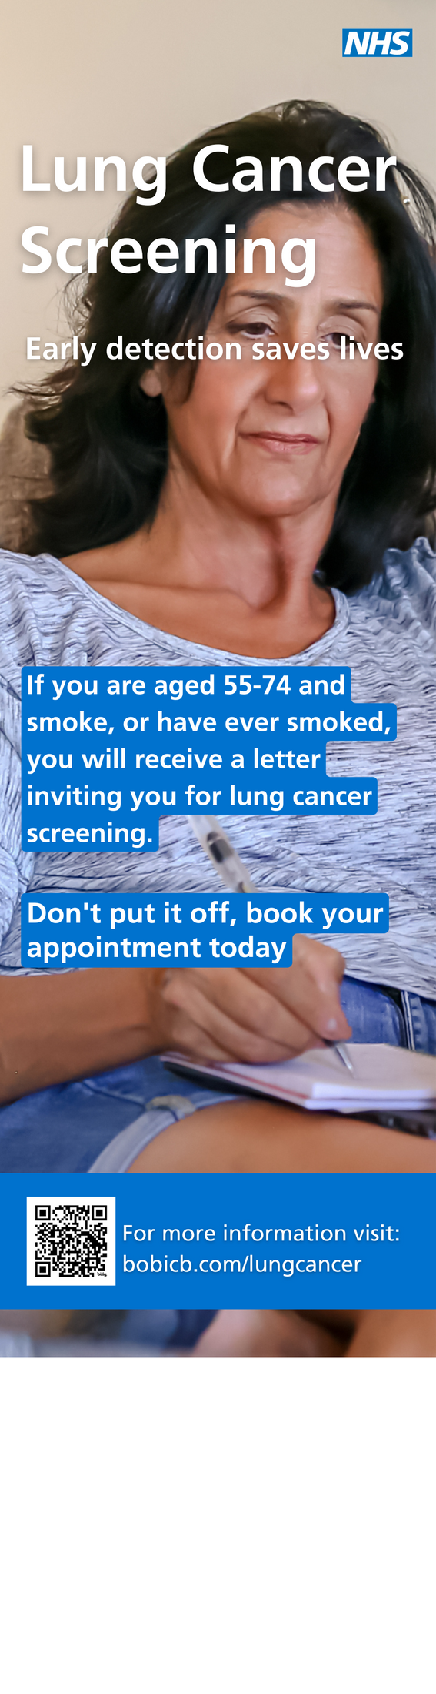
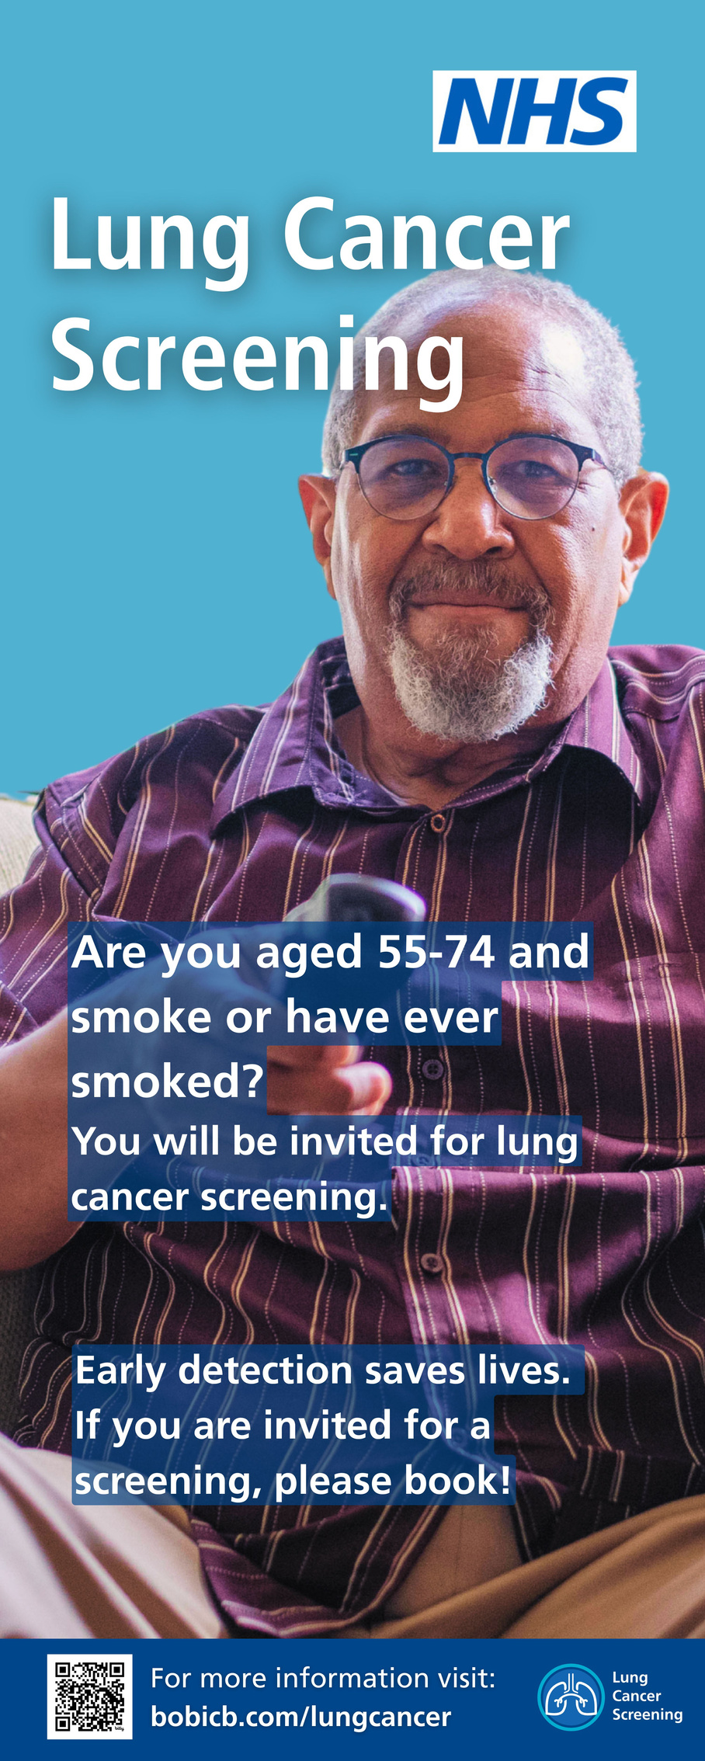
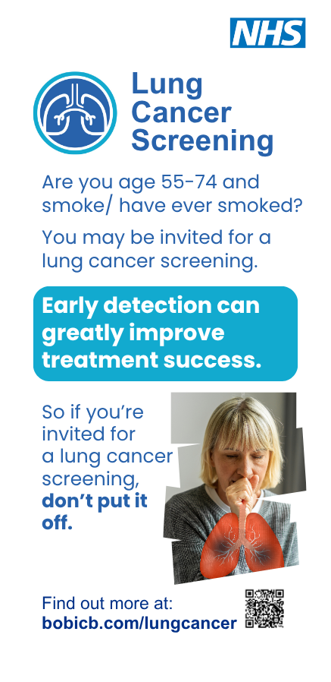
LUNG CANCER SCREENING ASSETS
Pull ups
2.
V1
V2
V3

Slide 4
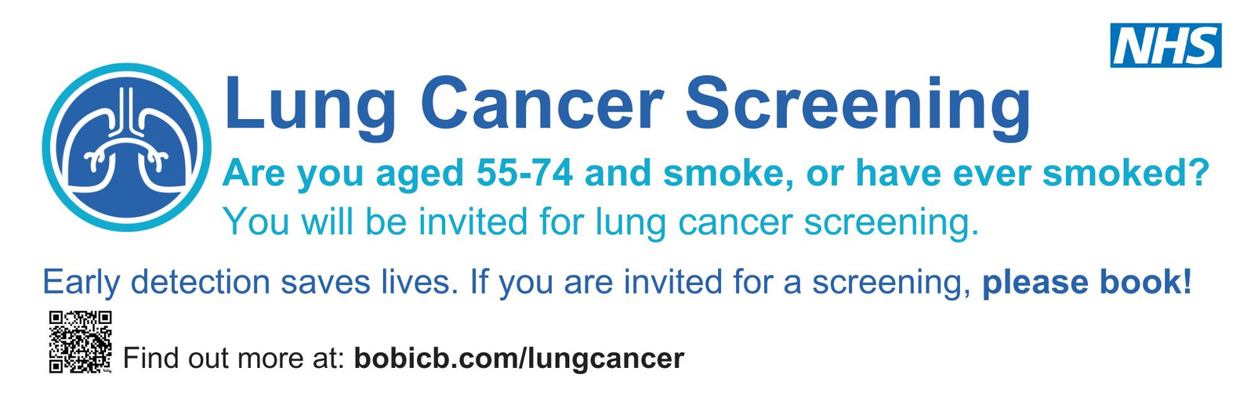
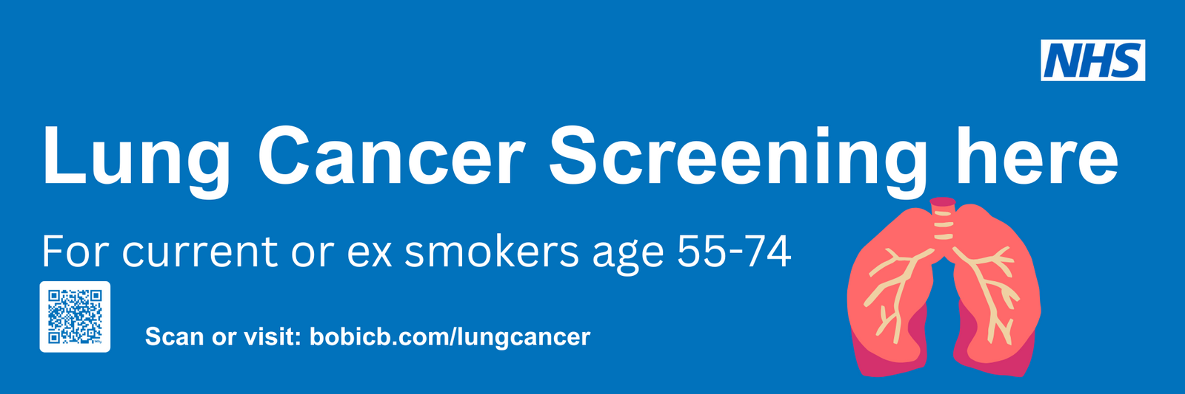
LUNG CANCER SCREENING ASSETS
Banners
V1
2.
V2

Slide 5
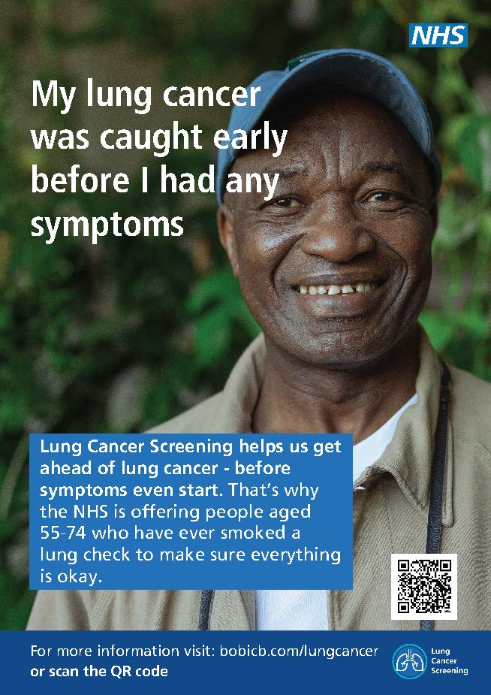
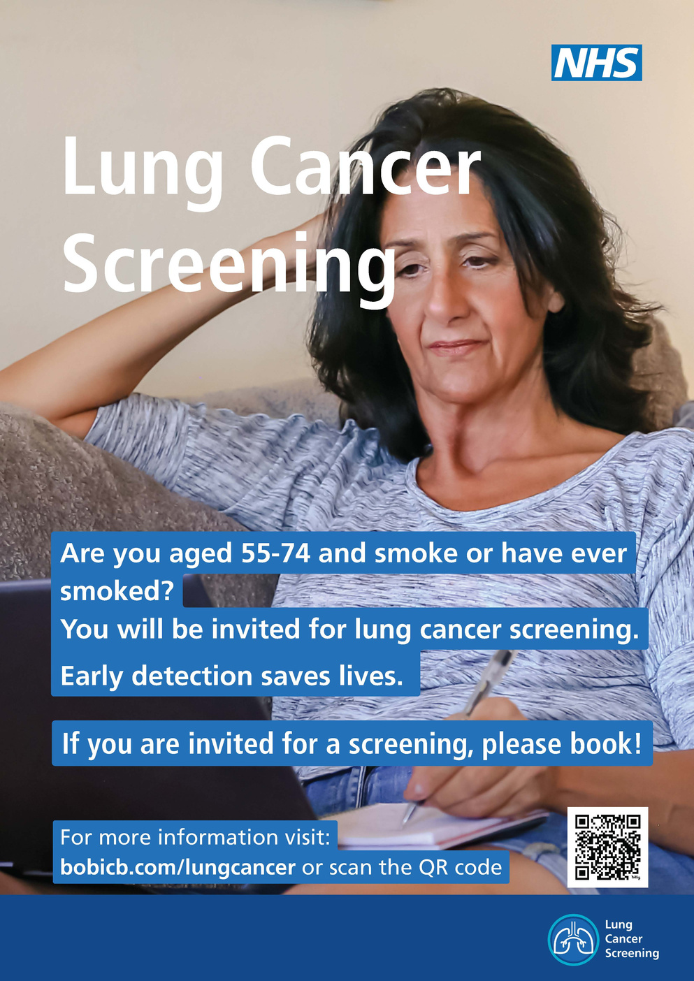
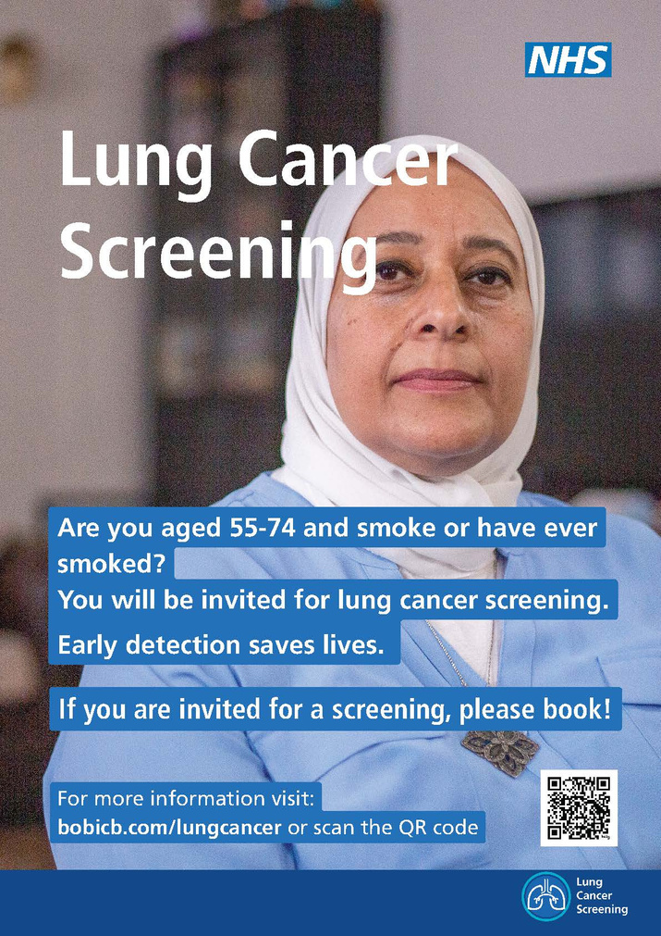
LUNG CANCER SCREENING ASSETS
Posters
V1
V2 a
V2 b
3.

Slide 6
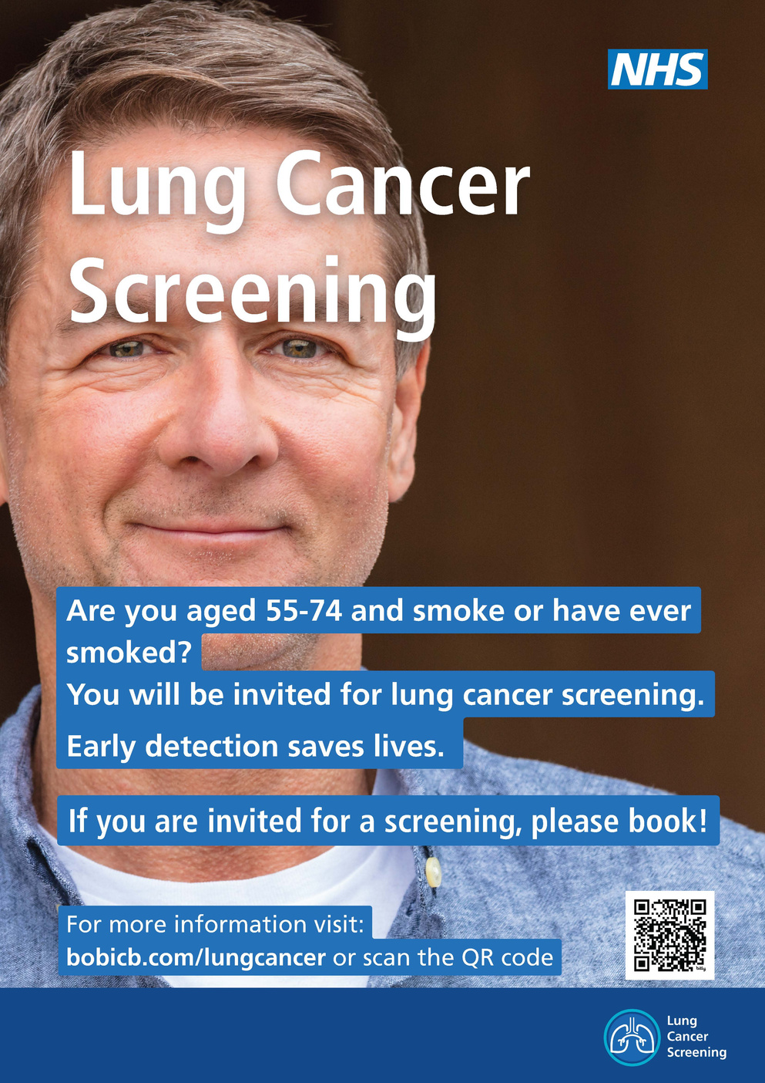
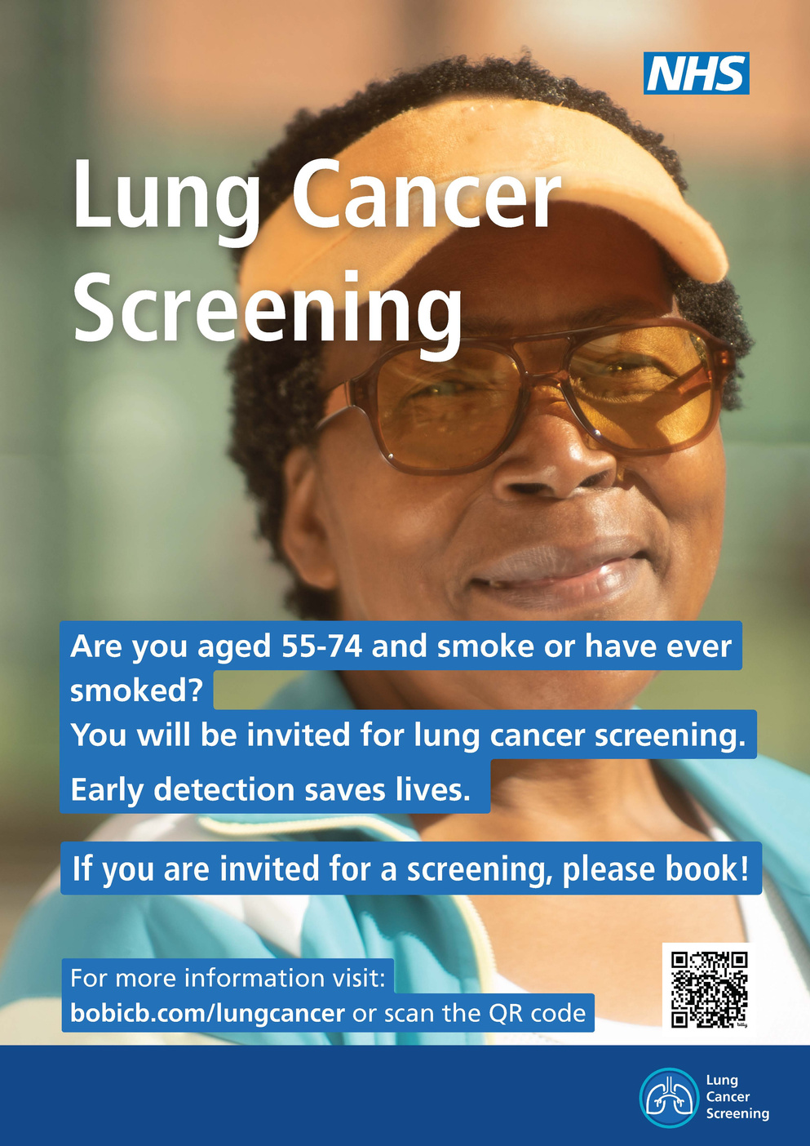
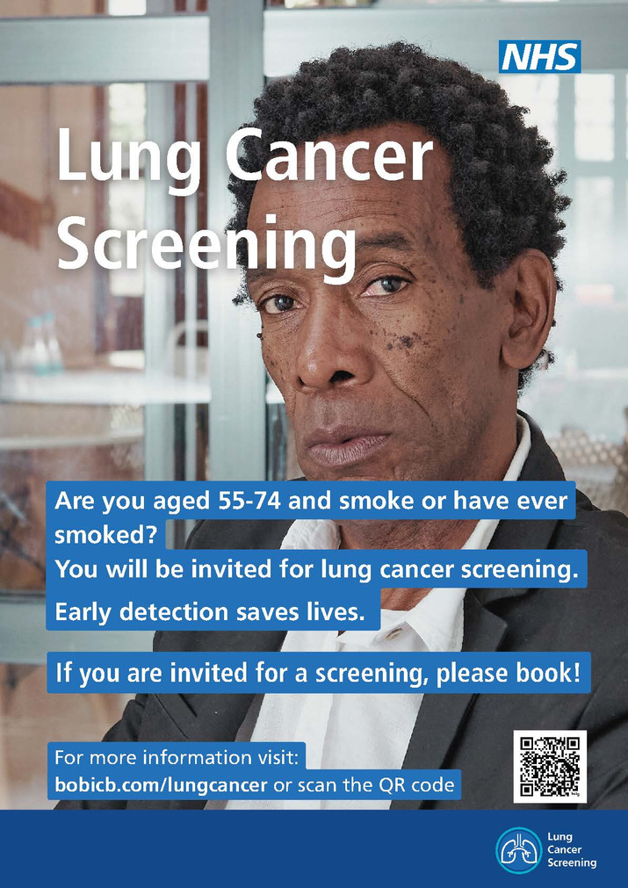
LUNG CANCER SCREENING ASSETS
Posters cont.
V2 c
V2 d
V2 e
4.

Slide 7
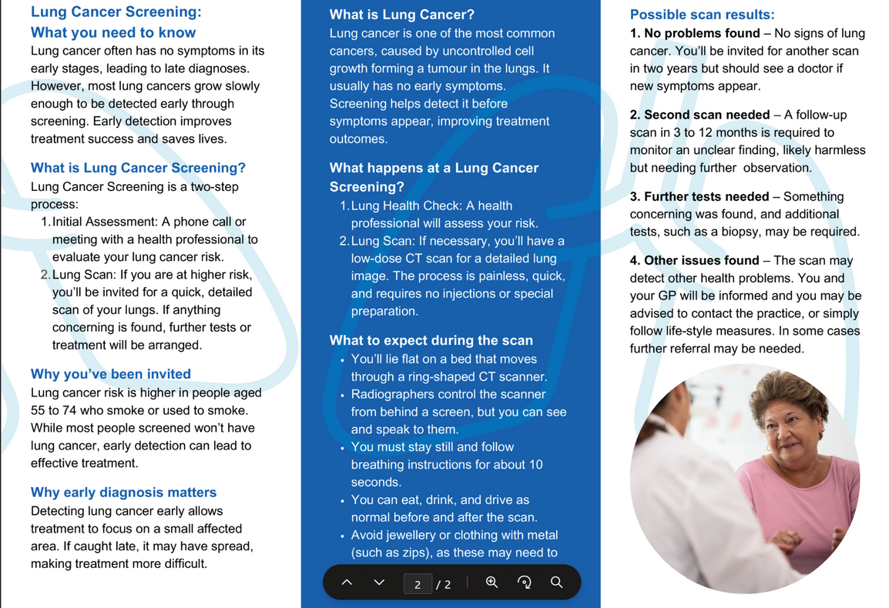
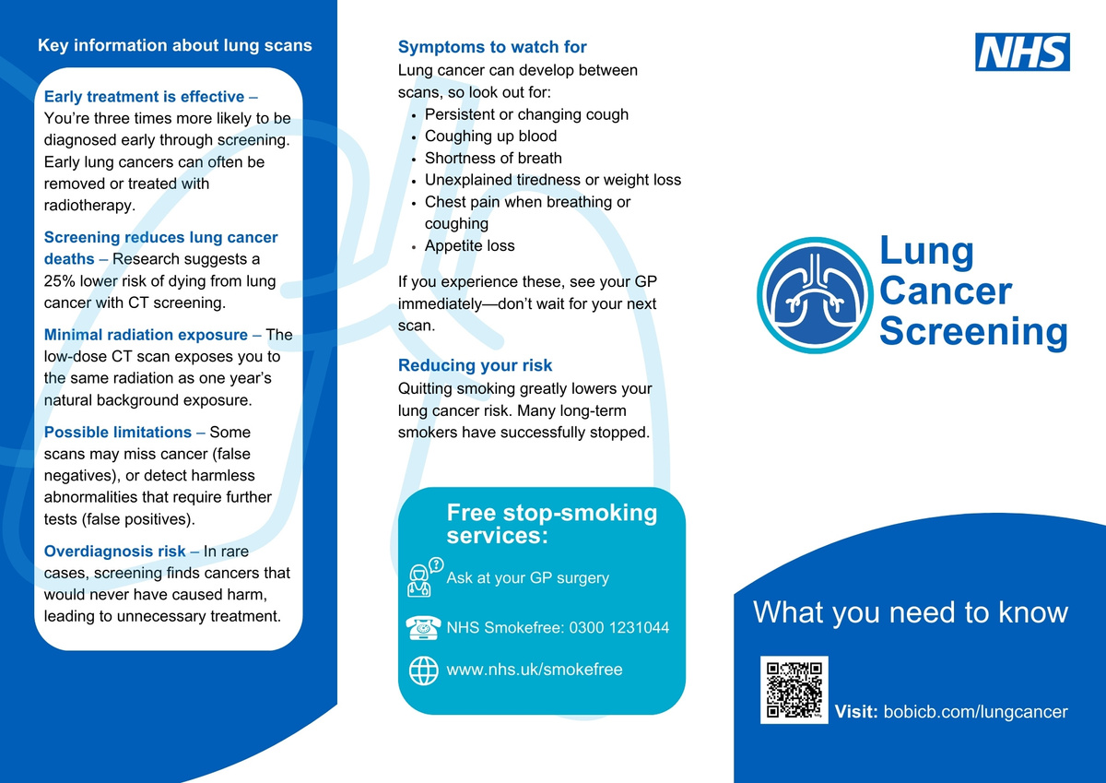
LUNG CANCER SCREENING ASSETS
Flyers/ leaflets
V1
5.

Slide 8
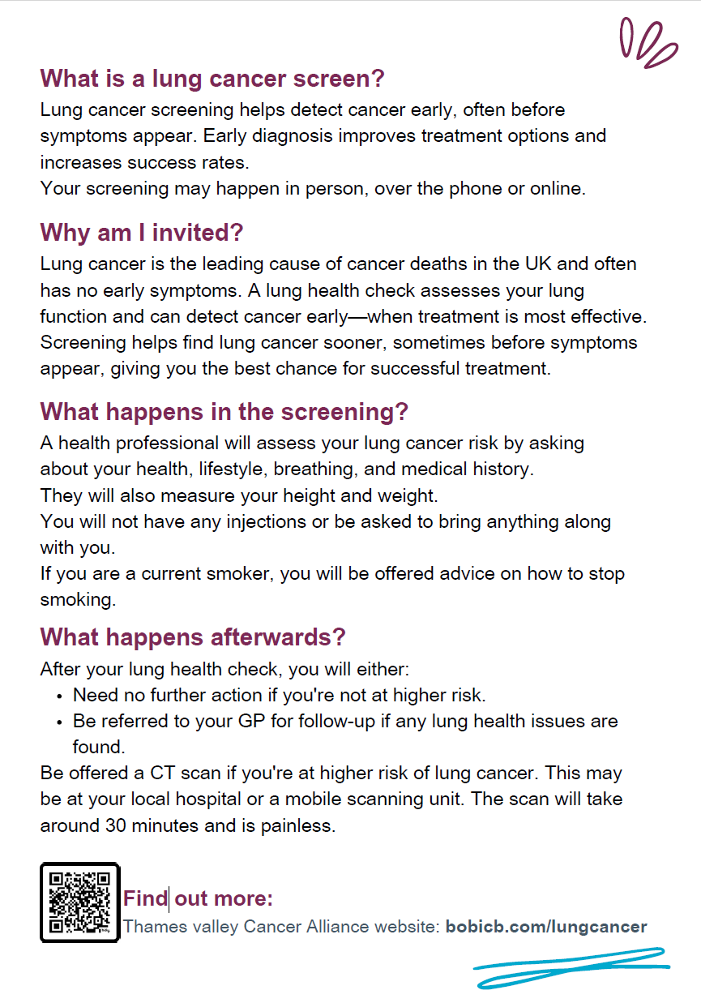
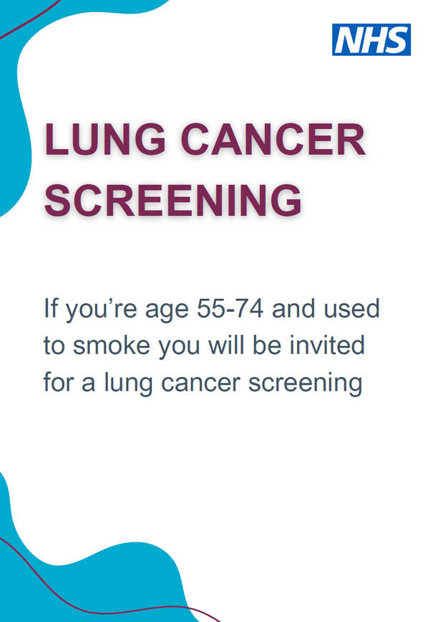
LUNG CANCER SCREENING ASSETS
Flyers/ leaflets cont.
V2
5.

Slide 9
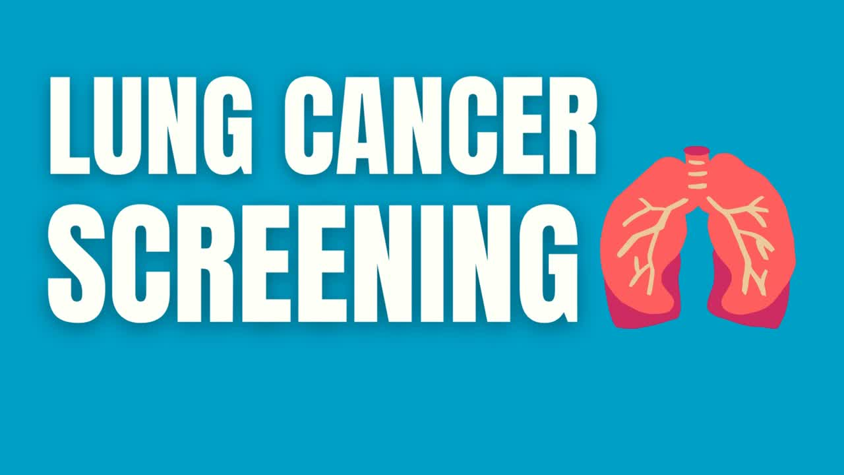
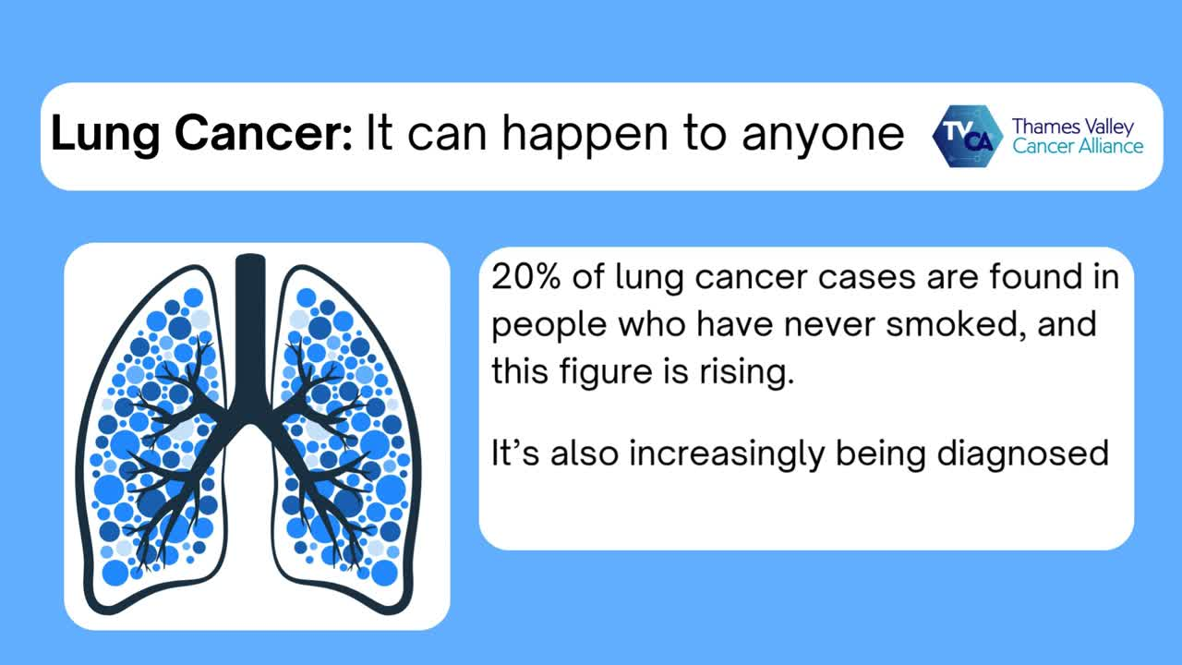
LUNG CANCER SCREENING ASSETS
Digital screens
V1
V2
6.

Slide 10
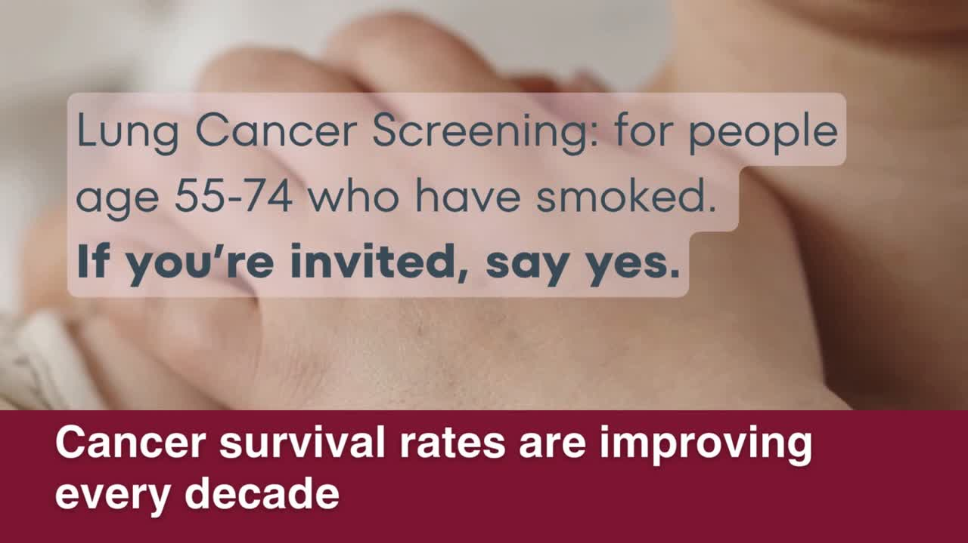
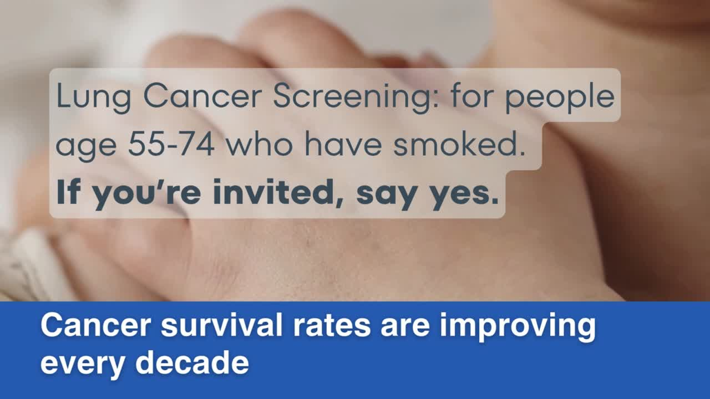
LUNG CANCER SCREENING ASSETS
Social media
6.

Slide 11

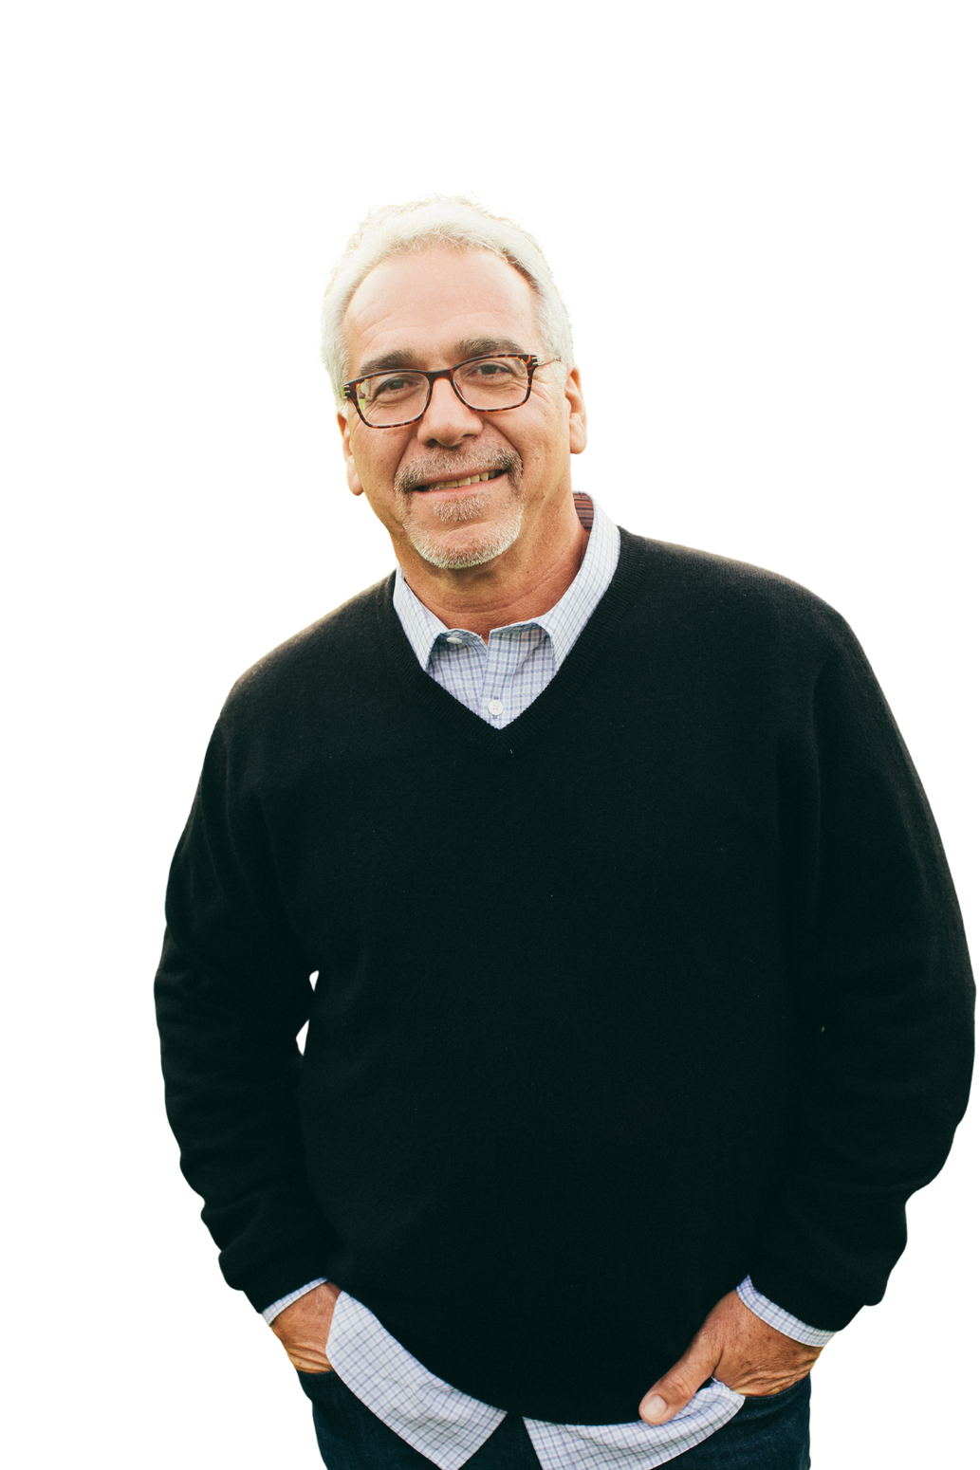
LUNG CANCER SCREENING ASSETS
In their words
“I know from experience that screening changes outcomes.
Finding cancer early means treatment is more effective and could save your life”
“"Getting diagnosed early made such a difference for me.
If you’re invited for a lung screening, please go — getting checked could save your life”
Name tbc
Name tbc
7.
Responsible Lung Cancer Screening Assessor at Great Western Hospital
Recently had a lung cancer screening

Slide 12
LUNG CANCER SCREENING ASSETS
Most people who attend will not have lung cancer, but for those who do, finding it early gives the best chance of successful treatment. Lung health checks provide reassurance and, in some cases, life-saving early diagnosis.
This October, NHS lung health checks align with Stoptober, the national stop smoking campaign. Together, they offer two powerful ways to protect your health:
  Say yes to your lung check. If you get an NHS invitation, respond promptly – it could make all the difference.
  Say no to smoking. Stopping smoking is the best thing you can do for your health. The benefits start almost immediately, and if you quit for 28 days you’re five times more likely to stop for good.
Local GP/ Cancer Screening Assessor said:
"We know that finding lung cancer early can save lives. The NHS lung health check is a simple step that could lead to early diagnosis and more successful treatment. If you’re invited, please attend – it could make all the difference."
Eligible people will receive an invitation via letter or phone call from their GP or local NHS service.
To find out more about local Lung Cancer Screenings, visit: Lung cancer screening - thamesvalleycanceralliance.nhs.uk
Press release
Say Yes to Your NHS Lung Health Check This Stoptober
Residents in Swindon, Oxford and Buckingham are being invited to take part in free NHS lung health checks.
The programme is aimed at those aged 55–74 who smoke or used to smoke, helping to spot lung cancer at an early stage when treatment works best.
Local NHS teams are encouraging everyone who receives an invitation to say YES to their lung health check as it could save their life.
Lung cancer is the leading cause of cancer deaths in the UK and often develops without symptoms in the early stages. Early detection makes treatment more effective, which is why the NHS is urging eligible residents to take up the offer of a lung health check.
The check begins with a conversation with a GP or NHS health professional and may lead to a CT scan. This quick and straightforward scan can detect lung cancer early, when treatment is most likely to be successful.
8.

Slide 13
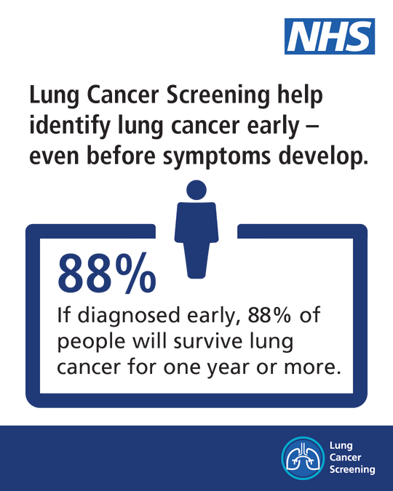
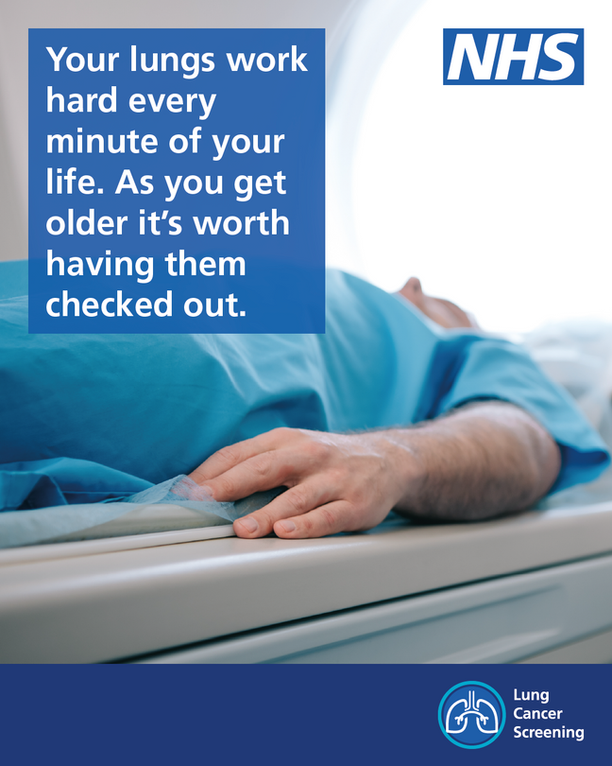
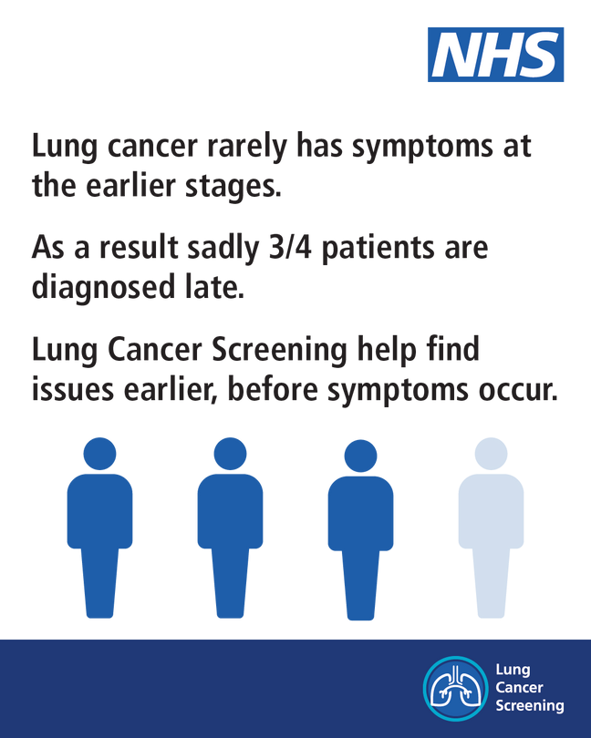
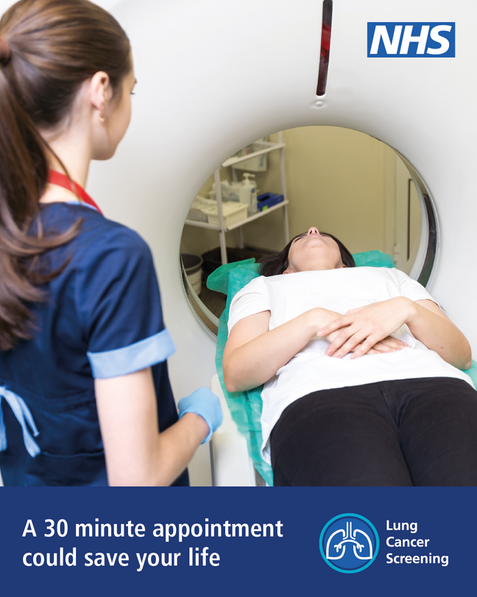
LUNG CANCER SCREENING ASSETS
National materials
Social media
9.

Slide 14
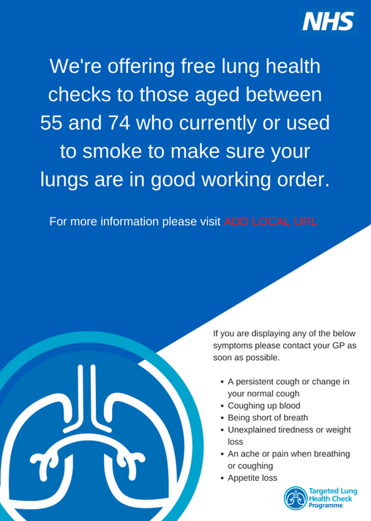
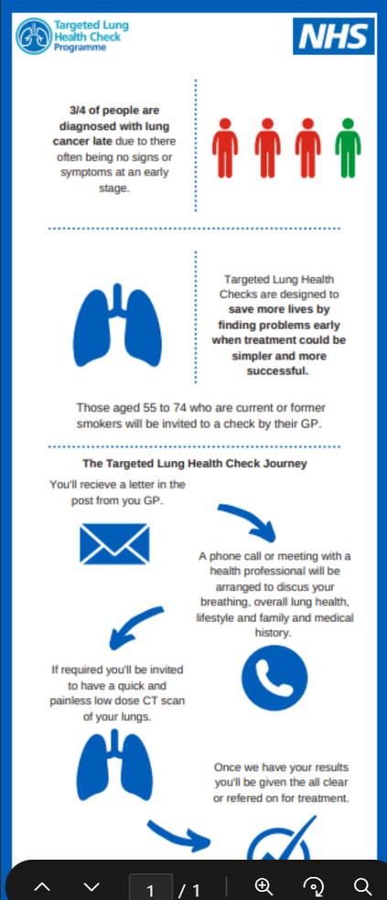
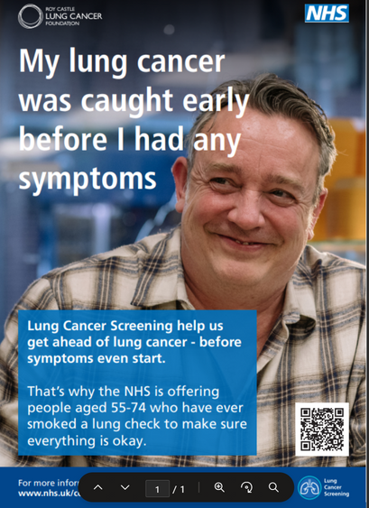
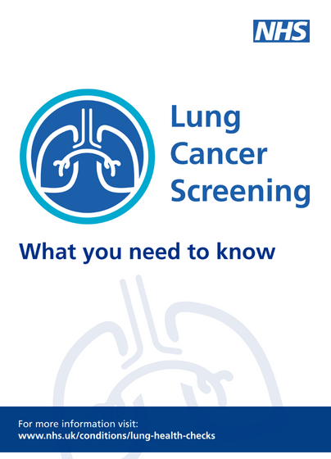
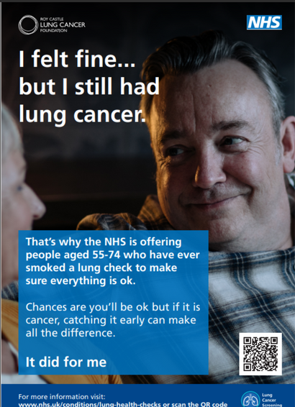
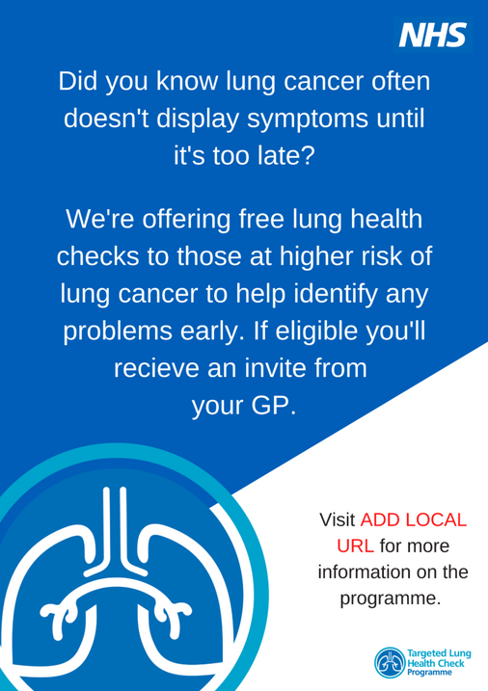
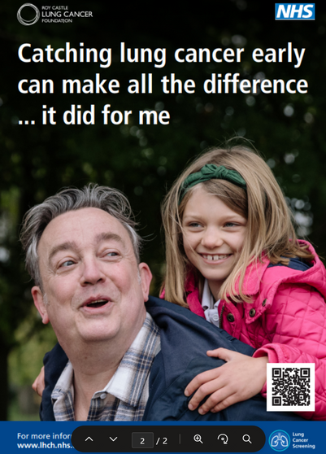
LUNG CANCER SCREENING ASSETS
National materials
Leaflet and posters
Download leaflet here:
9.

Slide 15
LUNG CANCER SCREENING ASSETS
Get in touch
email: becks.smith@nhs.net
11.

