Slide 1

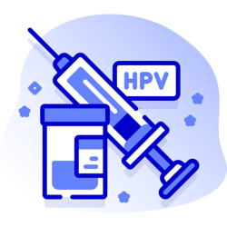
Improving Human Papillomavirus (HPV) Vaccine Uptake
A Toolkit of information and resources to support General Practice
Version: 1.0
Date of publication: November 2025
Date of review: November 2026

Slide 2



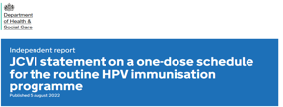
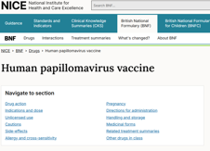
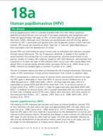
Contents and guidelines
This toolkit is designed to support health professionals in general practice to promote HPV vaccination, increase uptake, and ultimately reduce HPV-related cancers. It provides a comprehensive suite of resources and guidance for both health care professional and patients.
Introduction to the HPV vaccine
Eligible cohorts
Practical tools for opportunistic vaccination
Resources for healthcare professionals
Patient facing resources
Clinical guidelines (click on image to access)
UKHSA Guidance
JVCI statement
NICE BNF treatment summary
Green book

Slide 3


About HPV and the HPV vaccine
HPV is the name of a common group of viruses, with over 100 different types. Many types affect the mouth, throat or genital area. Some can cause warts and verrucae but “high-risk” types of HPV can cause changes to DNA, increasing the risk of certain cancers including cervical,
anal, vulval, vaginal, penile cancers and some types of head and neck cancer.
HPV is transmitted from skin-to-skin contact of the genital area, usually during vaginal, anal or oral sex.
The human papillomavirus (HPV) is a common and usually symptom-free virus
Most people will be infected by HPV during their lifetime
HPV vaccines became part of the routine vaccination schedule in 2008 for school-age girls aged 12-13, and the programme was extended to include boys in 2019. In 2018, a programme for gay, bisexual and other men who have sex with men (GBMSM) up to and including 45 years
of age who attend sexual health and/or HIV clinics.
The HPV vaccine used in the NHS vaccination programme is called Gardasil 9 and targets nine types of HPV, which protect against oral,
throat, cervical, vulval, vaginal, penile and anal cancers and genital warts.
In September 2023, the vaccination schedule changed to a 1 dose schedule for most people. The exceptions to this are:
  2 dose schedule from the age of 25 years for the GBMSM programme
  3 dose schedule for eligible individuals who are immunosuppressed and those known to be living with HIV.

Slide 4

Benefits of HPV Vaccination
Vaccination against HPV has proven effective in reducing the rates of cervical cancer (UK Health Security Agency). A 2021 study found that cervical cancer rates were reduced by almost 90% in women in their 20s in England, who were offered the vaccine aged 12-13 (Falcaro et al. 2021).
Additionally, it is one of the key pillars alongside cervical screening and pre-cancer treatment to help achieve the NHS ambition to eliminate cervical cancer by 2040.
Other benefits include
Prevention of HPV-related cancers (anal, penile, oropharyngeal, vulval, and vaginal)
Reduction in genital warts
Herd immunity (reducing overall circulation rates of HPV in the community)
Prevention of transmission
Protection against recurrent respiratory papillomatosis
Cost-effectiveness (reducing the burden of HPV-related diseases)

Slide 5

National HPV vaccination strategic
priorities
NHS England’s cancer elimination by 2040 plan sets out the ambition that by 2030 90% of girls are fully vaccinated with the HPV vaccine by the age of 15. This will be achieved by:
Increasing access to HPV vaccination.
Raising awareness of and understanding the benefits of HPV vaccination.
Reducing inequalities by understanding the barriers to vaccination, developing inclusive materials and identifying groups who may be at a higher risk of developing cervical cancer.
Improving digital capabilities by streamlining parental consent for vaccination and maximising the best use of available data on vaccination.
Strengthening workforce capacity to enhance HPV vaccination efforts.

Slide 6

Who is eligible for HPV vaccination?
Cohort One: Adolescents
Boys and girls in school year 8 (usually aged 12 to 13)
What team delivers this? Invited by School-aged Immunisation Service (SAIS) and delivered in school setting (or community clinics)
2. Cohort Two: Catch-up cohort
Girls aged 14 up to their 25th birthday and boys born after 1 September 2006 up to their 25th birthday who missed having the vaccine at school.
What team delivers this? Invited by School-aged Immunisation Service (SAIS) and delivered in school setting (or community clinics) while young person is school-aged. General practice for those older than school-age – click here for GP toolkit. Opportunistic vaccinations (patient request, if eligible, or identification of a vaccination gap when presenting for another issue)
3. Cohort Three: Gay, bisexual and other men who have sex with men (GBMSM)
GBMSM and other at-risk individuals (up to an including 45 years of age) not previously vaccinated
Where to get the Vaccine: Sexual health clinic or HIV clinic regardless of risk, sexual behaviour or disease status

Slide 7


Cohort one: Adolescents
The HPV vaccine is routinely recommended for children in school year 8, for children aged 12 to 13 years old, see Immunisation schedule for further guidance).
This cohort normally receive their vaccination as part of the school-age immunisations programme delivered by school-aged immunisation services (SAIS) in the local area and via catch-up opportunities in school and community clinics.
Provided by: School-aged immunisation service (SAIS). For contact details and community clinic information for the school-aged immunisation services, click below:
Buckingham School Aged
Immunisation Service
Buc-tr.BucksChildImms@nhs.net
Berkshire School Aged
Immunisation Service
Berkshire East (Bracknell, Slough, Windsor &
Maidenhead)
eastschoolimms@Berkshire.nhs.uk
Berkshire West
(Reading, West Berkshire, Wokingham)
westschoolimms@Berkshire.nhs.uk
Oxfordshire School Aged
Immunisation Service
immunisationteam@oxfordhealth.nhs.uk

Slide 8

Cohort two: Catch-up cohort
Girls aged 14 up to their 25th birthday and boys born after 1 September 2006 up to their 25th birthday who missed having the vaccine at school
If the routine HPV vaccine delivered through the school's programme is missed:
Girls remain eligible to receive the HPV vaccine up to their 25th birthday
Boys who were born on/after 1 September 2006 are eligible up until their 25th birthday
For individuals who started but did not complete their vaccination before reaching the age of 25 years, the vaccination course should be completed where possible as per the vaccination schedule
Females and males in eligible cohorts coming to the UK from overseas and registered with a GP should be offered vaccination if they are aged under 25 years.
For individuals who are immunosuppressed see Green Book chapter 18a
Provided by:
School-aged immunisation service if still of school age: see previous slide for contact details
General practice: Opportunistic vaccinations (patient request, if eligible, or identification of a vaccination gap when presenting for another
issue
Sexual Health Services: Opportunistic vaccinations to those eligible for the routine programme who have not been offered the vaccine
and are under 25 years. Those eligible, should check with their local Sexual Health clinic to confirm service available.

Slide 9

Cohort three: GBMSM
GBMSM (up to and including 45 years of age)
Gay, bisexual and other men who have sex with men (GBMSM), up to and including 45 years old, who attend specialist sexual health services and or HIV clinics regardless of risk, sexual behaviour or disease status, are eligible for HPV vaccination if they have not previously been vaccinated.
Other eligible at-risk individuals include some transgender individuals, sex workers, and men and women living with HIV infection (See Green Book chapter 18a).
Under 25s in this cohort should be offered a single dose of HPV vaccine*
GBMSM who have already received at least one dose before their 25th birthday are considered to have completed their vaccination course and do not require further doses
GBMSM aged 25 years and older (up to and including 45 years) should continue on the 2 dose HPV vaccination schedule*
* unless immunosuppressed or known to be living with HIV –3 doses are required
This cohort can receive their HPV vaccination at a Sexual health clinic HIV clinic.

Slide 10

Thames Valley HPV uptake data
The national uptake ambition for the school-age HPV vaccination programme is 90%. See figures below for your local area.

Slide 11

The role of General Practice
HPV Catch-up Campaign 2025/26
Each year, GP practices are required to participate in a national vaccination and immunisation campaign, as a requirement of the GP contracts. This year, the agreed campaign is a catch-up campaign for HPV vaccination.
For the 2025/26 GP campaign, practices are asked to invite unvaccinated individuals aged 16-24 for their HPV vaccine. This includes:
all females born on or before 1 September 2009 –up to their 25th birthday
males born from 1 September 2006 to 31 August 2009 (inclusive).
Practices are asked to take a ‘make every contact count’ (MECC) approach to ensure that vaccination is offered at every opportunity
The GP HPV campaign will run from Monday 21 July 2025 to Tuesday 31 March 2026.
For each eligible HPV vaccination dose delivered, a £10.06 item of service (IoS) fee is payable under the General Medical Service Contract. Please refer to the 2025 26 Immunisation Catch-up Campaign for further details.

Slide 12

The role of General Practice
Practice Requirements for 2025/26
Ensure the named practice immunisation lead is engaged, plans and oversees the practice’s participation in the catch-up campaign, including informing the local commissioner of the outcome of the campaign;
Ensure the named practice immunisation lead takes responsibility for improving practice staff awareness and communication to eligible patients on the importance of the HPV vaccination for adolescents and young people in the agreed age group; and
Undertake proactive systematic checks and actions
How to carry out a proactive systematic checks at the Practices
Check that all patient immunisation records have been updated following notifications received from either School Aged Immunisation Service (SAIS) or local Child Health Information Services (CHIS) teams, once an HPV vaccination has been given
Invite the eligible unvaccinated cohort (ages 16 to 24). All females up to their 25th birthday will be eligible, as will males born on or after 1 September 2006
Continue to update digital records for patients who do not respond or who fail to attend scheduled clinics or appointments and continue to offer HPV vaccination opportunistically

Slide 13
The role of General Practice
GP practices could consider the following:
Practice Champion role: Appoint a designated HPV lead to coordinate efforts, champion best practices, and support staff
Training and communication with eligible patients about the importance of HPV vaccinations. This could be a GP trainee or PH registrar
Opportunistic vaccination: Review vaccination records during unrelated consultations and offer HPV vaccination when appropriate. Consider offering flexible vaccination appointments which include evening and weekend appointments
Implement a 'make every contact count' (MECC) approach and consider other adolescent vaccination checks
Community collaboration: Use the resources in this pack to promote HPV awareness in partnership with local schools, youth services, and community organisations to promote awareness and access. Example – university GP practices could work with student unions to promote and improve uptake
Patient engagement tools: Use recall systems such as letters, SMS reminders, and EMIS/Ardens searches to identify and prompt eligible patients.
Education and reassurance: Address common concerns, including vaccine safety and fertility myths. Emphasise the importance of vaccination for both boys and girls.
Visual promotion in practice: Display UKHSA-approved posters in waiting areas to raise awareness. Run short, silent video loops promoting HPV vaccination (available from NHS or relevant charities).

Slide 14
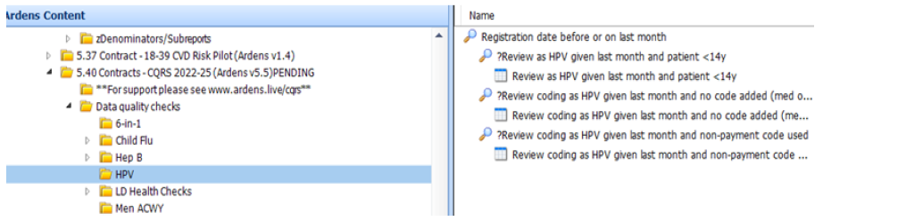
Ardens and HPV searches
Ardens Searches: EMIS
To support data quality of HPV, Ardens have included 5.40 CQRS Searches: Ardens EMIS Web as part of their CQRS search suite.
New “Smart” Childhood Immunisations Template: EMIS
Ardens have deployed a new version of the Childhood Immunisations Template (v18.45 or above), which includes the following:
a new “smart” front page advising clinicians of which vaccines a child has had based on their age and vaccination history
any catch-up vaccines the child is eligible for if a vaccine is contraindicated or has previously been declined.
To find out more, please read the Smart Childhood Immunisations Template support article.

Slide 15
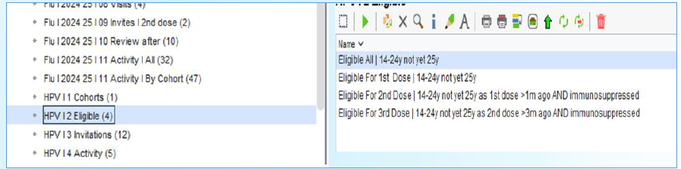
Ardens and HPV searches
System Wide TPP searches: SystmOne
To support data quality of HPV, TPP have system wide searches available: V&I Enhanced Services Activity Reports: Ardens
Ardens Childhood Immunisations Template: SystmOne
Ardens have deployed a Childhood Immunisations Template which includes the following:
a home page advising clinicians of which vaccines a child has had based on their age and vaccination history
any catch-up vaccines the child is eligible for if a vaccine is contraindicated or has previously been declined.
To find out more, please read Childhood Immunisations: Ardens

Slide 16


SMS reminders
These can be sent by the practice in March, April or May to encourage parents to return their e-consent forms to the school immunisation teams.
Example:
“As your child is in school year 8 you will be receiving an invitation from the School Aged Immunisation team for your child to have their HPV vaccination. This vaccination helps to reduce your child’s risk of getting HPV related cancer in later life. As your GP practice we would encourage you to respond to the invitation by completing the electronic consent form.
If you have any queries, please contact the school age immunisation service on [Insert appropriate area number].”
Text reminders to parents of all children in school year 8 (Cohort 1)

Slide 17


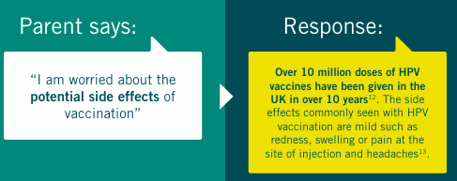

Practice level actions
Opportunistic Conversations
Making Every Contact Count (MECC) encourages health professionals to use everyday interactions to promote positive health behaviours. Coding these conversations can support local audits and quality improvement initiatives. Practices are encouraged to implement a MECC approach to maximise the catch-up opportunity.
Conversation scripts: To support conversations around HPV vaccination with hesitant parents.
Click on the image to access e-learning for health training resources and MECC toolkit
Click on the image to access discussion points to guide conversations

Slide 18
Practice level actions
Update your practice website using the below information:
The human papillomavirus (HPV) vaccine helps protect against the human papillomavirus virus (HPV); a common virus that often causes no symptoms but can lead to serious health problems, including some cancers and genital warts. The vaccine is routinely offered to boys and girls in year 8 (age 12-13) at school as part of the national immunisation program.
What is HPV?
HPV (Human Papillomavirus) is a very common group of viruses — there are over 100 different types, around 40 of which can affect the genital area. Some types can also affect the anus, mouth, and throat. These viruses are generally grouped into high-risk and low-risk types.
HPV is very common and often causes no symptoms, meaning many people who have it may not realise they are infected.
What can an HPV infection do?
Some types of HPV can cause abnormal changes in cells, which may lead to certain cancers, including:
Cervical cancer
Anal cancer
Vulval and vaginal cancer
Penile cancer
Some head and neck cancers
Other, low-risk types of HPV can cause genital warts, while others may lead to minor skin conditions such as common warts and verrucas.
How does HPV spread?
HPV is spread through skin-to-skin contact in the genital area, most often during vaginal, anal, or oral sex.
The HPV vaccination
The HPV vaccine helps protect against the types of HPV that cause most cancers and genital warts.
The vaccine has been offered to girls aged 12–13 since 2008 as part of the routine NHS vaccination programme.
In 2019, the programme was extended to include boys of the same age group.
Since 2018, the vaccine has also been available to gay, bisexual, and other men who have sex with men (GBMSM), up to and including 45 years of age, who attend sexual health or HIV clinics.

Slide 19
Suggested text for General Practice websites
What is Human Papillomavirus) (HPV)?
HPV is a very common group of viruses. There are over 100 different types, around 40 of which can affect the genital area. Some types can also affect the anus, mouth, and throat. These viruses are generally grouped into high-risk and low-risk types.
HPV is very common and often causes no symptoms, meaning many people who have it may not realise they are infected.
What can an HPV infection do?
Some types of HPV can cause abnormal changes in cells, which may lead to certain cancers, including:
Cervical cancer
Anal cancer
Vulval and vaginal cancer
Penile cancer
Some head and neck cancers
Other, low-risk types of HPV can cause genital warts, while others may lead to minor skin conditions such as common warts and verrucas.

Slide 20
Suggested text for General Practice websites
How does HPV spread?
HPV is spread through skin-to-skin contact in the genital area, most often during vaginal, anal, or oral sex.
The HPV vaccination
The HPV vaccine helps protect against the types of HPV that cause most cancers and genital warts.
The vaccine has been offered to girls aged 12–13 since 2008 as part of the routine NHS vaccination programme.
In 2019, the programme was extended to include boys of the same age group.
Since 2018, the vaccine has also been available to gay, bisexual, and other men who have sex with men (GBMSM), up to and including 45 years of age, who attend sexual health or HIV clinics.

Slide 21


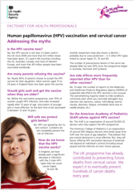
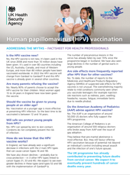

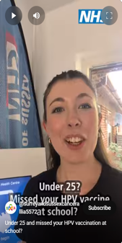

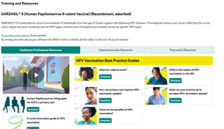
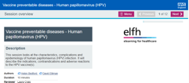
Resources for healthcare professionals
Factsheets and e-learning:
Social media and campaign resources:
UKHSA factsheets:
UKHSA / NHS Facebook banner:
SSCA TikTok video:
MSD training and resources for GARDASIL® 9:
NHSE e-learning for healthcare (elfh) programme:
NHS GP toolkit
Click on the image to access resource

Slide 22

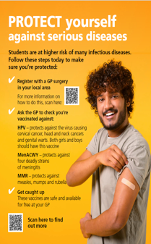
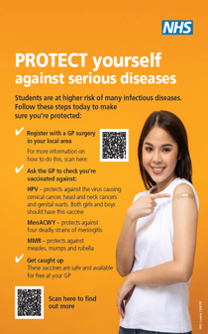

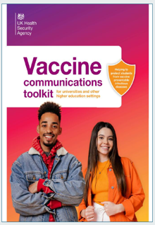
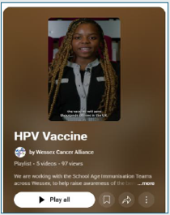
Resources for schools and higher
education
PSHE Association
Co-produced by young people and
researchers from the University of
Bristol, London School of Hygiene and
Tropical Medicine:
Provided by Wessex Cancer Alliance (can be used in other areas but provide local SAIS information). Several videos to raise awareness for both school aged students and young adults under 25
Click on the image to access resource

Slide 23
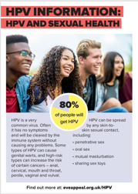

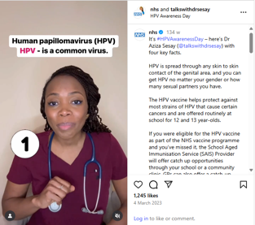
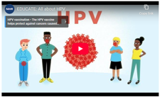

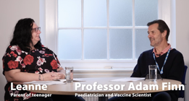
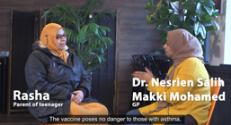
Resources aimed at adolescents and parents
NHS and talkswithdrsesay
Instagram video.
4 key facts about HPV
Defend your tomorrow campaign: HPV and cervical cancer
The Eve Appeal: Information and myth busting
Protecting my teen from HPV
The HPV vaccination and my teen
Safety and side effects
University of Oxford: information and animation
Click on the image to access resource

Slide 24


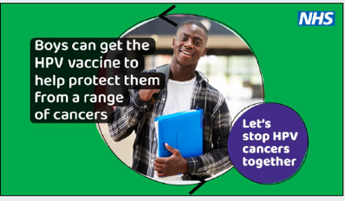
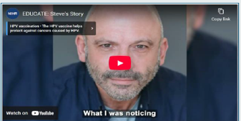
Resources aimed at boys
Cardiff City FC and Cardiff and Vale University Health Board Wales.
2025/26 GP campaign – HPV catch-up digital screens and social media assets.
NIHR Health Protection Research Unit in Behavioural Science and Evaluation at University of Bristol EDUCATE and COMMUNICATE projects
Click on the image to access resource

Slide 25

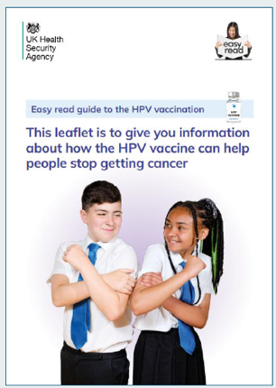
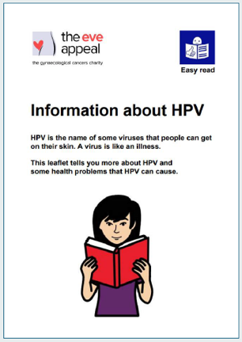
Resources for children with special
educational needs and disabilities (SEND)
UKHSA / NHS universal leaflet:
Easy read version.
The Eve Appeal: Easy read version
Click on the image to access resource

Slide 26


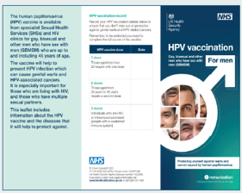
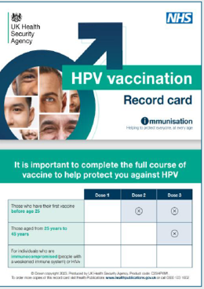
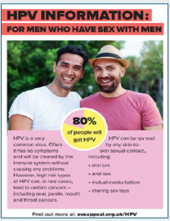

Resources for GBMSM
UKHSA / NHS leaflet
The Eve Appeal leaflet
UKHSA / NHS poster
UKHSA / NHS vaccination record card.
The Eve Appeal - What do you know about HPV video.
Not specific to the GBMSM cohort but includes relevant information
Click on the image to access resource

Slide 27

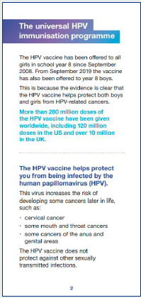
Accessible resources
Audio recording
British Sign Language video
Braille version
Easy read
Large print version
Click on the image to access resource

Slide 28
References
HPV vaccine – NHS
Green Book Chapter 18a Human papillomavirus (HPV)
Human papillomavirus (HPV) – NHS
HPV vaccination guidance for healthcare practitioners - GOV.UK
Human papillomavirus (HPV) vaccination coverage in adolescents in England: 2023 to 2024 - GOV.UK
NHS England » Cervical cancer elimination by 2040 – plan for England
NHS England Confirmation of national HPV vaccination and immunisation catch-up campaign for 2025/26

